Slide 1

The Bill of Rights
INSERT presenter’s name, title and organization (and perhaps date and location of presentation) here.
Used with permission of the New Jersey and Florida Law Related Education Associations, Inc.

Slide 2
How many amendments are in the Bill of Rights?

Slide 3
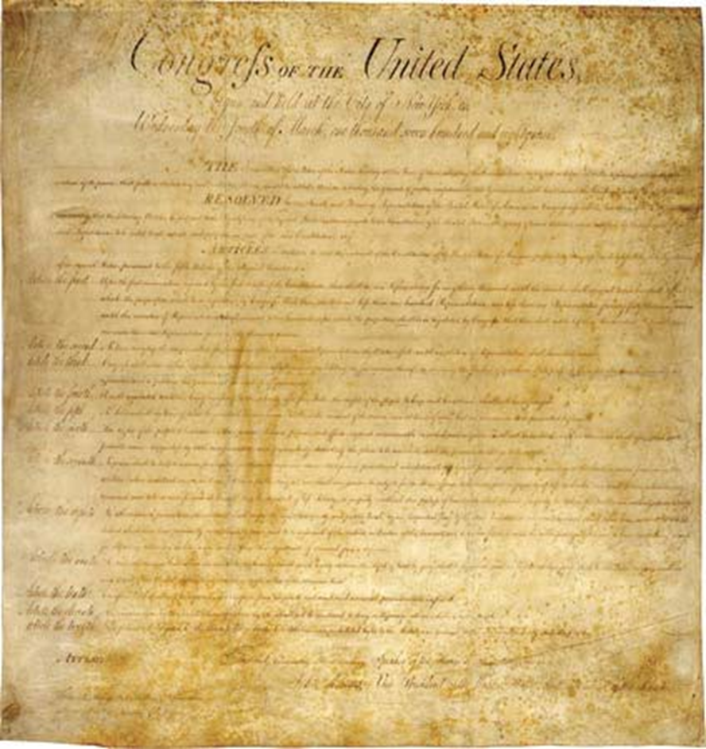
10

Slide 4
What are the five rights listed in the First Amendment?

Slide 5

The First Amendment – Five Rights
Freedom of Speech
Freedom of Religion
Freedom of Press
Freedom of Assembly
Freedom to Petition the Government

Slide 6
What right is listed in the Second Amendment?

Slide 7

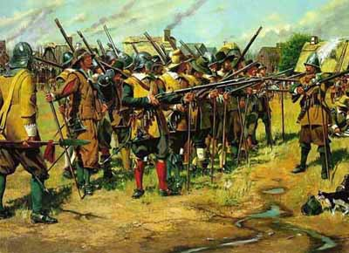

The Right of the People to Keep and Bear Arms

Slide 8
According to the Third Amendment, who is not allowed to be quartered in your house without your consent?

Slide 9


The government cannot force you to shelter soldiers in your home without your consent in times of war or peace.

Slide 10


Rights of the Accused Amendments

Slide 11
According to the Fourth Amendment, in most circumstances, a search and seizure is not permitted without…

Slide 12
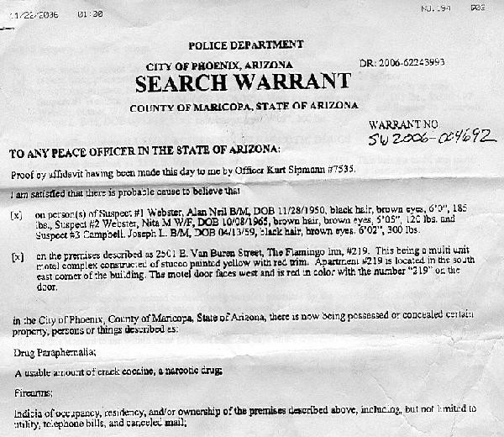
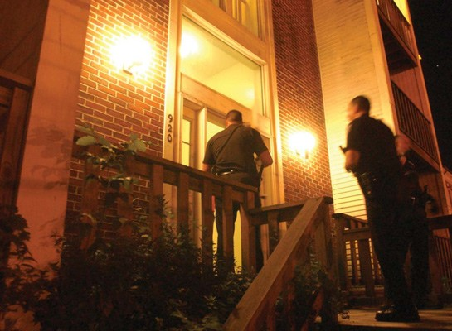
Warrant / Probable Cause

Slide 13
What four principles are part of the Fifth Amendment?

Slide 14
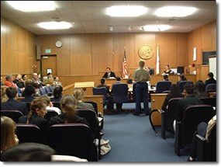
Fifth Amendment
Self-incrimination
Double Jeopardy
Due Process
Eminent Domain

Slide 15
Fifth Amendment
You cannot be tried for the same crime twice—called “Double Jeopardy.”
You do not have to testify against yourself. “I plead the Fifth.” (self-incrimination)
You must have due process of law before you are convicted.
The government cannot take your land unless it pays.

Slide 16
What rights related to a trial are afforded to the people in the Sixth Amendment?

Slide 17
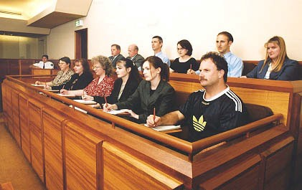
Sixth Amendment
Speedy and public trial
Impartial jury
Informed of the nature of the accusation
Confronted with witnesses
Obtain witness in favor
Assistance of counsel

Slide 18
The Seventh Amendment guarantees the right to a trial by jury in most cases of this kind…

Slide 19
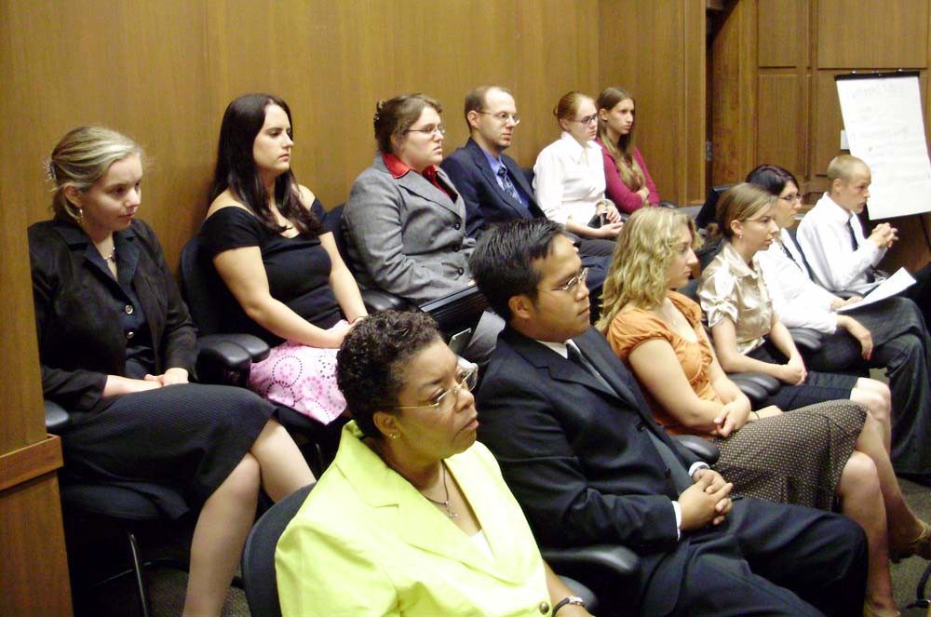
Civil

Slide 20
What type of punishment is not allowed according to the Eighth Amendment?

Slide 21
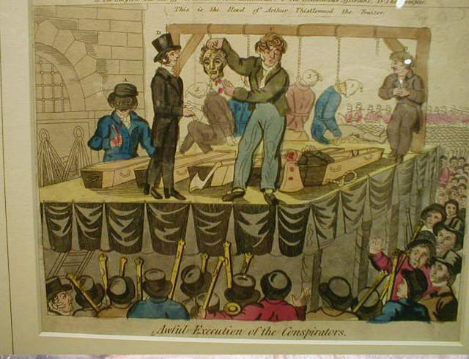
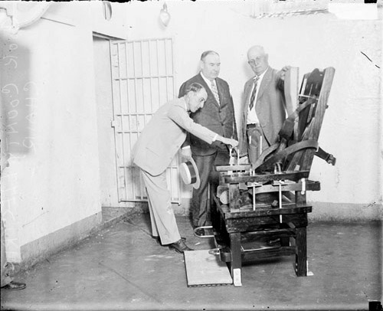
Punishment that is “cruel and unusual”

Slide 22
Which amendment states that even though the Constitution lists certain rights, the people still retain other rights that are not listed?

Slide 23
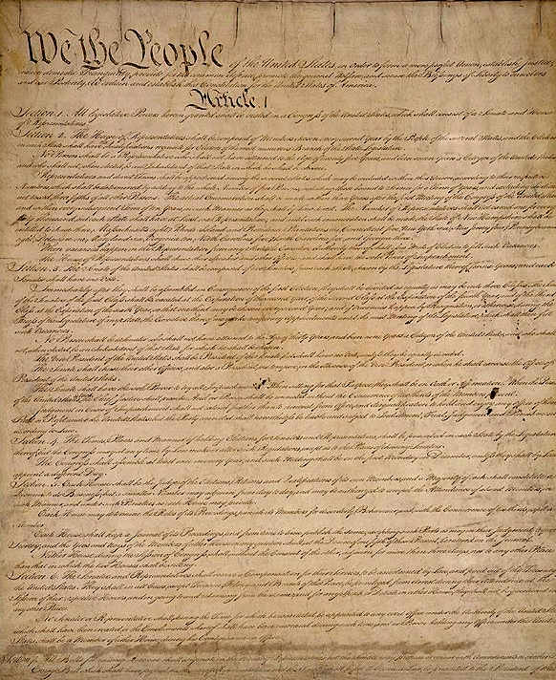
9th

Slide 24
According to the Tenth Amendment, the powers not delegated to the United States by the Constitution are reserved to the…

Slide 25

States

Slide 26
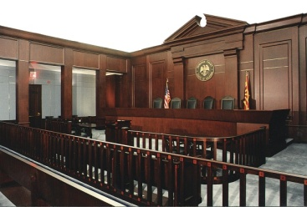

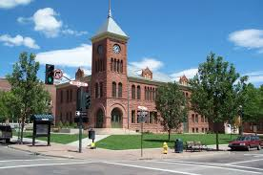
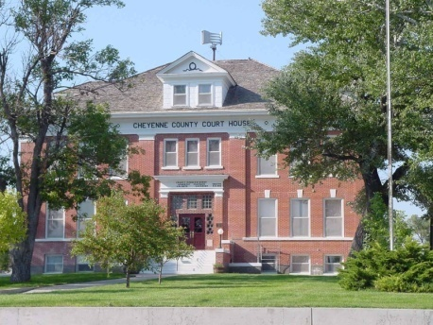

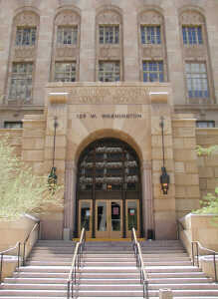



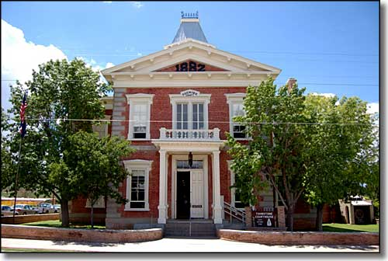
Our Courts
Serving Arizona
Serving Justice

