Slide 1

How Arizona Judges Are Accountable
INSERT presenter’s name, title and organization (and perhaps date and location of presentation) here.
Notes:
NOTE TO PRESENTER:
Thank you for volunteering to lead the discussion about How Arizona Judges Are Accountable. The slides that follow have notes that only you can see during the PowerPoint presentation to help in your discussion. Any NOTE TO PRESENTER is directed to you, the presenter, as an aid; provides instructions on how to use a specific slide and is not intended for discussion with the group. Any DISCUSSION NOTE, however, is for you to use as a script or reminder and is intended to be shared with the group.
PLEASE ALSO NOTE: In preparing for this presentation, (1) you will want to add your name, title and organization (and perhaps the date and location of the presentation) where indicated on Slide 3; (2) instructions for starting the animation on Slide 4 are listed in the NOTE TO PRESENTER and (3) the intent of this discussion is for those in attendance to learn about the Our Courts Arizona program and learn and discuss more about how Arizona Judges are accountable.

Slide 2
Our Courts Arizona
Hypothetical bus crash
Learning objectives
Let’s get going . . .
Notes:
DISCUSSION NOTE:
Introduce yourself, where you work and your background.
Introduce Our Courts Arizona: Our Courts Arizona is a joint activity of citizens, lawyers and judges to provide information to the public about Arizona’s courts. A primary objective of Our Courts Arizona is to increase public awareness, knowledge and understanding of Arizona’s courts, how the court system works, the role of judges, the Arizona and United States Constitutions and the rule of law and the importance of fair, impartial and accessible courts.
Our discussion today arises out of a hypothetical lawsuit filed after a bus crash.
I will start with an animation of the crash, shown from two perspectives. There’s no sound, so just watch what happens.
Then I will tell you why you have different playing cards and we will use those cards to discuss some issues that might, or might not, cause some concerns.
We want this to be interactive throughout and hope that we will have some real differences of opinion.
Discuss learning objectives: My hope is that, after our discussion today, you will have a feel for the fact that Arizona Judges are accountable, have a better understanding of a few specific ways Arizona Judges are accountable and that we will have some fun along the way.
So, let’s start by viewing a 40 second animation of the bus crash, without sound . . . NEXT SLIDE

Slide 3
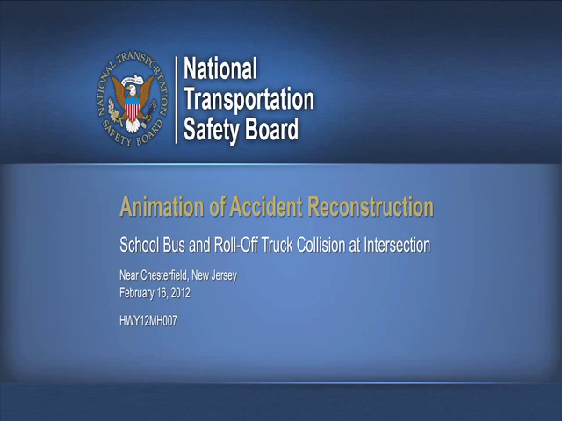

Slide 4
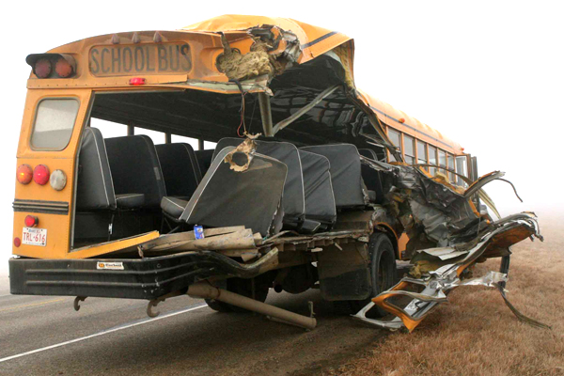

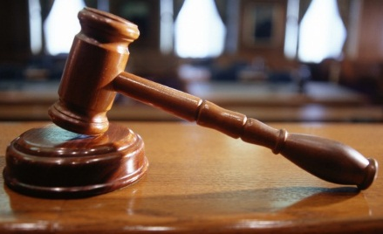

BUS CRASH FALLOUT
Discovery
Notes:
DISCUSSION NOTE:
People in the bus were hurt, some of them pretty badly, but they all recovered.
The people in the bus who were hurt sue the truck driver and his employer Trucking Co. to recover the cost of their injuries (including medical treatment and physical therapy), their pain and suffering and other costs and expenses.
The people who sue and the truck driver and trucking company are called the parties to the lawsuit.
This is a civil lawsuit, where one party (actually several parties) are seeking money from another.
The parties to the lawsuit do what’s called discovery, which consists of exchanging documents, asking each other questions under oath at what is called a deposition and exchanging and gathering other information about the crash. And they may also file motions, which are requests for court orders, and do other things along the way.
But now it’s time for trial, where the parties will present argument and evidence to a jury of people who have no knowledge of the case, who will be instructed on the law by the judge and who will then make a decision about who wins.

Slide 5




THE FIRST DAY OF TRIAL
Hearts are the people in the bus who were hurt and have sued Trucking Co. (called plaintiffs).
Spades are Trucking Co. (called the defendant).
Diamonds are potential jurors.
Clubs are people who came to watch, including witnesses who the parties may call to tell the jury what they know.
Notes:
DISCUSSION NOTE:
Divide the audience into four groups.
You each received a playing card (and if you didn’t, let me know).
Hearts are the people who were hurt and have sued Trucking Co. (called plaintiffs).
Spades are Trucking Co. (called the defendant).
Diamonds are potential jurors who have been called in today to ask some questions and, if selected, sit on the jury and decide the case.
Clubs are court employees.
Keep these groups in mind as we work through some potential issues.

Slide 6

ISSUE #1
Judge Recommends Plaintiff’s Attorney on LinkedIn
Notes:
DISCUSSION NOTE:
The Judge just went on a website and recommended the lawyer who represents the people who were hurt. As trial starts, the Judge tells that lawyer “Congratulations! I recommended you on LinkedIn.”
Does this show favoritism?
Might the people who are hurt have some concerns?
What is the reaction of the potential jurors? Fair and impartial?
And what would the observers think? Concern about getting a fair hearing?
What might the Judge do now?

Slide 7
ISSUE #1
The Arizona Code of Judicial Conduct describes what an Arizona judge can and cannot do and requires judges to:
  “uphold and promote the independence, integrity, and impartiality of the judiciary and shall avoid impropriety and the appearance of impropriety;”
  “perform the duties of judicial office impartially, competently, and diligently;” and
  not be involved in any proceeding where “the judge’s impartiality might reasonably be questioned.”
Notes:
DISCUSSION NOTE:
One way Arizona Judges are accountable is through The Arizona Code of Judicial Conduct. Arizona Code of Judicial Conduct is publicly available and can be found at the Arizona Supreme Court’s website www.azcourts.gov.
Code establishes standards for the ethical conduct of judges and judicial candidates.
Contains Four Canons of conduct, numerous specific rules and related comments. (First quote is Canon 1; second quote is canon 2 and third quote is Rule 2.11)
Based on the concept that an independent, fair and impartial judiciary is indispensable to our system of justice.
The rules contained in the code reflect that judges “individually and collectively, must respect and honor the judicial office as a public trust and strive to maintain and enhance confidence in the legal system.”
It is not intended as an exhaustive guide for the conduct of judges and judicial candidates, who are governed in their judicial and personal conduct by general ethical standards as well as by the Code.
The code is intended, however, to provide guidance and assist judges in maintaining the highest standards of judicial and personal conduct, and to provide a basis for regulating their conduct through disciplinary agencies

Slide 8
ISSUE #1
The Judicial Ethics Advisory Committee issues advisory opinions applying the Arizona Code of Judicial Conduct and, in 2014, issued an opinion stating an Arizona judge is prohibited from using LinkedIn to recommend a lawyer who regularly appears before that judge.
The Arizona Commission on Judicial Conduct disciplines Arizona judges who violate the Arizona Code of Judicial Conduct (reprimands, censures, suspensions and even removals).
Notes:
DISCUSSION NOTE:
Other ways Arizona Judges are accountable are the Judicial Ethics Advisory Committee and the Arizona Commission on Judicial Conduct.
Judicial Ethics Advisory Committee issues advisory opinions to judges in applying the Arizona Code of Judicial Conduct.
Nine member Commission, seven of whom are judges and two of who are attorneys, appointed by the Chief Justice of the Arizona Supreme Court.
Created in 1976, among other things, the Commission has issued advisory opinions regarding various aspects of the Arizona Code of Judicial Conduct, providing guidance on what is permissible, what may be permissible and what is not permissible.
Focus is on providing guidance to judges to help them determine, in advance, what they can do and cannot do.
Opinions from 1976 to the present are available on the website. www.azcourts.gov/azcjc .
Advisory Opinion referenced is 14-01.
Arizona Commission On Judicial Conduct.
1. In 1970, and in 1988, Arizona voters amended Arizona’s Constitution to create and refine the Commission on Judicial Conduct. Arizona Constitution Article 6.1.
2. Commission on Judicial Conduct reviews, investigates and takes action on complaints against Judges.
3. Commission has 11 members including judges, lawyers and non-lawyers.
4. Commission has jurisdiction over all Arizona judicial officers and has authority to investigate a wide variety of complaints against judges.
5. Complaint form is available on the website and can be filled out electronically.
6. Commission can impose a variety of consequences, including reprimands, censures, suspensions and even removals.

Slide 9
ISSUE #1
The Arizona Rules of Professional Conduct (called Ethical Rules) describe what an Arizona judge who is an Arizona attorney can and cannot do.
The State Bar of Arizona’s Committee on the Rules of Professional Conduct issues advisory opinions applying the Ethical Rules.
The State Bar of Arizona’s Lawyer Discipline System disciplines Arizona attorneys who violate the Ethical Rules.
Notes:
DISCUSSION NOTE:
For Arizona Judges who are attorneys, they are also accountable under the Arizona Rules of Professional Conduct, the State Bar of Arizona’s Committee on Rules of Professional Conduct and the State Bar of Arizona’s Lawyer Discipline System.
Arizona Rules of Professional Conduct.
Judges who are attorneys also must comply with the Arizona Rules of Professional Conduct and can be subject to discipline by the State Bar of Arizona if they do not. See www.azbar.org/ethics.
Ethics Rules and advisory Ethics Opinions are publicly available and can be found at http://www.azbar.org/Lawyers.
State Bar of Arizona’s Lawyer Discipline System is summarized at http://www.azbar.org/LawyerRegulation

Slide 10
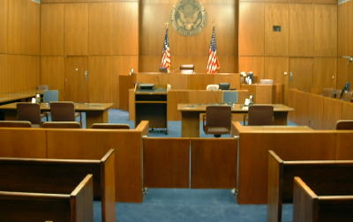
ISSUE #2
Parties ask judge to “kick out” the observers, including the witnesses.
Notes:
NOTE TO PRESENTER:
Use to discuss how Judicial Accountability Isn’t Just To What The Parties Agree.
DISCUSSION NOTE:
Do the observers have a right to attend?
Do jurors (yes jurors) have a right to serve?

Slide 11
ISSUE #2
Judges take an oath that they “will support the Constitution of the United States and the Constitution and laws of the State of Arizona.”
“Justice in all cases shall be administered openly.” Arizona Constitution Article 2 Section 11.
Can exclude witnesses until they testify so they don’t hear other testimony, but closing the courtroom to all would be contrary to these provisions and subject to review by an appellate court.
Notes:
DISCUSSION NOTE:
For Arizona Judges who are attorneys, they are also accountable under the Arizona Rules of Professional Conduct, the State Bar of Arizona’s Committee on Rules of Professional Conduct and the State Bar of Arizona’s Lawyer Discipline System.
Arizona Rules of Professional Conduct.
Judges who are attorneys also must comply with the Arizona Rules of Professional Conduct and can be subject to discipline by the State Bar of Arizona if they do not. See www.azbar.org/ethics.
Ethics Rules and advisory Ethics Opinions are publicly available and can be found at http://www.azbar.org/Lawyers.
State Bar of Arizona’s Lawyer Discipline System is summarized at http://www.azbar.org/LawyerRegulation

Slide 12

ISSUE #3
Bus Victims want to let everyone in court hear the story and vote for who should win
Notes:
NOTE TO PRESENTER:
Use to Show Need For Rule Of Law And Accountability Different Than Elected Officials

Slide 13
ISSUE #3
Arizona Judges don’t decide cases by a vote of the public or those present.
Arizona Judges do take an oath to support the Constitution of the United States and the Constitution and laws of the State of Arizona.
Notes:
NOTE TO PRESENTER:
Use To Show How Judges Are Accountable In A Different Way Than Members Of The House Of Representatives Or The Senate Or The Governor Or Other Partisan Elected Officials.

Slide 14
ISSUE #3
Arizona Judges don’t decide cases based on the attorneys or parties involved, or newspaper articles or even whether the judge agrees with the law.
Arizona Judges do decide specific cases by applying the rule of law to the facts presented by the parties.
Notes:
NOTE TO PRESENTER:
Use To Show How Judges Are Accountable In A Different Way Than Members Of The House Of Representatives Or The Senate Or The Governor Or Other Partisan Elected Officials.

Slide 15
Questions?

Slide 16
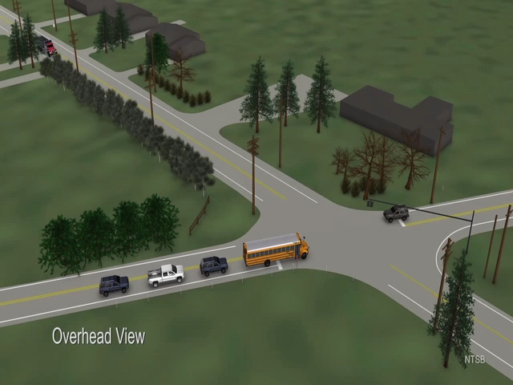

Slide 17
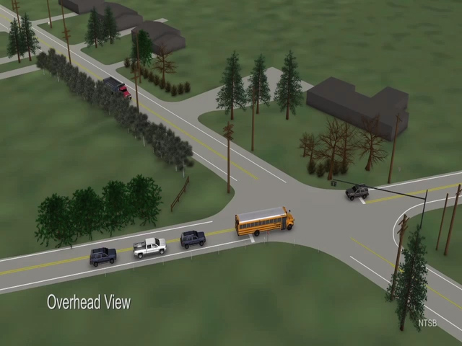

Slide 18
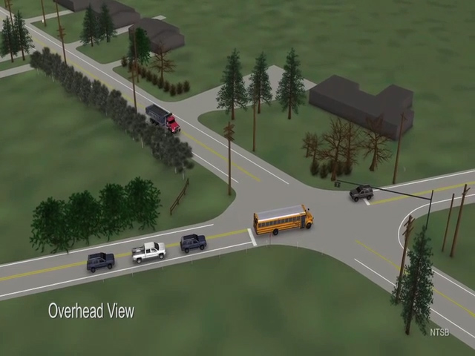

Slide 19
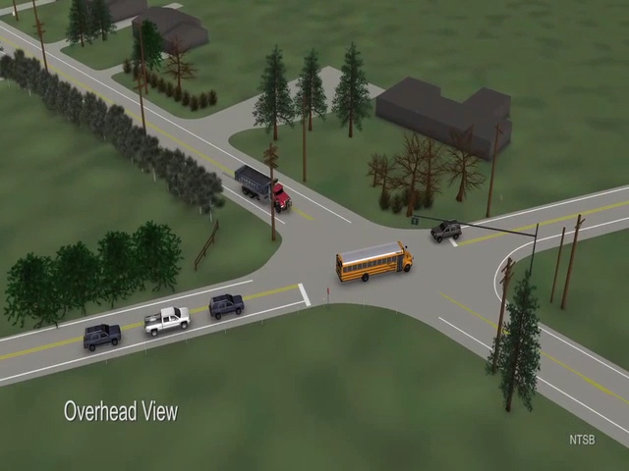

Slide 20
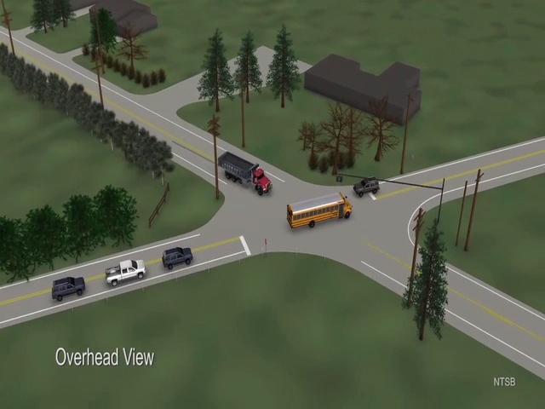

Slide 21
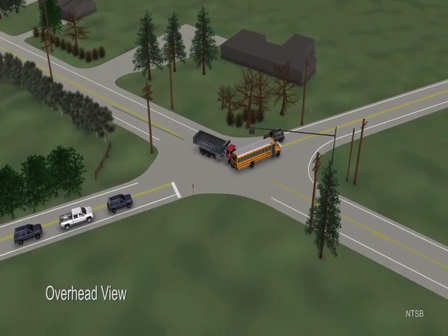

Slide 22
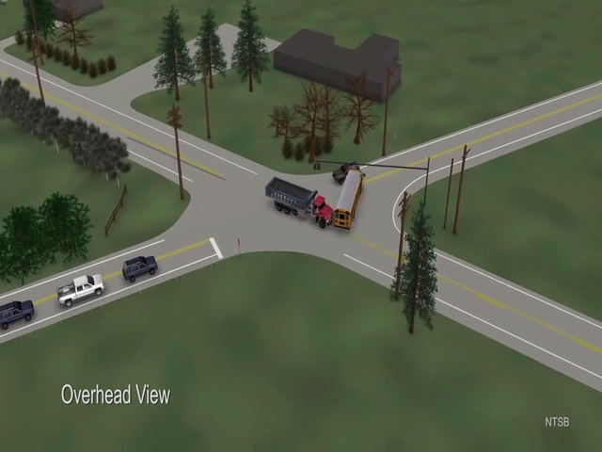

Slide 23
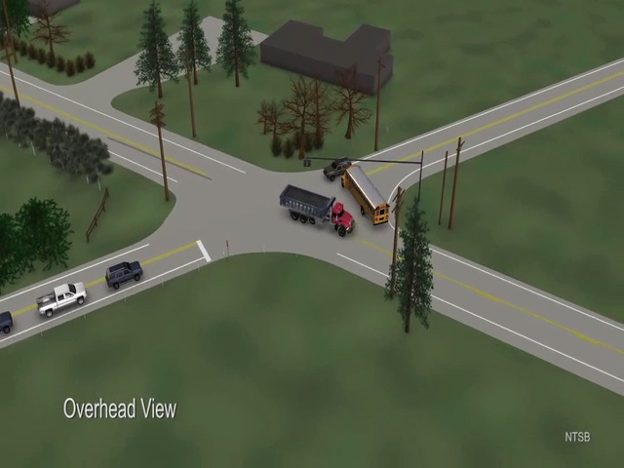

Slide 24
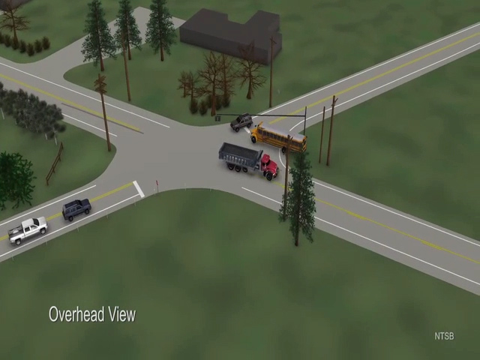

Slide 25
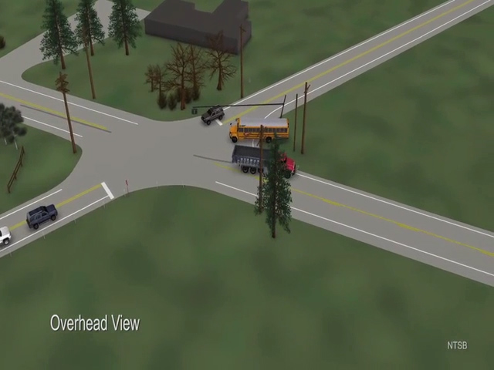

Slide 26
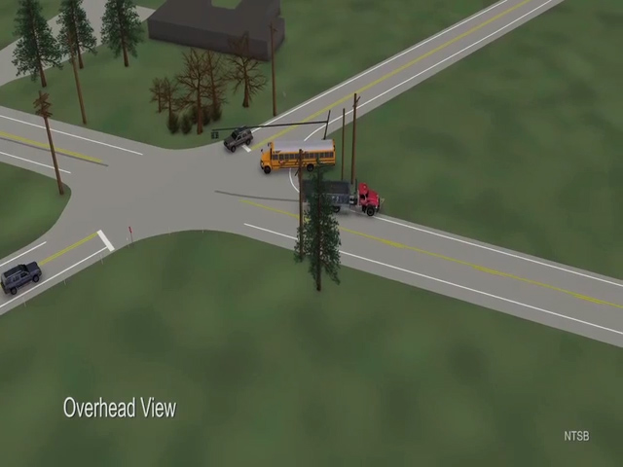

Slide 27
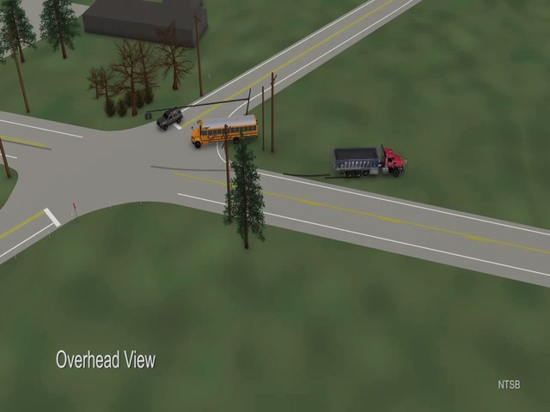

Slide 28
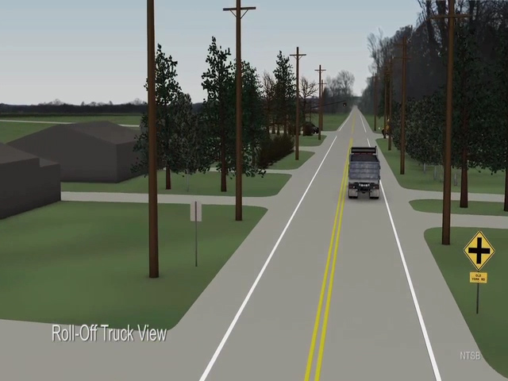

Slide 29
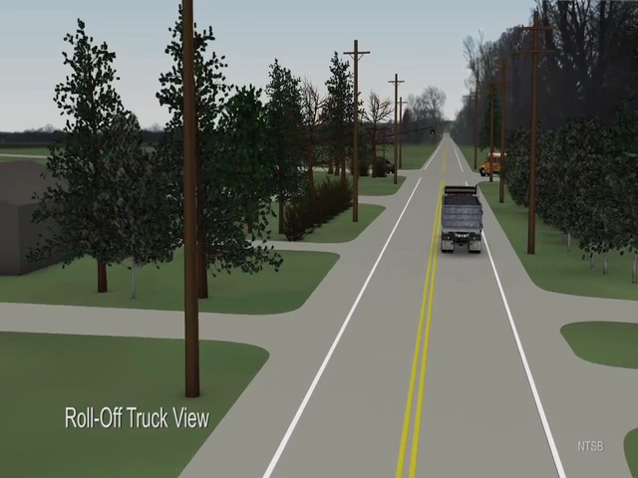

Slide 30
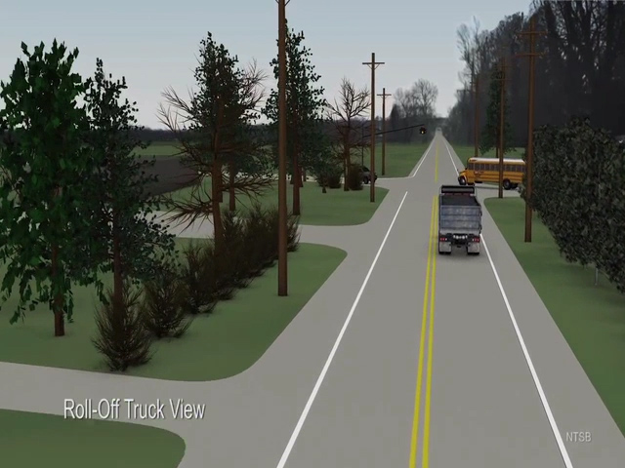

Slide 31


Slide 32
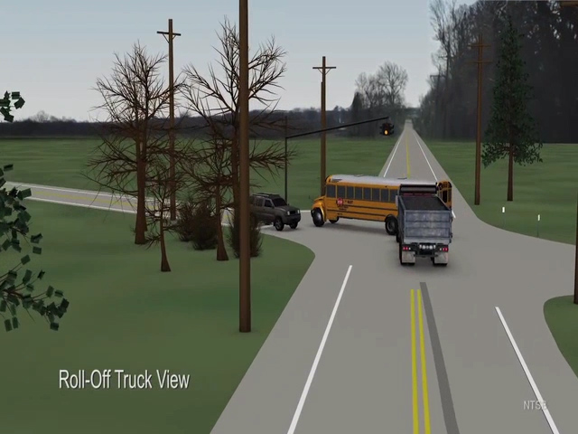

Slide 33
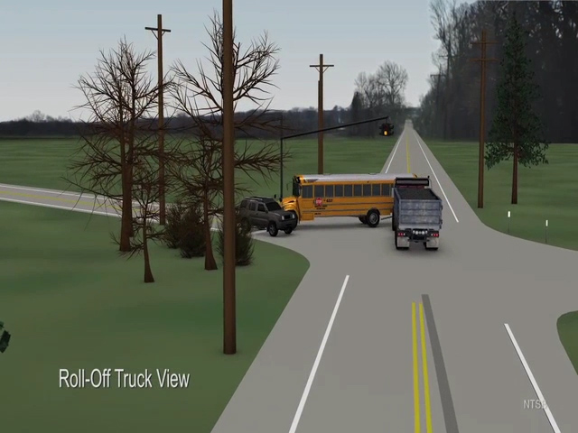

Slide 34


Slide 35
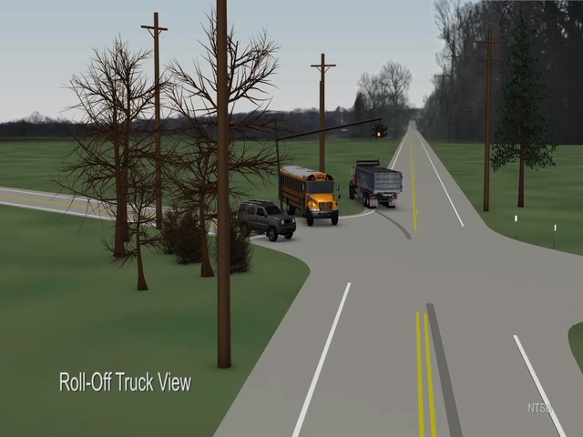

Slide 36
