Slide 1

Court Fundamentals
Judge
[court name]

Slide 2
What is this program about?
Why did the Arizona Supreme Court create this initiative?

Slide 3
Fair, impartial and accessible courts are indispensable to the rule of law and the protection of individual rights.

Slide 4
Court Fundamentals
- Third Branch
- Equal Justice
- Fair & Impartial Courts

Slide 5
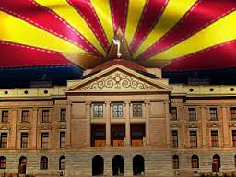
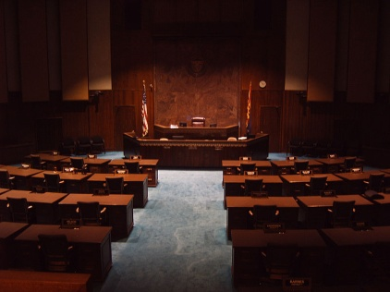
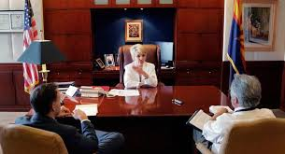
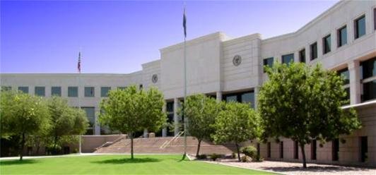
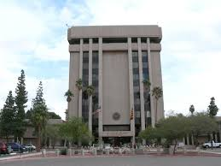
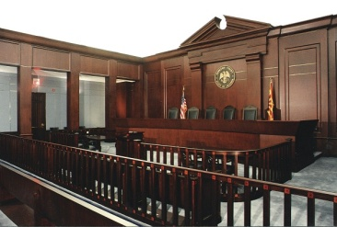
Legislative
Three Branches
Executive
Judicial
Notes:
I’m sure that you all remember that there are three branches of government
Legislative
Executive
Judicial
Differentiate the state system from the federal system:
The states have their own government system, represented by the photos of our Arizona capitol, governor’s office, and Supreme Court building.
The federal government has a completely separate governmental system that governs us, but the structure is analogous: 1) Congress; 2) President; 3) SCOTUS.
When people hear about courts, they may think of one system of courts. There are really two, the state court system and the federal court system.
Today, I will be talking about our Arizona state courts.

Slide 6

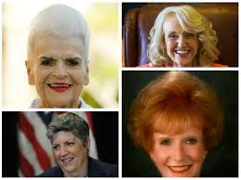

Separation of Powers
Each branch has different powers established by the state constitution. The separate powers enable each branch to “check” or limit the power of the other two branches.
  Legislative Branch
    Makes our statutory laws
  Executive Branch
    Governor enforces our laws
  Judicial Branch
    The appellate courts interpret our laws and the trial courts apply the laws.
Notes:
Briefly describe the functions of the three branches of government as it pertains to creating, enforcing and applying law, focusing now on statutory law.
You do not need to discuss the nuances of the separation of powers because there will be an issue at the example that illustrates the practical aspects of this doctrine. It is only necessary that the audience understands that each branch has an important, but different role in our system of government.

Slide 7
A primary purpose of the courts:
Provide Equal Justice
Notes:
The Theme: Equal Justice
To preserve the freedom of each and every individual, our courts must provide EQUAL JUSTICE.
This slide sets the foundation for the next slide describing the elements of Equal Justice.

Slide 8
Apply
the Rule of Law
Apply Law
Equally to All
Equal
Justice
In Fair & Impartial Courts
Notes:
The Theme: Equal Justice
To preserve the freedom of each and every individual, our courts must provide EQUAL JUSTICE.
We do this with
Apply the RULE OF LAW
Apply Law EQUALLY TO ALL
In Fair & Impartial Courts

Slide 9
What is
a “fair and impartial judiciary”?
Notes:
Rhetorical question. Depending on the level of audience participation up to this point, you may want to solicit a couple of responses to this question.
The responses may be useful in bringing back core concepts toward the end of the session.

Slide 10
A Judge is bound to decide each case fairly, in accord with the relevant facts and applicable law, even when the decision is not the one the home crowd wants.
-- William H. Rehnquist, Chief Justice-1986-2005
Notes:
This slide provides a simple, but concrete explanation of a fair and impartial judge/court.

Slide 11
Fair & Impartial Courts Require:
Constitutional Integrity – Ensures that one branch (judiciary) has the power to overturn laws that violate federal & state constitutions;
Enforcement of the Rule of Law – Guarantees that legitimate laws can be enforced in daily life, not simply stated in theory.
Equal Application of the Law – Every person enjoys the same protections and restrictions under the law.
Notes:
This slide increases the depth of understanding of what a Fair and Impartial Court means.
Constitutional Integrity briefly introduces the concept that there is a body of law superior to statutory law.
Rule of Law touches upon the principle that laws are known in advance, they govern everyday activities, and they are different from religious, moral, or ethical principles.
Equal Application of the Law pertains to the expectations that any person who enters a courtroom can expect.

Slide 12
How does the Rule of Law, Equal Justice and the Separation of Powers apply in an actual case?
A Truck / Bus
Accident
Notes:
This slide tells the audience that we are going to examine how the principles of Rule of Law, Equal Justice, and Separation of Powers could apply in an actual case.
You will see an animation of an accident in which a child on the bus was injured.

Slide 13
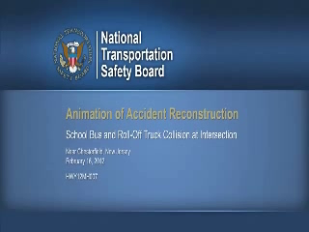
Truck Bus Accident
Notes:
You may need to click screen to start it. You may also be presented with a slider bar at the bottom, in which case you need to click the Play arrow.
The animation is not necessary to discuss the issues that follow, but it helps to make the discussion more realistic. Asking several fault questions gets the audience involved in the scenario and later will help them to understand the practical significance of the legal issues to be discussed.
The animation was made by the NTSB regarding an actual non-Arizona accident.
To prime the audience for participation, ask one or more of the following questions after the animation fades to blue, but before moving to the next slide.
Do you think anyone was at fault in this accident? If so, who and why?
Could more than one person be at fault?
Could whoever designed or maintained the intersection be at fault?

Slide 14
BUS CRASH SUIT
A child on the bus sued the drivers of the bus and truck for his serious injuries. He also sued the state highway department for not installing a regular stop light.
Today is the first day of trial, where the parties will tell their story and ask the jury to decide the case.
The parents want the jury to award their son money for his injuries.
The defendants oppose the request and/or blame the others.
Notes:
A child on the bus was badly hurt but he recovered with some disability.
The child’s parents sue the drivers of the bus and the truck to recover the cost of their injuries (including medical treatment and physical therapy), their pain and suffering and other costs and expenses. They also sue the state for not installing a regular stop light (rather than a flashing yellow light).
The parents, child, and drivers are called the parties to the lawsuit.
This is a civil lawsuit, where one party (actually several parties) are seeking money from another.
The parties to the lawsuit do what’s called discovery, which consists of exchanging documents, asking each other questions under oath at what is called a deposition and exchanging and gathering other information about the crash. And they may also file motions, which are requests for court orders, and do other things along the way.
But now it’s time for trial, where the parties will present argument and evidence to a jury of people who have no knowledge of the case, who will be instructed on the law by the judge and who will then make a decision about who wins.

Slide 15
Issue 1
During jury selection, a potential juror discloses that he is a friend of the bus driver and he attends the same church as the judge.
If he has talked with the bus driver about the accident, would that be a problem? What if they had not talked about the accident?
Is it a problem if a juror and the judge attend the same church? Can they talk about the case if the juror keeps an open mind about the verdict?
Notes:
The purpose of using this scenario is to get the audience to discuss two types of relationship interference with a fair and impartial trial:
The friendship of the potential juror raises issues of bias and receiving evidence outside of trial. People might differ about whether friendship alone is sufficient to disqualify a person from serving on the jury, but it should become clear with a guided discussion that it is critical for the evidence to come in during the trial only.
The second relationship issue is more complex depending on the size of the church, the size of the community, and the prior interactions between the juror and the judge.
The second question about conversations regarding the trial should reinforce the principle of judicial integrity and the transparency of the process (i.e., the judicial process occurs only in the courtroom).
OK to explain how the relationship issues involving the judge and bus driver are legally different and may result in different resolutions.

Slide 16
Issue 2
The jury issues a verdict against the state for 30% of the student’s damages (and 35% against each of the drivers).
The legislature passes a law after the trial that nullifies verdicts against the state unless it was more than 50% at fault and applies it to all cases starting last year. It would nullify this verdict.
Should the legislature be able to pass laws affecting past actions? Why or why not?
Notes:
The purpose of using these hypothetical facts is to get the audience to discuss the separation of powers in a simplified example.
The examples will introduce indirectly the concept of the rule of law. Although you should avoid the technical issues associated with ex post facto jurisprudence, the example can illustrate the basic principle that law and its consequences should not change after the facts occurred.
The questions are designed to get the audience to come to its own conclusions on this point.
If there is time, you can explain that the general prohibition against ex post facto laws is embedded in the US Constitution (Article I, Section 9) and generally applied to the states.

Slide 17
Issue 3
Assume the state’s lawyers ask the court to dismiss the case against it.
Should the court decide whether the new law applies to this case?
Assume the answer to the question depends on the interpretation of the federal and state constitutions. Does that change or support your answer?
Notes:
Issue 3 opens up another perspective on how the judiciary functions not just at trial, but also in interpreting laws and determining whether they pass constitutional muster.
The purpose is to encourage the audience to decide for themselves whether the courts or the legislature should decide if a law is valid under the state or federal constitutions. This may open a discussion about how a law is made (by the legislature or the people), enforced (by the state or private parties), and applied in a particular case (by the judiciary)
You can use this last slide to reinforce the principles presented at the beginning about the application of law and the role of the constitution in comparison with statutory laws.

Slide 18
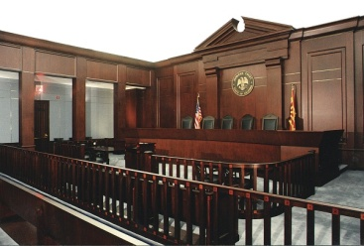
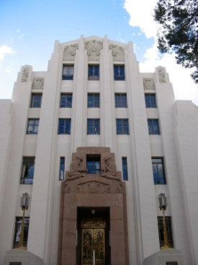
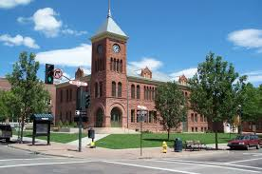
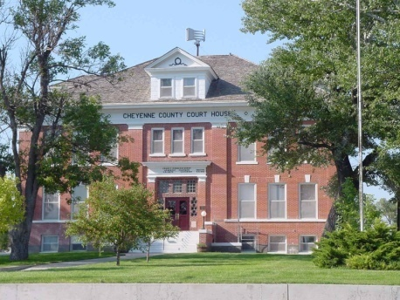
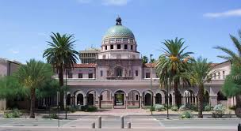
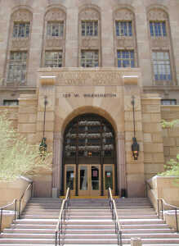

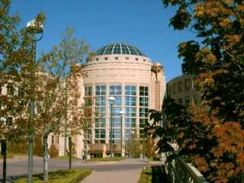
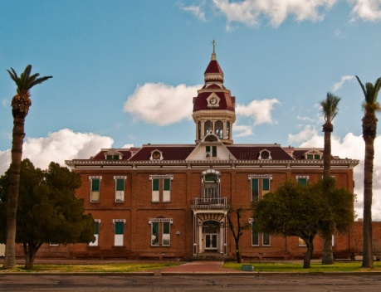
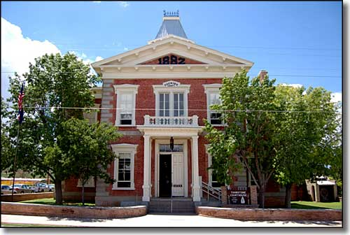
Our Courts
Serving Arizona
Serving Justice
Notes:
Thank the audience.
Depending on the time remaining, solicit more general questions or indicate your willingness to talk with individual audience members afterwards.

