Slide 1

How Decisions Are Made
INSERT presenter’s name, title and organization (and perhaps date and location of presentation) here.
Notes:
MESSAGE TO PRESENTER: THIS PRESENTATION IS DESIGNED AS AN INTERACTIVE PRESENTATION. PLEASE ENCOURAGE AND FACILITATE AUDIENCE PARTICIPATION. THIS PRESENTATION IS DESIGNED TO COMMUNICATE THE CRITICAL IMPORTANCE OF THE ROLE OF OUR INDEPENDENT JUDICIARY AND THE NEED FOR JUDGES TO LISTEN TO THE FACTS, INTERPRET THE LAW, AND APPLY THE LAW TO THE FACTS IN A FAIR AND IMPARTIAL MANNER.
Introduce yourself and Our Courts.
Our Courts Arizona is an outreach initiative by the Arizona Supreme Court in which judges provide nonpartisan information to the public about our courts through interactive presentations.
During the presentation today, we will discuss the state court system and, in particular, issues relating to judicial decision-making. The handout provides more information about the selection, retention, evaluation, and accountability of Arizona’s merit selection judges, that is, all appellate judges and justices in Arizona, and all superior court judges in Maricopa, Pima, and Pinal Counties.
*Another handout entitled “Our Courts Serving Arizona” provides information about Our Courts Arizona and how to get in touch with us to schedule a presentation.
*****Talk with the Audience******
Many people encounter our justice system through jury service. How many of you have been called for jury service?
How many have actually served on a jury? How many on a criminal jury? Civil?
When you were questioned about your qualifications to serve as a juror, do you remember the kinds of questions you were asked? What was the purpose of those questions? Was it to determine if you could be fair and impartial?

Slide 2
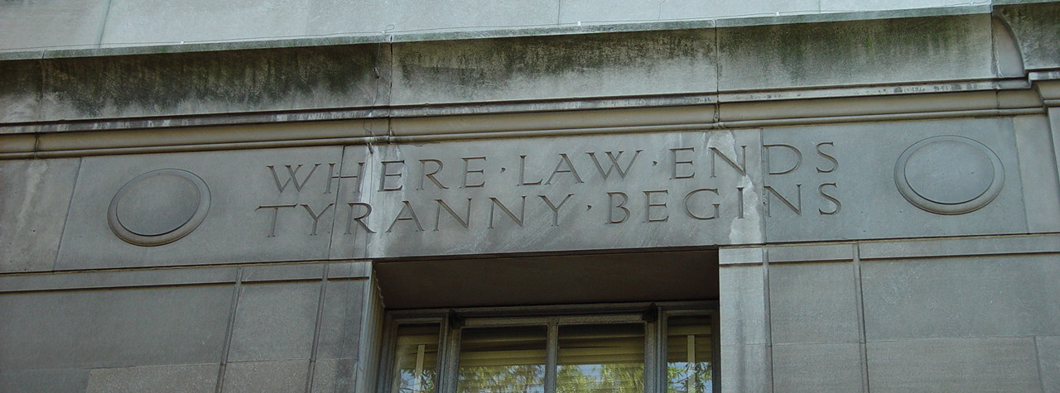
Our Courts Arizona
Who am I?
What is the “Our Courts Arizona” program all about?
What are the learning objectives for today’s session?
Notes:
Faculty should introduce themselves—who they are, what court they work at, what kinds of cases they hear, their background, why they became a judge, etc.
Discuss the purpose of Our Courts Arizona—to help citizens better understand the vital role that the judicial branch plays in defending rights and freedom, including the concepts of the separation of powers and the rule of law.
Briefly summarize what today’s session is all about—how judges should/do (and shouldn’t) make judicial decisions.

Slide 3
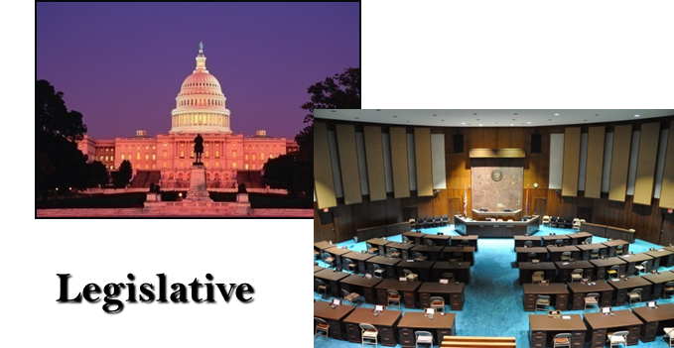

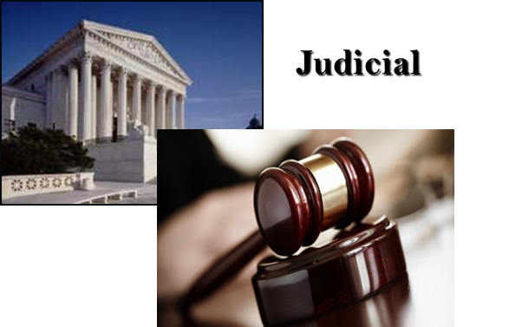
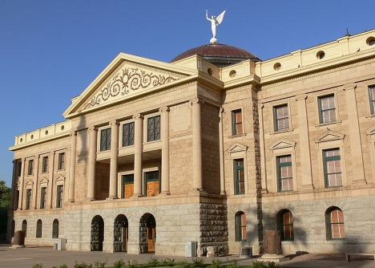
What are the 3 branches of government?
Executive
Notes:
Orient to 3 Branches
***Orient the audience to the three branches of government***
I’m sure you remember from civics classes that there are three branches of government.
Legislative
Executive
Judicial

Slide 4
Our Court Systems
Municipal Courts
Justice Courts
State Courts
(Superior Courts, Court of Appeals,
Arizona Supreme Court)
Notes:
Orient to the various Courts
And there are several levels of courts in Arizona’s state judiciary:
Municipal Courts
Justice Courts
Superior Courts
Arizona Court of Appeals
Arizona Supreme Court
*You may also briefly mention Federal Courts and Tribal Courts

Slide 5
Our State Courts are Busy
Cases Filed—FY 2014
    1,188,248 -Municipal Courts
    732,852 -Justice Courts
    201,170 -Superior Courts
    3,412 -Court of Appeals
    1,037 -Supreme Court
2,126,719 Total State Cases
Notes:
Our Focus Today is on Our State Courts.
How many cases are handled by our State Courts in a year? 10,000? 100,000? 1 million? More? You may read about a few high-profile cases in the paper, on the internet or hear about certain cases on the news. However, our courts handle millions of cases every year. As a result, our courts must handle cases in a manner that ensures justice, but does so in a manner that is efficient.

Slide 6
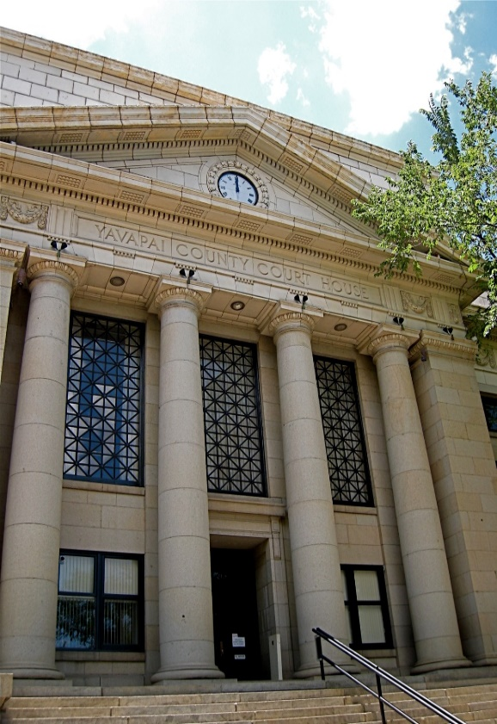
Your Day in Court
Notes:
***Choose a hypothetical to share with the audience***
HYPOTHETHICAL A:
It is three days after a major monsoon storm in Arizona. There is a city ordinance that requires residents within 24 hours after a monsoon to clear the sidewalk from debris and vegetation that has fallen. Walker is going home after getting groceries. He trips over a fallen tree, landing in a cactus on Castle’s property. Walker experiences severe pain and suffers a broken hip. Walker has surgery to repair the injury and is out of work for several weeks. Walker knows about the city ordinance and believes that Castle’s failure to clear the sidewalk caused his injury. About 8 months after the accident, Walker sues Castle alleging negligence. Castle has difficulty remembering what exactly happened so long ago, but his sidewalk was always free from debris, and Castle suspects that Walker tripped on debris in front of his neighbor's yard and just ended up landing on Castle’s cactus after the fall.
HYPOTHETHICAL B:
Great School advises all students that they may be subjected to warrantless searches of their person if a teacher, the principal, or a school official finds reasonable grounds for suspecting that the student has violated or is violating the law or rules of the school. Student A reports that she saw pictures of Student B on Student B’s Instagram and Facebook pages of Student B purportedly selling drugs outside the school cafeteria.
HYPOTHETICAL C:
Mother and Father separated 5 years ago. They have two children who are 8 and 9 years old. The children stay with Mom Monday through Friday after school every week and spend every weekend with Dad. Both Mom and Dad have remarried. When spending time with Dad, the children live in a 3 bedroom house with their 4 stepsiblings. The kids all have a positive relationship but space is limited. Mom’s new husband is being transferred for work to New York and she wants to take the kids with her, giving Dad parenting time only on school breaks and summers.
Divide the audience into three groups.
In Hypothetical A: Group 1 is Walker, Group 2 is Castle; and Group 3 is the public.
In Hypothetical B: Group 1 are the parents of Student B; Group 2 represents the State and school and Group 3 is the public.
In Hypothetical C: Group 1 is Mom or her lawyer, Group 2 is Dad or his lawyer, and Group 3 is the public.
Ask questions to establish the concepts of:
Fairness and impartiality
Equal treatment
Free from improper influences

Slide 7
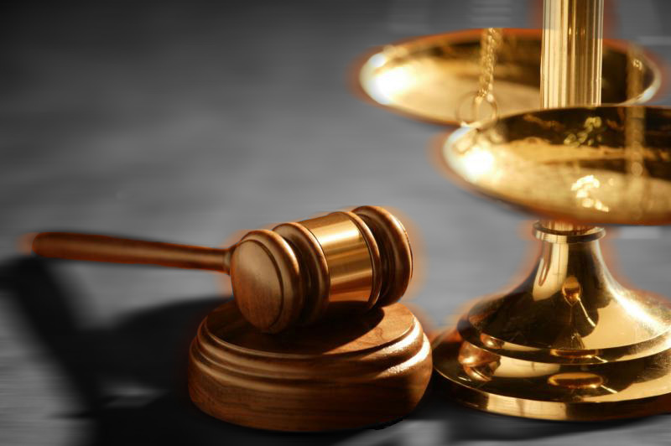
What should we expect from our courts?
Notes:
Inquire of the audience what should we expect from our courts?
A judge that has not decided the case before our trial or hearing?
Do we want to know that we can bring our disputes to court and that we will be heard?
Do we need a court free from political influences?
A judge that will listen and apply the law in a manner that is fair and impartial?
A judge that is able to make decisions?
To have freedom, we must have fair and impartial courts. A judge is called upon to interpret the law; listen to the facts and apply the law in a manner that is fair and impartial; to make procedural rulings; and often to mediate among parties to settle disputes.

Slide 8

Our Courts Must Apply the Law
Notes:
Where does the law come from?

Slide 9
Our Courts Must Apply
U.S. & Arizona Constitutions
U.S. & Arizona Statutes
U.S. & Arizona Agency Regulations
Arizona Rules of Procedure
Arizona Rules of Evidence
Notes:
The Rule of Law
Trial courts must follow the
U.S. Constitution
Arizona Constitution
Applicable federal laws
State laws
State rules of procedure & evidence
And… (see next slide)

Slide 10
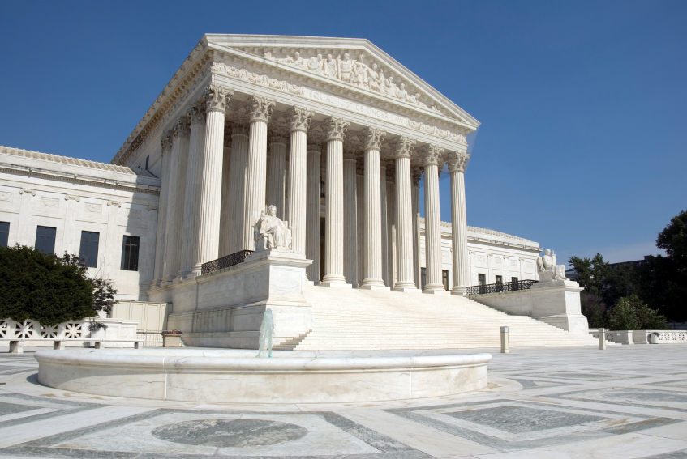
Decisions of Higher Courts
U.S. Supreme Court
Arizona Supreme Court
Arizona Court of Appeals
Notes:
Past Decisions of Higher Courts Control Many Court Decisions
Trial courts must apply these laws as they have been interpreted by the decisions of higher courts.
***Start with the court on which you sit and explain that the court at your level must apply the law as it has been interpreted by all higher courts, each of which is bound by the interpretations of the courts above it.***

Slide 11
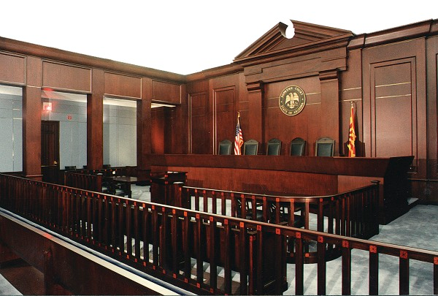
Our Trial Courts
Do Not Have the Last Word
Notes:
Court decisions are subject to review and correction.

Slide 12
Appeals
Notes:
The Appeal Process
The icon at the bottom represents the trial court.
The group of three represents the Arizona Court of Appeals, which sits in 3-judge panels to decide cases.
The group of five represents the Supreme Court of Arizona.
The group of nine represents the U.S. Supreme Court.
Describe the appellate process. Comment that the litigants have an appeal of right to the Arizona Ct. of Appeals.

Slide 13
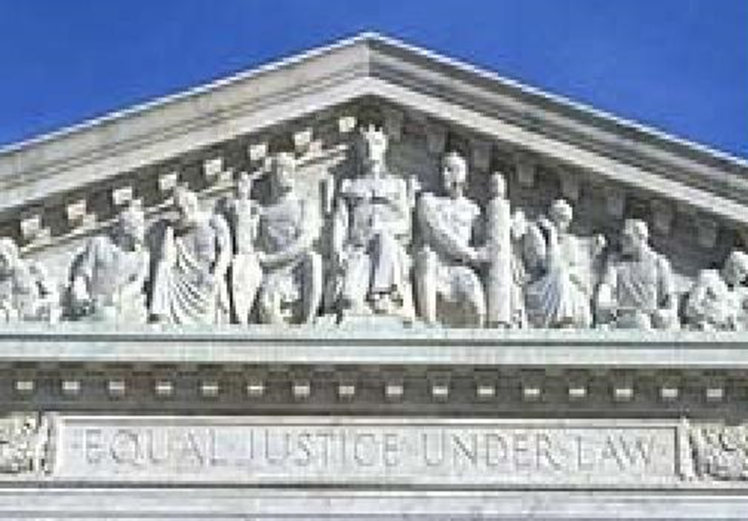
“Equal Justice Under the Law”
Entrance to the U.S. Supreme Court
Notes:
A Fundamental American Value: Equal Justice Under Law
This is what it says at the entrance to the U.S. Supreme Court. The entrance of the Arizona Court Building reads “Where Law Ends, Tyranny Begins.”
This is what our courts have done for more than 230 years, and what they must continue to do.

Slide 14

Applying
the Rule of Law
Equally to All
Fair & Impartial Courts
Notes:
The Theme: Equal Justice
To preserve the freedom of each and every individual, our courts must provide EQUAL JUSTICE.
We do this with
Fair & Impartial Courts
Applying the Rule of Law
Where does the law come from?
Trial courts must follow the U.S. Constitution, Arizona Constitution, applicable federal laws, state laws, and state rules of procedure & evidence. If a party feels that the trial court erred in its decision, the party may seek review of the court’s decision.
Equally to all
Our system of government rests upon an independent judiciary with judges who to listen to the facts, interpret the law, and apply the law to the facts in a fair and impartial manner.

