Slide 1

The Rule of Law
INSERT presenter’s name, title and organization (and perhaps date and location of presentation) here.
Notes:
MESSAGE TO PRESENTER: THIS PRESENTATION IS DESIGNED AS AN INTERACTIVE PRESENTATION. PLEASE ENCOURAGE AND FACILITATE AUDIENCE PARTICIPATION. THIS PRESENTATION IS DESIGNED TO COMMUNICATE THE CRITICAL IMPORTANCE OF GOVERNMENT THROUGH THE RULE OF LAW.

Slide 2
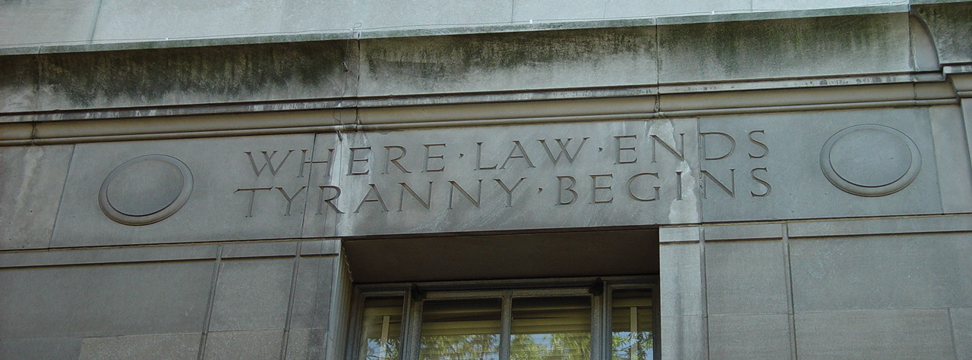
Our Courts Arizona
Who am I?
What is the “Our Courts Arizona” program all about?
What are the learning objectives for today’s session?
Notes:
Introduce yourself and Our Courts.
Our Courts Arizona is an outreach initiative by the Arizona Supreme Court in which judges provide nonpartisan information to the public about our courts through interactive presentations.
During the presentation today, we will discuss the importance of the concept known as the “rule of law.”

Slide 3
CONSTITUTION

Slide 4
CONSTITUTION

Slide 5
RULE OF LAW
CONSTITUTION

Slide 6


Slide 7
RULE OF LAW
DUE PROCESS
CONSTITUTION

Slide 8
RULE OF LAW
DUE PROCESS
EQUAL PROTECTION
CONSTITUTION

Slide 9
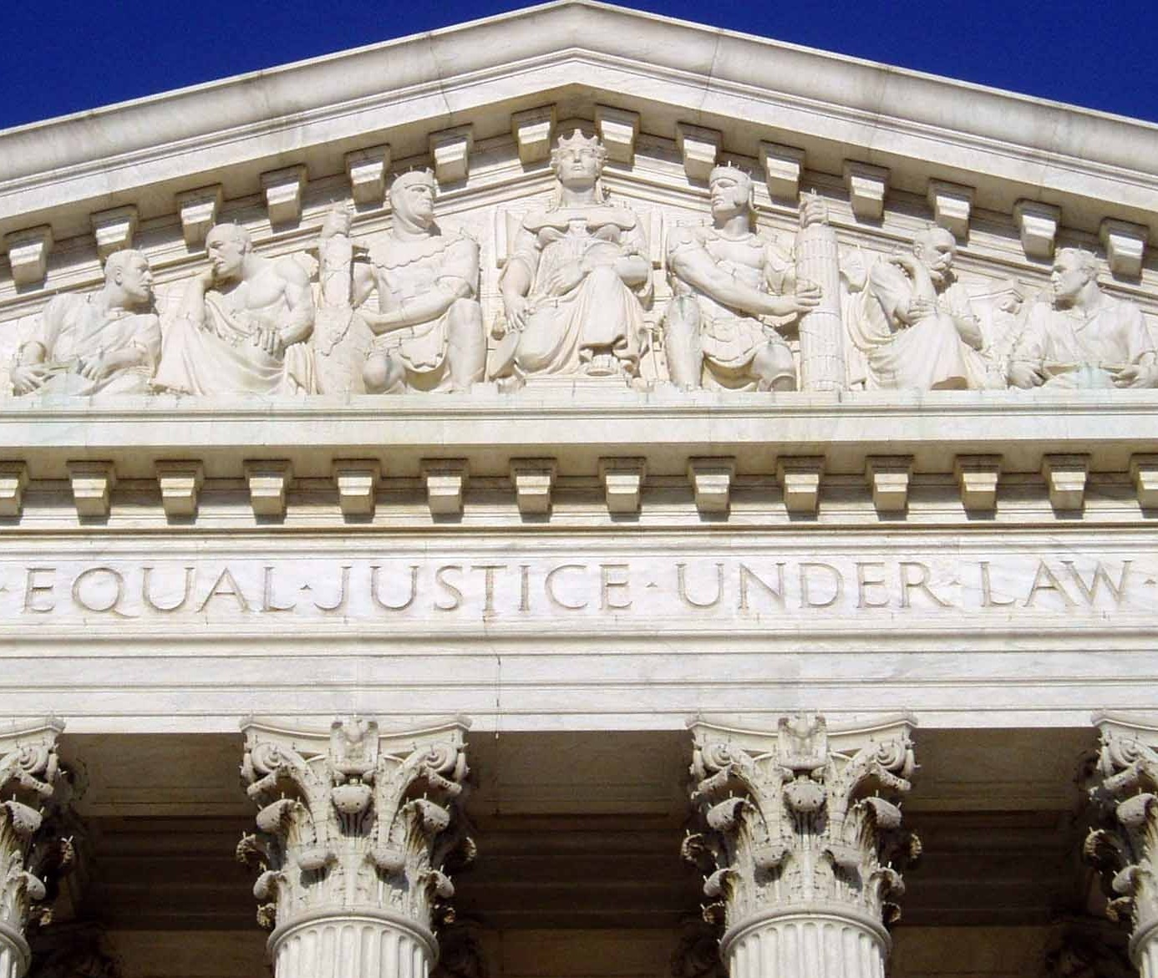
EQUAL JUSTICE UNDER LAW
Entrance to the U.S. Supreme Court

Slide 10
RULE OF LAW
DUE PROCESS
EQUAL PROTECTION
GUARANTEED RIGHTS
CONSTITUTION

Slide 11
RULE OF LAW
DUE PROCESS
EQUAL PROTECTION
GUARANTEED RIGHTS
SEPARATION OF POWERS
CONSTITUTION

Slide 12
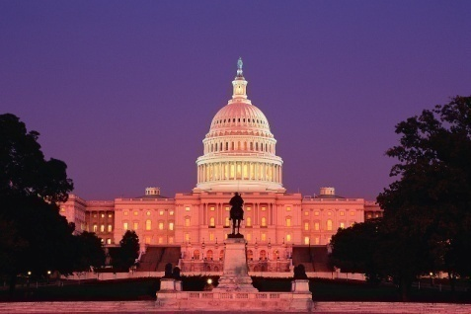
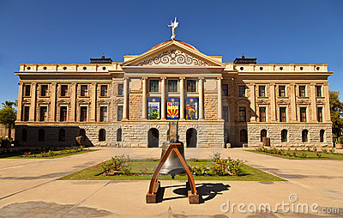

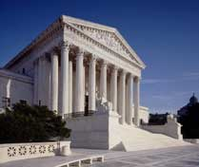
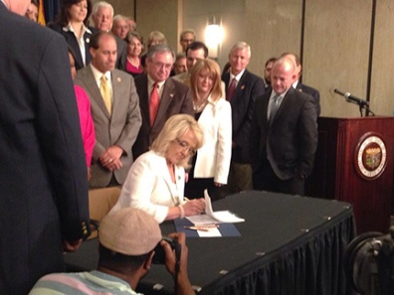
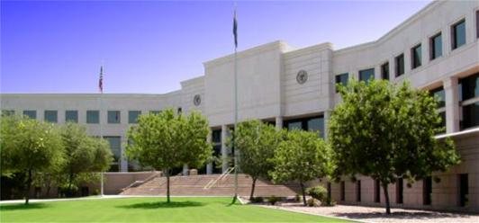
Legislative
Three Branches
Executive
Judicial

Slide 13
RULE OF LAW
DUE PROCESS
EQUAL PROTECTION
GUARANTEED RIGHTS
SEPARATION OF POWERS
CONSTITUTION

Slide 14
Thank you!

