Slide 1


Slide 2
The Bill of Rights
A Refresher
Our Courts Arizona Project. Used with permission of the New Jersey and Florida Law Related Education Associations, Inc.

Slide 3
How many amendments are in the Bill of Rights?

Slide 4
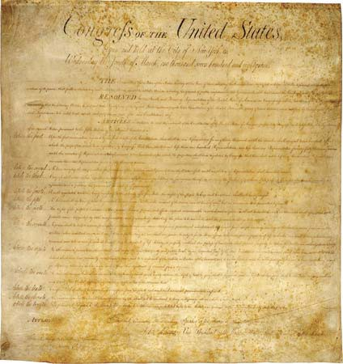
10
Image From: Image From: http://multimedialearningllc.files.wordpress.com/2009/05/bill‐of‐rights.jpg

Slide 5
What are the five rights listed in the First Amendment?

Slide 6

The First Amendment – 5 rights
Freedom of Speech
Freedom of Religion
Freedom of Press
Freedom of Assembly
Right to Petition the Government

Slide 7
What right is listed in the Second Amendment?

Slide 8
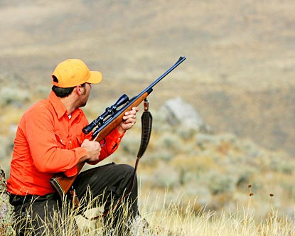
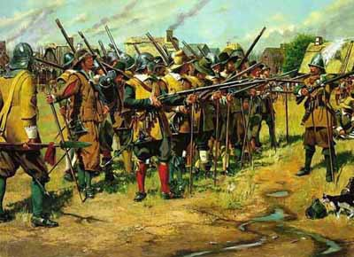

The right of the people to keep and bear arms.

Slide 9
According to the Third Amendment, who is not allowed to be quartered in your house without your consent?

Slide 10

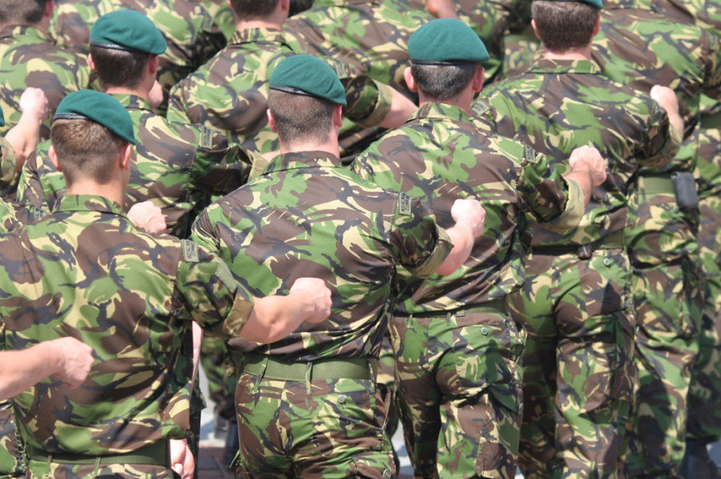
Soldiers
The government cannot force you to shelter soldiers in your home without your consent in time of war or peace.

Slide 11


Rights of the Accused Amendments

Slide 12
According to the Fourth Amendment, in most circumstances, a search and seizure is not permitted without . . .

Slide 13
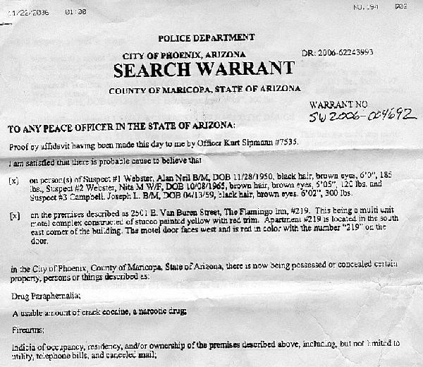
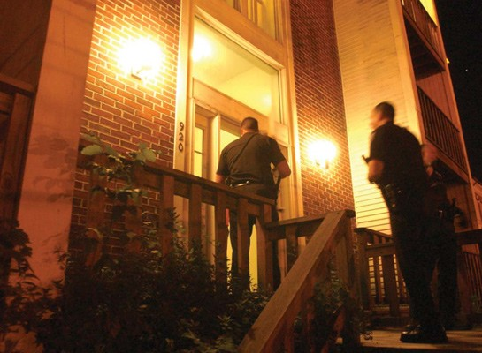
Warrant/Probable Cause

Slide 14
What four principles are part of the Fifth Amendment?

Slide 15
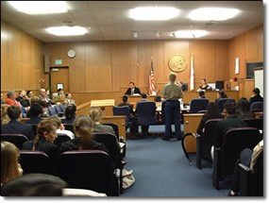
Self Incrimination
Double Jeopardy
Due Process
Eminent Domain

Slide 16
Fifth Amendment
You cannot be tried for the same crime twice—called “Double Jeopardy.”
You do not have to testify against your self. “I plead the fifth” (self incrimination).
You must have due process of law before you are convicted.
The government cannot take your land unless it pays.

Slide 17
What rights relating to a trial are afforded to the people in the Sixth Amendment?

Slide 18
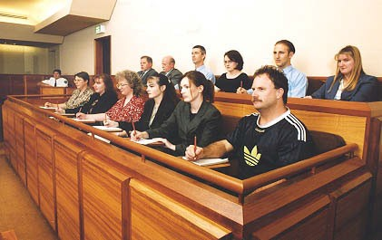
+ Speedy and public trial
+ Impartial jury
+ Informed of the nature and cause of accusation
+ Confronted with witnesses
+ Obtain witness in favor
+ Assistance of counsel
Image From: http://www.co.galveston.tx.us/judgecriss/212th%20DC%20Pictures/jury2.jpg,

Slide 19
The Seventh Amendment guarantees the right to a trial by jury in most cases of this kind…

Slide 20
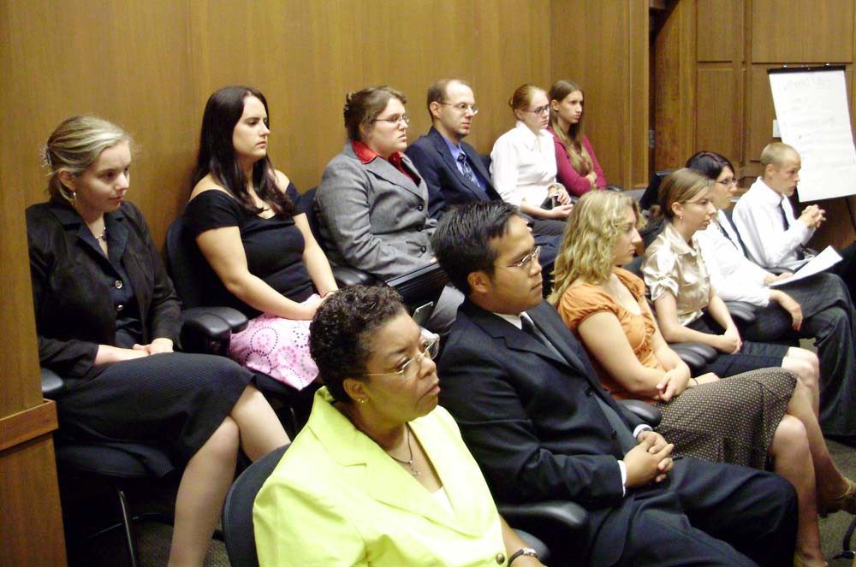
Civil
Image From: http://www.pastfoundation.org/2008Forensics/Updates/July03/The%20jury%20of%20twelve%20good%20people%20and%20true,%20listen%20to%20
the%20evidence%20presented%20by%20their%20colleagues.JPG

Slide 21
What type of punishment is not allowed according to the Eighth Amendment?

Slide 22
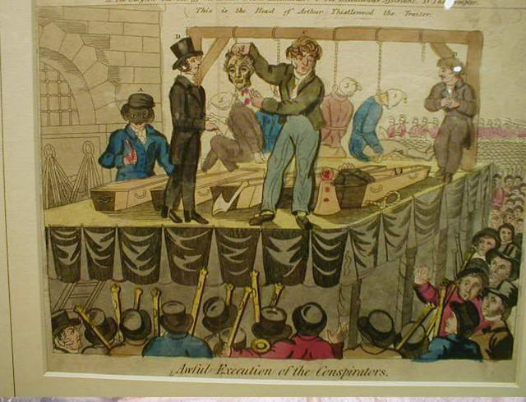
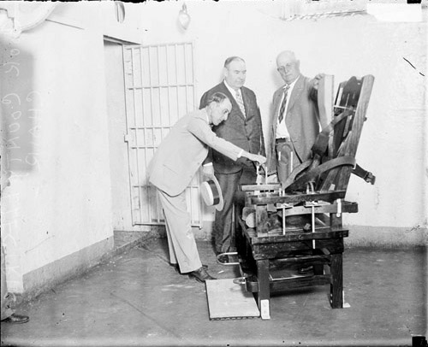
Punishment that is cruel and unusual

Slide 23
Which Amendment states that there are certain rights listed in the Constitution, but that does not mean that there aren’t other rights that the people have that are not listed.

Slide 24
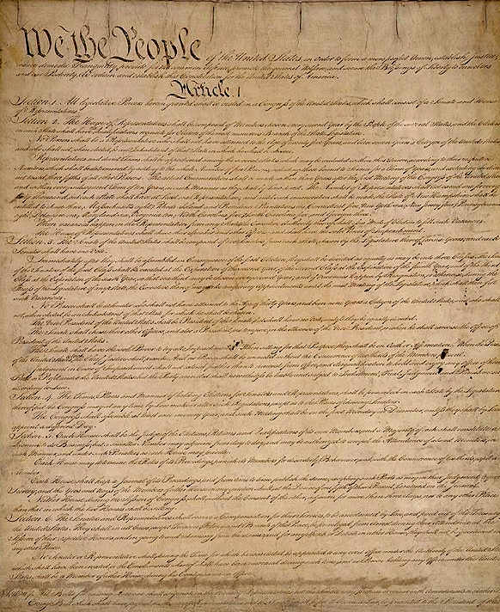
9th
Image From: http://www.newhall.cam.ac.uk/students/mcr/const.jpg

Slide 25
According to the Tenth Amendment, the powers not delegated to the United States by the Constitution are reserved to the . . .

Slide 26

States
Image From: http://www.natural‐law.org/images/states_map.gif

Slide 27
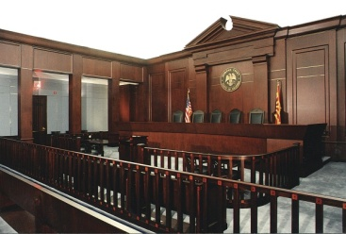
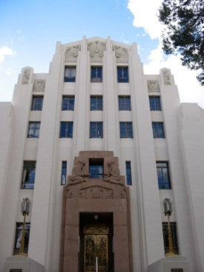
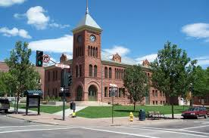
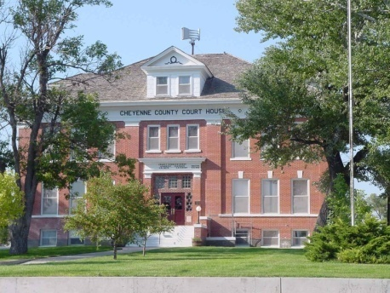
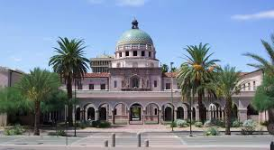
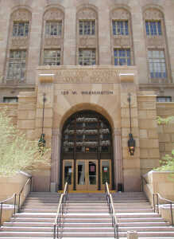

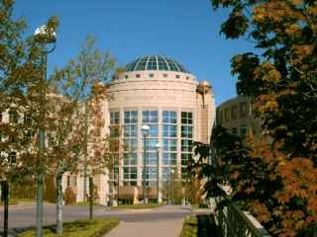
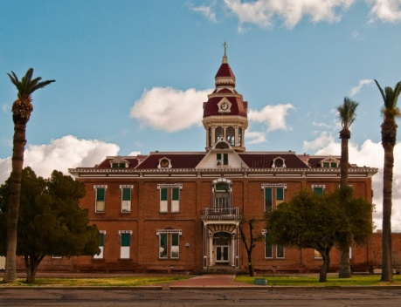
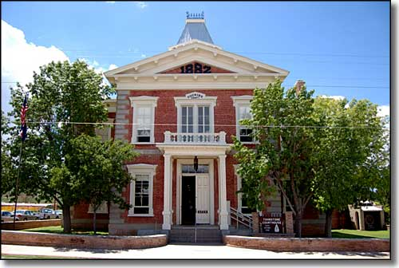
Our Courts
Serving Arizona
Serving Justice

