Slide 1

“An Economic Fresh Start- Bankruptcy Basics”
Notes:
Introduce yourself.
Introduce Our Courts as a joint activity of citizens, lawyers, and judges to provide information to the public about our state and federal courts.
Today’s presentation is about how bankruptcy cases work. In the few minutes we have together, I would like to explore the history of bankruptcy and how it has evolved into the present system. We can then examine the different kinds of bankruptcy cases that can be filed. Lastly, we will identify the basic components of an individual bankruptcy case. When we are through, hopefully you will have a better understanding of how bankruptcy cases work.

Slide 2
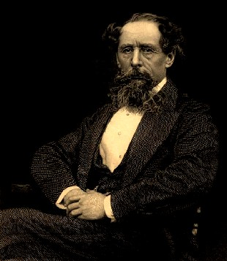
What do these people have in common?
            Charles Dickens
Notes:
Charles Dickens
**

Slide 3
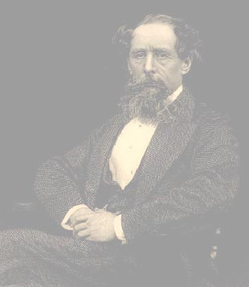

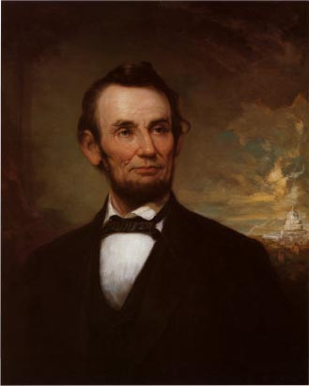
Thomas Jefferson
Abraham Lincoln
Notes:
Thomas Jefferson
**

Slide 4
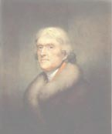
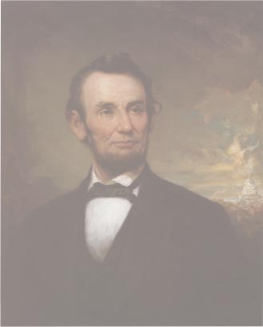
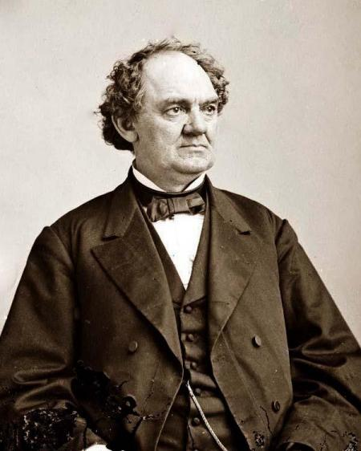
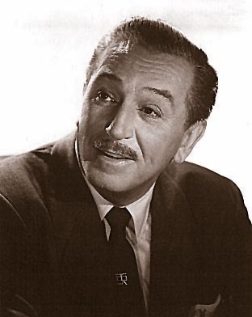
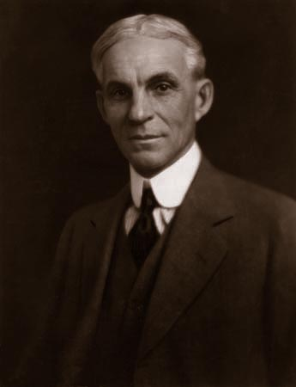
Walt Disney
P.T. Barnum
Henry Ford
Notes:
P. T. Barnum
**

Slide 5
All went through bankruptcy
$
Notes:
At one time or another in their respective lives, they or a company they controlled, all went through bankruptcy.

Slide 6

"Bankruptcy" –
A Broken Bench
Photo by 2010designs
Notes:
The term “bankruptcy” is believed to originate from ancient Latin describing a "broken bench," bancus, the tradesman's counter, and ruptus, broken, denoting one whose place of business was broke or gone. In medieval times, a tradesmen in the square who could not pay creditors' claims literally had his bench broken, which put him out of his misery.

Slide 7
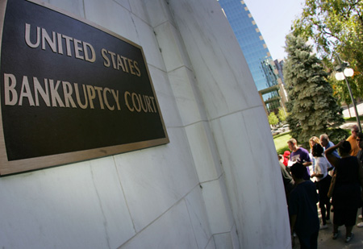
Changing Attitudes
Toward Bankruptcy
□ Historic view:
Moral Shame
□ Modern view:
A “Fresh Start”
Notes:
Historically, the process wasn’t always set up to be helpful to the debtor or the creditor.
Slavery was a popular technique for handling the problem, as were debtor’s prisons. And in Ancient Rome, there were circumstances in which a debtor would be executed and various body parts distributed to his creditors, with the choice parts, whichever those were, going to the creditors owed the most. With apologies to William Shakespeare, creditors were truly given a “pound of flesh.”
Fortunately, the modern view is different. The focus is on giving debtors a “fresh start,” while continuing to be fair to creditors.

Slide 8
Correcting Some Common Misperceptions
Most who seek bankruptcy protection were not
financially irresponsible;
most encountered unanticipated circumstances.
Notes:
At the outset, it is important to correct some common misperceptions about those who seek bankruptcy protection.
First, most who seek bankruptcy protection are not irresponsible people. They are people who have encountered unanticipated and sometimes catastrophic circumstances:
Some just took on too much debt. Maybe they ran up too many credit cards.
Others took on debt and then lost income, which prevented them from paying their debts.
Others faced unexpected circumstances, like a medical crisis with catastrophic medical bills.
And others perhaps trusted others to manage their money, and those others failed badly.

Slide 9
Correcting Some Common Misperceptions
Bad actors cannot escape misdeeds
○ Some obligations not forgiven
○ Penalties for hiding assets
○ Consequences for egregious conduct towards creditors
Filing to delay paying does not work.
Notes:
There is a misperception that bad actors can get away with misdeeds in the bankruptcy process. This is not correct.
Although as I will discuss, many obligations are forgiven in a bankruptcy, certain obligations are not forgiven. For example, if a debtor has been convicted of a crime and restitution is ordered, that order is not forgiven and the restitution must be paid. Likewise, domestic support obligations, such as child support, cannot be forgiven.
If the debtor attempts to hide his or her assets from creditors during a bankruptcy case, it is possible that the result will be the sale of the debtor’s assets with no forgiveness of any of his or her debts. There are also criminal penalties that can be imposed.
Likewise, if a debtor’s actions toward a particular creditor are egregious, it is possible that the Court may find that the debt owed to that specific creditor is not forgiven
And for reasons that I will discuss, filing solely to delay things does not work either.

Slide 10
Goals of Bankruptcy Laws
□ Fair treatment for all creditors:
Equitable payment of claims (based on the type of claim)
□ The “Fresh Start”:
Debtors get a discharge
Notes:
To make all of this less abstract, let’s consider a fairly typical bankruptcy case. Jane and John Doe always dreamed of buying a restaurant. They pooled their life savings and finally realized their dream. They open a restaurant serving the finest in Swiss cuisine. Things worked well for a while, but because of an economic downturn, they have fallen on hard times. Customers stopped coming, and as a result, they cannot pay their lenders, their employees, the people who lease them equipment, the vendors who have sold them food, or their taxes. And so, they talk to a lawyer about filing for bankruptcy protection.
[Divide room into creditors and the restaurant owners. Ask each what they are hoping to achieve, as an intro to this slide]
So, what are the goals of U.S. bankruptcy laws?
Although there are some problems for people who declare bankruptcy, the process is designed to be a helpful one to them and to their creditors:
Fair treatment for all creditors: Prior to a bankruptcy filing, each creditor has the right to take whatever legal collection actions they desire. No consideration for the rights of other creditors. Bankruptcy seeks to treat creditors fairly, based on the type of claims. For example, secured claims (i.e., ones for which collateral has been given, like a mortgage) will be paid before unsecured (i.e., no collateral) claims.
The “Fresh Start”: One of the most important phrases that you may have already heard or undoubtedly will hear in connection with a bankruptcy case is the term “fresh start.” The term refers to the goal of the bankruptcy laws that if the debtor has complied with the Bankruptcy Code’s requirements and has surrendered assets or sufficient future income for distribution to creditors, the debtor is entitled to a new beginning, unburdened by the unpaid balance of many pre-bankruptcy debts.

Slide 11
Most Common Types of Bankruptcy Cases
□ Chapter 13 – Individual Repayment Plans
□ Chapter 7 – Liquidations
□ Chapter 11 – Business Reorganizations
Notes:
So, let’s come back to Jane and John. They have consulted an attorney, and they have decided to seek bankruptcy protection. So, what will their case look like?
If you listen to the news, you have probably heard the terms Chapter 13, Chapter 7, or Chapter 11 proceedings described in connection with a bankruptcy case. Let me give you a brief explanation of what this means.
Bankruptcy law in the U.S. is federal law. This is because our founders were concerned about the risk of inconsistency among the different states. Our U.S. Bankruptcy Code is divided into various chapters. Several of these chapters describe separate forms of bankruptcy. The most common of these are chapters 13 (individual repayment plans), 7 (liquidations), and 11 (business reorganizations). [If asked: Chapter 9 deals with municipal reorganizations like the famous bankruptcy of Orange County, California in 1994, and Chapter 15, which deals with international proceedings].
How Jane and John’s case proceeds depends on which chapter they file their case under.

Slide 12
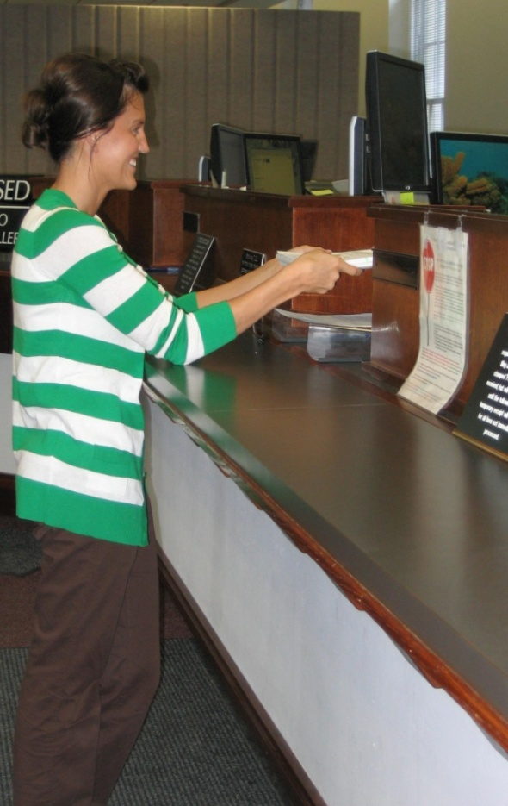
How a Bankruptcy Case is Filed
□ Credit Counseling Course
□ Schedules
○ Assets
○ Debts
Notes:
Let’s assume that Jane and John decide to do a repayment plan under Chapter 13. Chapter 13 cases deal with individual debtors with relatively small levels of debt. How must Jane and John proceed?
There is considerably more to the filing for bankruptcy than filing a piece of paper seeking the protection of the bankruptcy laws.
Before a filing can occur, individual debtors like Jane and John (i.e., not corporations or entities) must go to a credit counseling course, which, in part, explains the pros and cons of filing bankruptcy.
Then, Jane and John must complete schedules and other forms that must be filed with the bankruptcy petition. These 60+ page forms require detailed information from the debtor, including a breakdown of every debt owed and every asset that the debtor may possess.

Slide 13
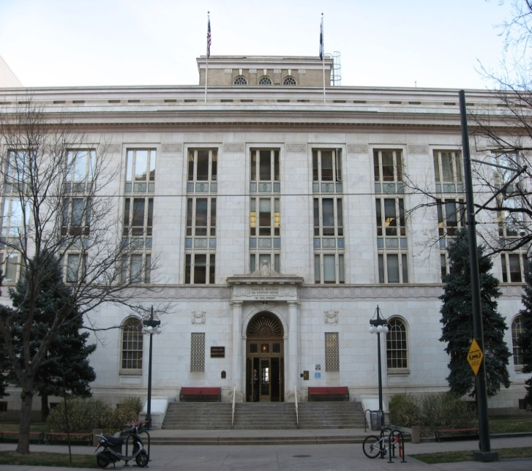
Bankruptcy Cases are Heard in Bankruptcy Court
□ Bankruptcy cases may
involve numerous mini-
trials
□ Accelerated timetable
□ Wide range of size and
complexity
Notes:
It is also important to note that Jane and John will file their case in specialized United States Bankruptcy Court (photo depicts the Customs House in Denver, where our Bankruptcy Court is located).
Jane and John’s bankruptcy case will be somewhat different from lawsuits that are typically heard in courts.
Unlike a typical lawsuit, bankruptcy is a process where one bankruptcy may generate one to several dozen mini-trials involving sometimes dozens of different parties on totally separate disputes, all within the same bankruptcy proceeding.
In bankruptcy cases virtually all proceedings, including trials, are only tried to a Judge. No juries except in very limited situations.
Because a bankruptcy case is a process, speed is critical. It is not unusual to go from the beginning of a case to its closing in 90-120 days. Complicated cases like some major corporate reorganizations can take considerably longer, sometimes up to one or two years to conclude. Still a vastly accelerated timetable when compared to other more general courts.
Cases can range in complexity and size. From a small case involving a young couple to the reorganization of huge corporate concerns such as United Airlines, Enron and Chrysler.

Slide 14
The Participants
□ The Debtor
□ The Creditors
□ The Trustee
□ The Court
Notes:
So, who will be the players in Jane and John’s chapter 13 bankruptcy proceeding? Unlike a typical lawsuit, which involves a very limited number of litigants, a bankruptcy case can involve hundreds of players. The general categories of participants are:
The Debtor – here those are Jane and John
The Creditors – the people to whom Jane and John owe money; in bigger cases, there could be hundreds of creditors.
The Trustee (for purposes of our discussion today, I will play that role) - There are several kinds of trustees that may be involved in a bankruptcy case depending on the type of case that is filed. Duties can range from the gathering of all or most of the debtor’s assets and selling them to raise money to distribute to creditors to supervision of the bankruptcy case to making sure that it is proceeding forward.
The Court – oversees all of the proceedings.

Slide 15

The Automatic Stay
□ All collection
activity must stop
□ Lifting the Stay
Notes:
So, Jane and John have filed their papers in the bankruptcy court, and their chapter 13 proceeding has begun. What happens next?
Well, immediately, something called an “automatic stay” occurs. This stay basically tells the world that all collection activity by creditors against the debtor or his or her property must immediately stop. This means foreclosures cannot be held, lawsuits against the debtor are stopped in their tracks, even if a trial is to start the next day, all collection activities against the debtor, including collection telephone calls must cease.
Creditors can ask that the stay be “lifted” or stated otherwise, that the creditor be allowed to proceed with the previously stayed action. In fact, a motion for relief from the automatic stay is one of the most common forms of litigation in the bankruptcy court.
The process for determining whether relief from the stay is appropriate is placed on a very fast track. Normally, the entire process is completed within 60 days.

Slide 16
How the Chapter 13 Case Proceeds
□ Meeting of creditors
□ Debtor proposes plan
□ Creditors may object
□ Parties try to agree
□ Court may hold hearing
□ Court approves plan
□ Debtor pays per plan
□ Remaining debts discharged
Notes:
So, what happens next for Jane and John.
Approximately 40 days after the bankruptcy filing, a meeting of creditors is held. This is a meeting run by the Chapter 13 trustee at which the debtor is questioned about the reasons behind the filing of the bankruptcy case and details about the debtor taken from the schedules. At the meeting, creditors get the opportunity to question the debtor directly. Most of these meetings are brief and to the point, with very few creditors in attendance.
[ask creditors what they might want to know; ask debtors what they are hoping for at this meeting]
[Walk through rest of slide, describing each event with reference to Jane and John’s case]

Slide 17
Chapter 7 Case – Liquidation
Same initial steps as Chapter 13 Case
Certain assets are exempt
Trustee gathers nonexempt assets
Trustee sells these assets
Trustee pays creditors on a percentage basis
Debts are discharged
Notes:
Now, as I mentioned there are several other types of bankruptcy proceedings. So, what if Jane and John chose to pursue a liquidation under Chapter 7, rather than a repayment plan under chapter 13? What would that look like?
The initial steps (e.g., credit counseling, filing of petition and schedules in Bankruptcy Court, and the automatic stay) are the same.
The basic players are also the same: debtors, creditors, trustee, and court.
In this kind of case, however, the goal is for the trustee to collect the assets and sell them.
[Walk through slide, again continually referring to our hypothetical]
Examples of exempt assets: household goods ($3,000), motor vehicles ($5,000), home ($60,000)

Slide 18
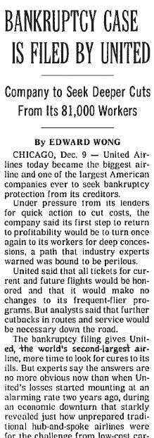
Chapter 11 – Business Reorganizations
□ Plan outlines proposal to pay debts
□ Creditors vote on plan
□ Creditors paid over time
Notes:
Finally, let’s change our hypothetical a little. Let’s assume that Jane and John formed a business entity, perhaps a corporation, to start their restaurant. And, now, the business wants to seek bankruptcy protection. Jane and John’s business might file under chapter 11.
As I have already noted, chapter 11 cases concern business reorganizations. The businesses can be relatively small, like Jane’s and John’s corporation, or they can be huge, like United Airlines and Enron.
In this type of case, Jane and John’s business would file a plan of reorganization that outlines a proposal to repay all or part of the debts that existed before the filing of the bankruptcy case. This plan is voted on by its creditors. If approved by the creditors, then all or part of the debtor’s pre-bankruptcy obligations are paid to the creditors over time as outlined by the plan.

Slide 19
Creditors Have Important Rights
Creditors can:
file a proof of claim
oppose a corporate reorganization
oppose a discharge of a particular debt
oppose a discharge of all debts
undo transactions that favor one creditor over another
Notes:
The slides that I have shown you so far have been focused on the process and on the debtors, but I would like to emphasize the point that bankruptcy proceedings seek to protect both debtors and creditors. Creditors have important rights as well.
[Go through slide].

Slide 20
Some Final Thoughts
□ Bankruptcy is not a cure for all financial ills, but it may be of invaluable assistance to people in need
□ Debtors should consult counsel before filing
□ Creditors should also consult counsel to protect their rights
Notes:
Bankruptcy is not the cure for all financial ills. There are serious ramifications suffered by those who seek bankruptcy protection (e.g., the debtor’s credit rating will be affected, and he or she may have a harder time getting a loan for a car or a house). However, it can be of invaluable assistance to financially troubled individuals and entities.
The decision to file is not easy. Anyone contemplating doing so should speak with a bankruptcy attorney, who can better explain all of the potential pitfalls.
Creditors also must take care to read all of the documents and notices they receive carefully, and they must file whatever documents are necessary to preserve their rights. They also should speak with an attorney to fully protect themselves.

Slide 21
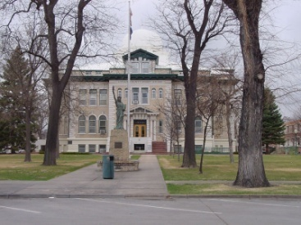

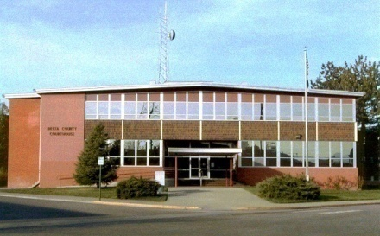
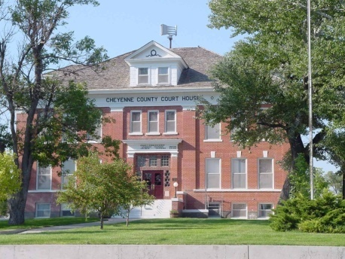

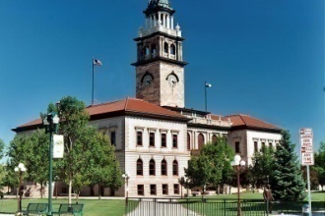

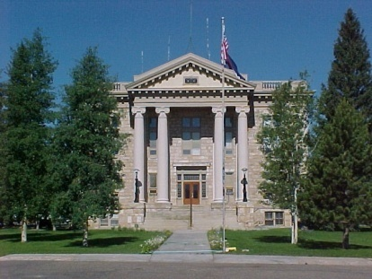

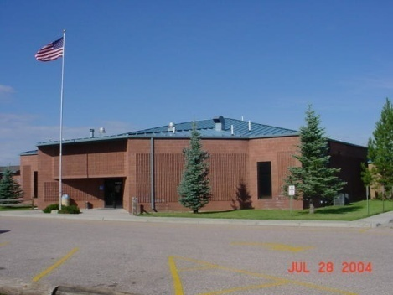
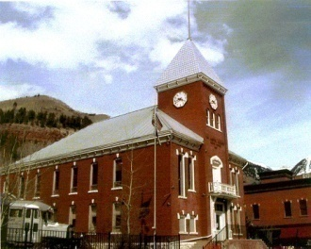
Our Courts
Serving Colorado
Serving Justice

