Slide 1

“Law & Order: The Life of a Criminal Case”
Notes:
Introduce yourself.
Introduce Our Courts, as a joint activity of citizens, lawyers, and judges.
The purpose of Our Courts is to provide information to the public about our state and federal courts.

Slide 2
Law and Order:
The Life of a Criminal Case
Notes:
Today’s presentation is about the state criminal courts in Colorado.
How many of you like crime shows on TV? Most of you understand they’re designed to entertain and not to accurately inform. Today we’ll talk about the reality of life in the trenches of our criminal courts.
How many have served on a jury in a criminal case?
Then some of you already have some familiarity with how a criminal trial actually unfolds. Today, we’ll talk briefly about the events preceding a typical state court criminal jury trial and the main phases of the trial itself.
Let’s look at a hypothetical case.
(NB: Subsequent notes (not on slides) weave in more detail for hypo case to render steps more concrete. Feel free to cut back on details in notes if time constraints do not permit you to use all of them.)

Slide 3
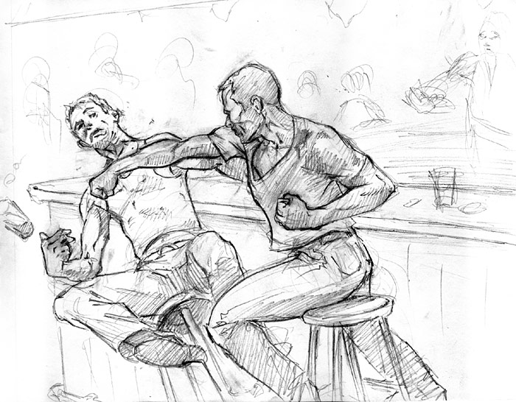
People v. Mr. X
Imagine a typical bar fight case . . .
Notes:
The police are dispatched to a bar. They learn that the alleged victim (V) claims that the defendant (D) intentionally struck him with his fist during a verbal argument and broke his nose. D is arrested at the bar and taken to jail. On the way to jail, a patrol officer, asks the D why he did it. The D mutters, “Well, he started it.”
Let’s talk about how this case would proceed through the Colorado criminal justice system.
First of all, let’s introduce the players.
DISCLAIMERS: Of course, all cases are unique. We are taking one hypothetical situation. What we discuss does not necessarily happen in every case.

Slide 4
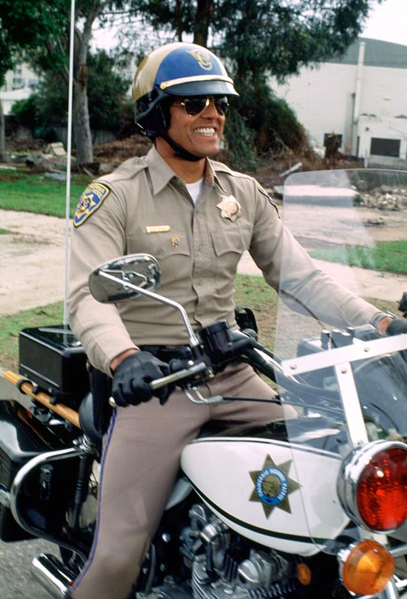
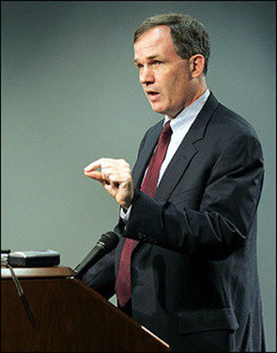
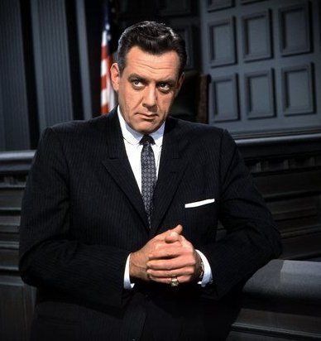
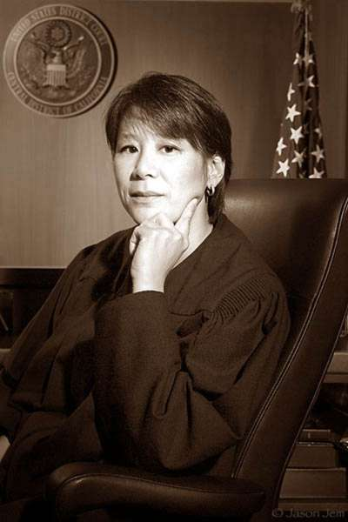
THE PLAYERS
Notes:
Who are the main participants in criminal cases?
Cases are brought in the name of the People of the State of CO against a defendant. Therefore the public and the accused are the parties to the case.
Who are the other players?
The police begin the process by investigating alleged crimes.
The district attorney’s office decides what charges are appropriate and prosecutes alleged offenders.
The defense attorneys protect a defendant’s rights.
The judge serves as a legal referee or umpire.
There’s a critical fifth play here – the jury.
(photos = Eric Estrada, Patrick Fitzgerald, Perry Mason and unidentified judge.)

Slide 5
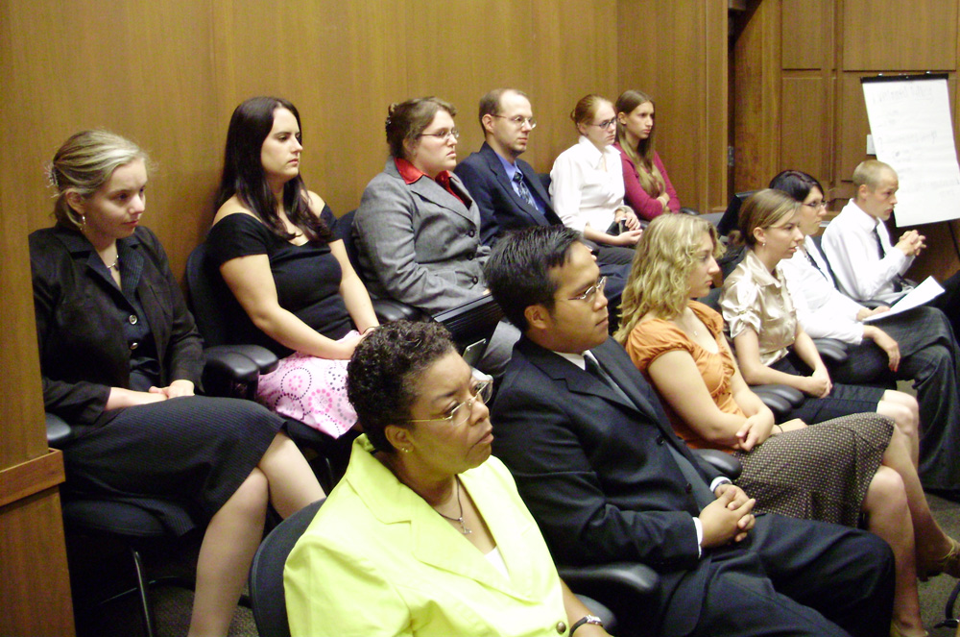
THE JURY:
Notes:
The United States and Colorado Constitutions both guarantee the right to a trial by jury in any case where incarceration is a possible penalty.
The use of jurors to resolve disputes is over 4,000 years old – beginning in ancient Egypt, Greece and Rome, then being formalized in Great Britain by the Magna Carta.
The role of a jury is to consider the evidence received at trial, and determine the quantity and quality of that evidence. They must determine whether the People have proven every element of a charge beyond a reasonable doubt.
In this case, if D is charged with Second Degree Assault, the People must prove the following beyond a reasonable doubt:
1. That the Defendant
2. in Colorado on or about a given date
3. with intent to cause bodily injury to another person,
4. caused serious bodily injury to any person,
5. without having acted in self defense.
So now we have our players and the charge – what is the primary source of law we use to test the charge?

Slide 6
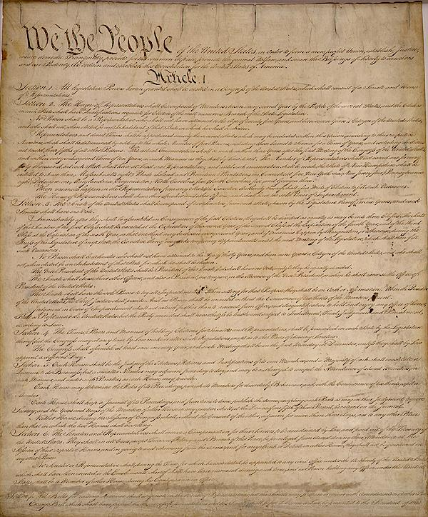
THE CONSTITUTION
Notes:
A Defendant’s rights are set out in the both the United States Constitution and the Colorado Constitution.
Among these rights are:
The presumption of innocence. Because it is the government that makes the accusations, the Constitution requires that the Government prove the case. A defendant has no obligation to say or do anything. This means a defendant also has a right to remain silent.
The procedures we have in place are designed to give life to principles enshrined in the constitution. Let’s talk about those procedures.

Slide 7
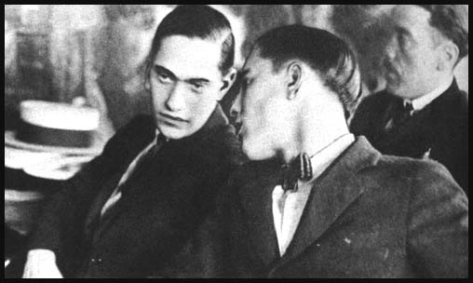
FIRST APPEARANCE IN COURT
Advised of Charges
Advised of Rights
  Appointment of counsel
  Speedy Trial is set
  Right to Jury Trial if imprisonment is an option
  Set Bail
Notes:
Shortly after his arrest, D must be taken to court, so that judge can advise D of his rights (eg, presumption of innocence, right to remain silent, right to counsel, right to jury trial, right to have reasonable bail set, and right to a speedy trial).
If the defendant is in custody or otherwise indigent, then counsel is appointed to D at no cost to him. Typically, this is when the Public Defender’s Office would be appointed to represent a defendant who cannot afford to hire counsel.
The parties then argue bail.
DISCLAIMER: Once again, we are looking at a series of “snapshots”. These issues do not apply equally to all cases, but may apply to our hypothetical. We are using a hypothetical simply to provide context.
(Picture = Leopold and Loeb represented by Clarence Darrow (unpictured in famous trial in 1924)

Slide 8
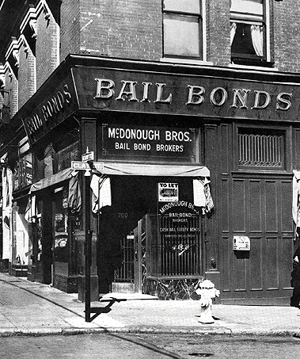
BAIL DETERMINATION
Seriousness of charge
Flight risk
Criminal history
Notes:
So, how do we make sure that people charged with crimes come back to court if we don’t keep them in jail? By setting bail. The vast majority of criminal D’s are entitled to have bail set. The primary purpose of bail is to ensure D’s appearance at future court proceedings.
This slide shows us what trial judges typically consider in setting bail.
Significant factors include (see 16-4-105, C.R.S.):
Seriousness of charge?
Nature of charge (felony, crime of violence)
Likelihood of conviction
Flight risk?
Ties to Community
Residence
Employment
Previous failures to appear
Criminal history?
priors increase flight risk because of possible sentencing consequences
priors heighten concern about danger if D released pending trial
Usually the judge starts the analysis by using a bond schedule (these are amounts at which bonds presumptively set for different kinds of cases)
So, let’s return to our hypothetical.
(Time permitting, you may want to briefly discuss types of bonds: cash, surety and property and the availability of Pretrial Services to supervise while on bond.)

Slide 9
BACK TO OUR HYPOTHETICAL
Notes:
So how does this apply to Mr. X.
D is lifelong Coloradoan, has lived in same place for 10 years, and employed with same employer for 10 years. Question of whether there is self-defense, and eyewitnesses tell different versions of who started the fight. D has 2 prior misdemeanor convictions for simple assault. He has never failed to appear at court. Finally, V sustains a broken nose, but there is a question of whether it is “serious” bodily injury.
Bond schedule might suggest that the presumptive bond for this type of offense is $50,000. On these facts, it would not be uncommon to see bond reduced to $10,000 or less.
Once bail is set, the parties begin to focus on “discovery.”

Slide 10
PROSECUTION DISCOVERY
The People are obligated to provide the Defendant with access to:
Investigation (e.g., reports, photos)
Physical evidence (e.g., fingerprints)
Recordings (e.g., 911 call)
Witnesses’ names and addresses
Exculpatory material
Notes:
The prosecution has an obligation to provide many materials to the defense.
This “discovery” must occur without a request, and no later than 20 days after the defendant’s first appearance in court.
The obligation is continuing. New discovery materials must be turned over automatically.
Exceptions to these rules involve work product, lawyer’s opinions, confidential informant information.
The defense has discovery obligations too – let’s discuss those.

Slide 11
DEFENSE DISCOVERY
The Defense is obligated to provide information to the People:
Non-testimonial Information
Expert Information
Nature of Defense
Notice of Alibi
Notes:
These must occur as soon as practicable, but not later than 30 days before trial.
Non-testimonial information may include: fingerprints, cheek swabs (for DNA), handwriting examples.
In our case, self-defense may be something that the D would claim.

Slide 12
PLEA BARGAINING
Typical considerations of Prosecution
Typical considerations of Defense Counsel
What kind of offense?
Is there a defense?
Is there evidence that should be suppressed?
Does defendant need treatment?
What is the possible sentence?
What kind of offense?
What does the victim think?
What criminal history?
How strong is the case?
Do we have enough resources?
Notes:
As the case continues to move through the criminal justice system towards trial, there is usually some effort to resolve the case through a plea bargain. The overwhelming majority of cases are resolved by plea bargain, rather than by trial. This slides shows us some of the reasons why plea bargaining occurs and helps us understand some of the practical considerations on both sides of the aisle:
In our hypothetical case, imagine the following considerations:
Prosecution
-offense - crime of violence alleged
-victim input (briefly explain Victim Rights Act)
-criminal history – here prior assaults suggest tougher stance (possible incarceration)
-likelihood of conviction – must prove beyond reasonable doubt and here there is a conflict in eyewitnesses and possible defense
-resources – can’t try everybody; can’t incarcerate everybody
Defense
-nature of offense - argument for 3rd degree assault (cartilage displacement vs. boney fracture)
-viable defense – self defense
-potential motions – suppression of statement (Miranda violation)
-mitigation – D good parent and employee who struggles with depression and sometimes drinks too much – amenable to treatment
-risk tolerance – If convicted as charged D facing 5-16 years in prison; significant downside risk for D if convicted as charged
Does the judge get involved? Next slide.

Slide 13
PLEA BARGAINING
The Judge is never
involved in plea negotiations
Notes:
CO strictly prohibits judges from becoming involved in the plea bargaining process. This helps to maintain the judge’s neutrality.
Say plea negotiations fail, what next?

Slide 14

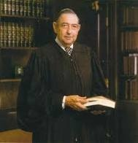
PRETRIAL ISSUES
Constitutional Issues
  E.g., Motion to Suppress Statement
Evidentiary Issues
  Other “bad acts”
Notes:
If efforts to resolve the case by plea bargain fail, then the case typically proceeds to a pretrial “motions hearing” and then to trial.
If the D’s constitutional rights have been violated, the remedy is to prohibit use of the information that was obtained unlawfully.
Suppression issues are often argued before trial at a motions hearing. Here, D might file a motion to suppress the statement he made in the patrol car on the way to jail. He might claim that this statement should be excluded from trial because there was a violation of his Miranda rights.
The DA might also want to use evidence of D’s prior misdemeanor assault convictions. Sometime admissible, sometimes not. Also often argued before trial at a motions hearing.
(Photo = Judge Reynaldo Garza – first Latino federal judge)

Slide 15
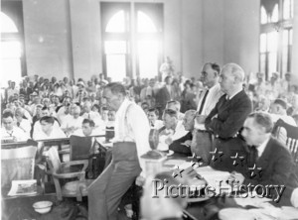
TRIAL
Phases of Trial:
Jury selection
Opening Statement
Presentation of evidence
Instructions of law
Closing Argument
Deliberations and verdict
Notes:
Discuss main stages of trial. Emphasize the following:
Jury selection – trying to find people who can be fair and impartial (explain typical questions if time permits)
Opening Statements – tells the jurors what the evidence is anticipated to be
Presentation of evidence – People present evidence through witnesses and exhibits; D has no obligation, but may do same
The Rules of Evidence dictate what is allowed during trial (only relevant evidence, etc.)
Instructions of law – judge responsible for instructing on law (eg, burden of proof, elements, definitions)
Closing Arguments – lawyers are able to suggest analysis to fit the evidence into the law
Deliberations and verdict – jury retires to jury room and tries to reach unanimous verdict
JURY NEVER CONSIDERS POSSIBLE SENTENCE EXCEPT FOR A DEATH PENALTY CASE

Slide 16

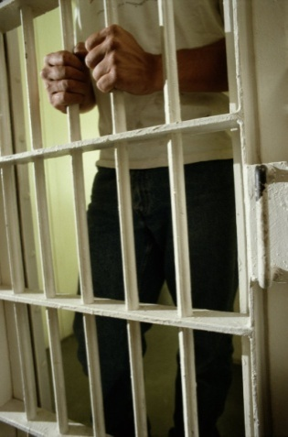
WHAT NEXT?
Not Guilty
  Case is dismissed, Defendant released
Guilty
  Judgment of Conviction
  Sentencing
Notes:
Jury returns a verdict. If not guilty, then the D is released from custody or his bail bond is discharged.
If guilty, then the judge enters a judgment of conviction and sets a sentencing date.
Judge orders the Probation Department to prepare a presentence investigation report (explain).
Judge decides whether there will be a continuation of bail.
Here, imagine the D is found guilty of Second Degree Assault.

Slide 17
SENTENCING
OPTIONS AVAILABLE:
Probation
  Terms and Conditions (Jail)
Community Corrections
Prison
Restitution
Notes:
A presentence investigation report (or PSI) is typically ordered.
Discuss various standard sentencing options on slide. (Even if community corrections not always an option following this type of conviction, discuss anyway to give audience overview of different types of supervision.)
(People may ask about current prison population. CO DOC adult inmate population is 22,777 as of 3/31/10 (excluding those on parole)).*
*(https://exdoc.state.co.us/secure/combo2.0.0/ajax/ajax_nodes_contentPreview.php?id=5035#Adult_Inmate_Population)
Restitution rights of victim – may request that D pay for any expenses that are caused by D conduct

Slide 18
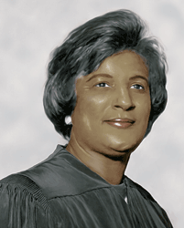
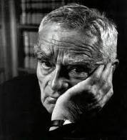
YOU BE THE JUDGE
Nature of the Offense
Potential for Rehabilitation
Aggravating Circumstances
Mitigating Circumstances
Deterrence
Protection of Community
Notes:
(Walk your audience through the considerations here (much as with bond) and ask them what they think the appropriate sentence would be.)
(Class 4 felony. Presumptive sentence 5-16 yr prison + 3 yr mandatory parole.)
(Photos = Judge Learned Hand and Judge Constance Baker Motley)

Slide 19
Appeals
Notes:
The icon at the bottom represents the trial court.
The group of three represents the Colorado Court of Appeals.
The group of seven represents the Supreme Court of Colorado.
The group of nine represents the U.S. Supreme Court.
VERY BRIEFLY Describe the appellate process. Comment that the litigants have an appeal of right to the Colo. Ct. of Appeals,
but that the Supreme Ct. of Colo. and the U.S. Sup. Ct. choose the cases they will hear.
Acknowledge that most cases are resolved in the trial courts and court of appeals, and that few cases are decided by the Colorado Supreme Court.
And even fewer by the U.S. Supreme Court.
The People cannot change the result of a case once it has gone to trial – only a D may do that.
An appeal is based upon the Judge’s rulings on evidence during trial, and also the instructions of law given to the jury.
An appeal is not based on the appeals court “second-guessing” the verdict of the jury.

Slide 20
Our Criminal Courts are Busy
Criminal Cases Filed (2012 statewide)
82,848 in County Courts – misdemeanors
35,551 in District Courts - felonies
118,399 Total Criminal Cases
Notes:
County courts handle misdemeanor cases (eg, DV cases not involving a weapon or SBI and DUI’s).
District courts handle felony cases (everything from possession of drugs to murder).
The difference between felonies and misdemeanors is generally in the sentences available (DOC v. Jail).
Crimes are classified by the legislature.
*This is the total number of state trial court criminal cases in CO in 2012, excluding traffic and juvenile cases. Individual courtrooms usually have hundreds of cases pending before them at any given point in time.

Slide 21
Applying
the Rule of Law
Equally to All
Equal Justice
Fair & Impartial Courts
Notes:
The Theme: Equal Justice
To preserve the freedom of each and every individual, our courts must provide EQUAL JUSTICE.
We do this with
Fair & Impartial Courts
Applying the RULE OF LAW
EQUALLY TO ALL

Slide 22
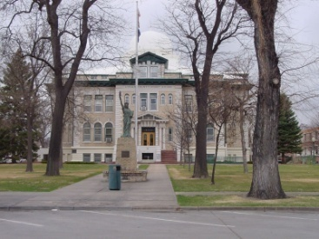
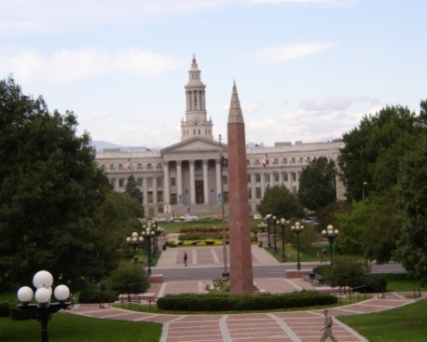
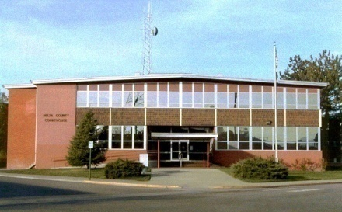
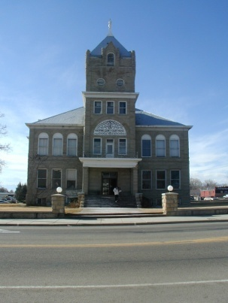
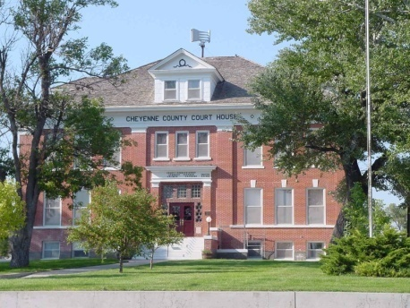
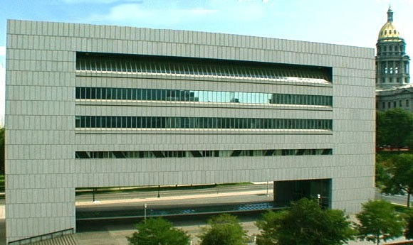
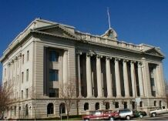
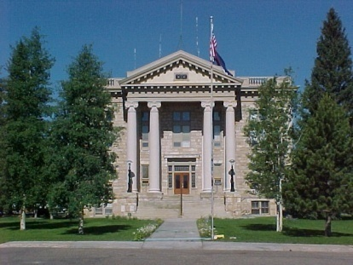
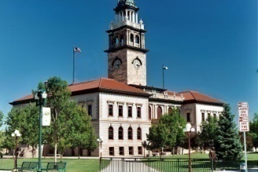
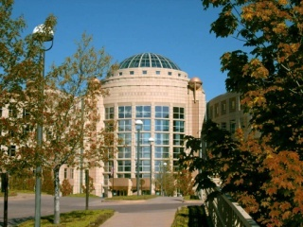
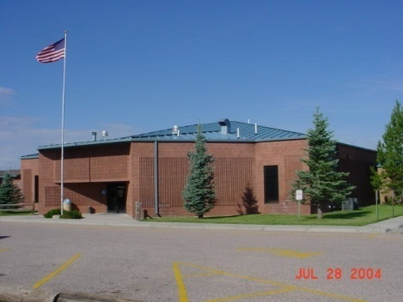
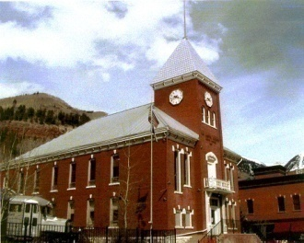
Our Courts
Serving Colorado
Serving Justice

