Slide 1

“Divorce in Colorado Courts”
Notes:
Introduce yourself.
Introduce Our Courts as a joint activity of citizens, lawyers, and judges to provide information to the public about our state and federal courts.
Today’s presentation is about how divorce (NOW KNOWN AS DISSOLUTION) cases work in Colorado. In the few minutes we have together, I would like to explore the differing interests at stake, the issues that need to be addressed in a typical divorce case, the different ways in which divorce cases are resolved, and the ongoing role of the court in divorce cases in this state.

Slide 2

What Is Divorce (Dissolution)?
□ Formal End of a Marriage
○ Unwinding Joint Lives
○ Legal Considerations
○ Practical Considerations
□ Requirements in Colorado
○ Domicile Here for 91 Days
○ Marriage “Irretrievably Broken”
○ 91-Day Waiting Period
□ Divorce in Colorado is “No-Fault”
Notes:
First, it is important to understand what divorce is. Go through slide.
Re legal considerations, divorce terminates the marriage contract and allows each spouse to remarry. In addition, financial matters must be dealt with. For example, assets and debts must be separated so that assets and debts that were once joint become the assets and debts of the separate parties. Likewise, the parties need to deal with tax issues (e.g., who is responsible for what, returns that were once joint now become separate, etc.).
Re practical considerations, the parties must deal with issues like who will take care of the children, where each spouse will live, who will make decisions regarding the children, etc.
Re the domicile requirement, one of the parties must be domiciled in Colorado for 90 days preceding the commencement of the proceeding; re the 90-day waiting period, 90 days or more must have elapsed since the court acquired jurisdiction over the respondent, either through service of process or the respondent’s joining as a co-petitioner or otherwise appearing.
Note for speakers: Although off topic, you may get asked what marriage is. If you do, note that Colorado recognizes both traditional marriage (e.g., ceremony or marriage certificate) and common law marriage (most states do not recognize common law marriage, but Colorado does). Common law marriage requires that the parties hold themselves out as married, have a present intent to be married, and cohabitate.

Slide 3





A Typical Scenario
Notes:
To assist us in discussing what happens in a typical divorce case in Colorado, let’s look at a hypothetical case: Jane and John have decided to divorce. They have two children. Jane and John are both employed full time. John is a computer programmer and makes $75,000 per year. Jane is a nurse and makes $50,000 per year. Both have retirement accounts through their respective employers. They own a home with some equity and a significant mortgage, and they jointly own personal property like cars, furniture, a television set, etc. They also have car loans and a fair amount of credit card debt.
ASK THE AUDIENCE: What are the differing interests at stake here?

Slide 4
The Differing Interests At Stake
□ Husband & Wife
□ Children
□ The Community
Notes:
The different players have differing interests.
Why might the community have an interest? We want people to be able to live as healthy, productive members of society, but when people are going through the divorce process, they frequently are unable to do so. Divorce is highly stressful on all concerned. Children, in particular, often require special attention during this process.
BREAK AUDIENCE INTO GROUPS REPRESENTING THE PARENTS, THE CHILDREN, AND THE COMMUNITY. ASK EACH GROUP WHAT EACH IS CONCERNED ABOUT

Slide 5
Typical Issues In Divorce
□ “Allocation of Parental Responsibilities”
○ Decision-Making (Custody)
○ Parenting Time (Visitation)
□ Child Support
□ Division of Assets & Debts
□ Maintenance (Alimony or Spousal
Support)
Notes:
Go through slide. Let’s look at each of these issues. Ask audience: Why are these issues important to parents? To the community?

Slide 6
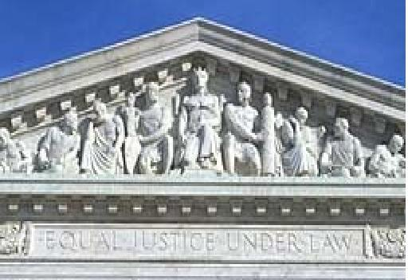
The Role Of The Court
□ The Court Must Approve the Resolution of the
Issues Between the Parties
□ In Doing So, the Court Must Apply the Law
° U.S. & Colorado Constitutions
° Laws Passed by the Legislature
° Decisions of Higher Courts
Notes:
Ultimately, the court must approve the resolution of the key issues that I have described. In doing so, the court must apply the law, including the law as adopted by our legislature and decisions of higher courts.

Slide 7

Parenting Time Considerations
□ Best Interests of the Child
□ Wishes of Parents & Child
(If Child Old Enough)
□ Integration of Child Into
Community
□ Ability of Each Parent to Place
Child’s Needs Ahead of His or
Her Own
Notes:
Parenting time considerations include (but are not limited to) the listed factors. Also, courts consider:
-the relationships between the child, parents & siblings
-the child’s adjustment to his or her home, school & community
-the mental & physical health of those involved
-the distance between the parents’ homes
-the need for frequent and continuing contact with both parents
The current tendency leans toward 50/50 parenting time.
Go through factors, possibly using hypothetical. Ask audience: Why is each factor important?

Slide 8

Decision-Making Responsibility Considerations
□ Health, Education, Religion &
General Welfare
□ Best Interests of the Child
□ Parents’ Past Relationship with
the Child
□ Ability to Foster a Good
Relationship with the Other
Parent
Notes:
Decision-making responsibility can be divided between the parents (e.g., one parent might be authorized to make major decisions regarding health matters, and the other might be authorized to make decisions about religion) or can be placed in one parent.
Go through factors using our hypothetical, if possible. Ask audience: Why is each factor important?

Slide 9


How Child Support Is Determined
□ Child Support is the Child’s Right
□ Child Support Worksheet
° Gross Incomes of Each Parent
° Number of Overnight Visits
° Cost of Health Insurance, Day Care
& Regular Medical Expenses
Notes:
Go through factors using hypothetical if possible. Note that there are child support guidelines that help ensure fair and equal treatment. Both parties have a child support obligation.
In addition, regarding the number of overnight visits, 92 is a magic number. If the parent paying child support has 92 or more overnight visits from the child, then the amount of child support is reduced.
The age of emancipation has been changed by the legislature from time to time. Currently, it is 19. Notably, there is no legal duty to pay for college.

Slide 10

Fairly Dividing Assets and Debts
□ Marital Property
□ Separate Property
□ “Fair & Equitable” Division
Notes:
Go through factors, tying them to hypothetical, if possible.
Note that “marital property” is anything acquired during the marriage except gifts, inheritance, and separate property, or the proceeds from same. Marital property in Colorado also includes any increase in the value of separate property. Joint tenancy property is presumed to be marital property. These rules can be altered by pre-, during-, or post-nuptial agreements.
“Separate property” is anything acquired before the marriage or after the divorce decree. Separate property must be traced carefully.
Marital property is divided fairly and equitably. Factors to be considered include (1) each party’s contributions (including those of a homemaker), (2) the value of separate property, (3) the economic circumstances of each spouse, and (4) sometimes economic “fault” (e.g., one party’s wasting or depleting assets). In general, courts seek to determine what is fair.

Slide 11

Maintenance
□ Maintenance Awards Vary
□ When Courts Generally Award
Maintenance
□ Factors Affecting the Amount &
Length of Maintenance
Notes:
Go through factors using hypothetical. Ask audience: why is each factor important?
Courts generally award maintenance when (1) a party has received insufficient income from the property settlement, (2) the spouse seeking maintenance cannot support himself or herself.
Factors affecting the amount and length of maintenance include (1) the contribution of the spouses to the marriage (including a homemaker’s contribution), (2) the length of the marriage, (3) the age, physical & emotional condition of the spouse seeking maintenance, (4) the parties’ standard of living during the marriage, and (5) specific sources of income.
The parties can contract for a specific amount of maintenance for a specific amount of time.

Slide 12
How Divorce Cases Are Resolved
□ Mediation
□ Collaborative Divorce
□ Private Judge
□ Court
Notes:
The issues in divorce cases do not all get resolved in court, although some do. Other options include mediation, collaborative divorce, and hiring a private judge. The court, however, must approve all out-of-court resolutions.
A lawyer is not required.
Let’s look at how each of those work.

Slide 13
Mediation
□ What is Mediation?
□ Who Participates?
□ How Mediation Works
Notes:
Mediation is a process in which a neutral mediator helps two parties try to find a positive solution through negotiation. The mediator need not be a lawyer and does not have decision-making authority. He or she will determine the issues in dispute and then try to get the parties to compromise. The players in a mediation are:
The mediator – the person who will assist the parties in their discussions
The husband and wife – here, Jane and John
Describe how the mediation process works, using the hypothetical and perhaps having the audience play Jane and John.

Slide 14

Collaborative Divorce
□ Goal: Avoid Negative Atmosphere of
Litigation
□ Parties & Professionals Work as a
Team
□ Parties May Need to Find a New
Attorney if Collaboration Fails
Notes:
Collaborative divorce combines the commitment to settlement, which is at the core of mediation, with a model where lawyers work in association with their clients to negotiate agreements. Collaborative divorce provides the benefits of attorney assistance while avoiding the negative atmosphere of litigation. In a collaborative divorce, each party has his or her own attorney, and all experts are retained as neutrals in the process. Specifically, the parties hire attorneys who represent their interests but who also have been trained in non-adversarial, conflict resolution. Collaboratively-trained coaches (communication specialists, mediators, and/or mental health professionals) are part of the team, as are financial professionals, if needed. In some cases, the team agrees that if the collaboration fails, the parties will hire new lawyers and experts.

Slide 15
Using A Private Judge
□ Why Use a Private Judge?
° Privacy
° Cost
° Quicker Result
□ Who Participates?
□ The Process
Notes:
The parties may choose to hire a private judge. Frequently, this judge is a retired judge.
The use of a private judge keeps the divorce proceedings private. In addition, it is thought that using a private judge results in a quicker and less expensive conclusion of the divorce proceedings.
The proceedings before a private judge are just like those in a court case, only the proceedings occur in a private setting (e.g., a conference room in the private judge’s office), and the procedure is frequently less formal.

Slide 16

Proceeding In Court
□ Petition & Response
□ Mandatory Disclosures/Discovery
Process
□ Initial Status Conference
□ Temporary Orders (If Necessary)
□ Efforts to Settle Before Trial
□ Trial
□ Permanent Orders Issued by the Court
Notes:
Go through slide. Make sure to define temporary orders and permanent orders (i.e., make clear that these are orders relating to the key issues noted before).

Slide 17
The Court Retains Authority Concerning:
The Children
Maintenance (Unless Parties Agree Otherwise)
Enforcement of Orders
(e.g., If Noncompliance)
Notes:
Unlike some types of cases, in which the court’s authority ends when the trial ends, the court retains the authority to deal with issues relating to the children (e.g., parenting time and support) and maintenance. This includes modifying parenting time, decision-making authority, child support, and maintenance, if circumstances change so as to warrant modification of these orders. The court also retains the authority to enforce its orders if one or both parties fails to abide by them.

Slide 18

Our Trial Courts Do Not Have The Last Word
Parties Can Appeal
Adverse Decisions
Notes:
Parties can appeal adverse decisions, and this process helps to ensure that our courts decide cases fairly and impartially and in accordance with the rule of law applied equally to all.

Slide 19
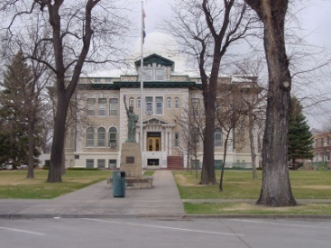
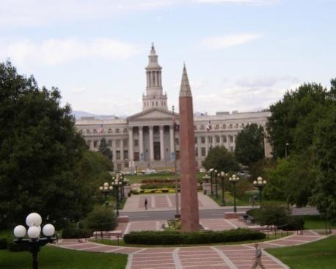
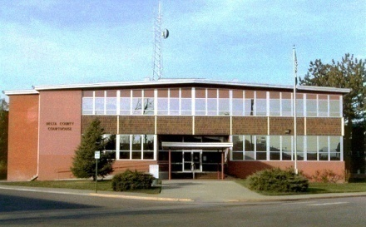
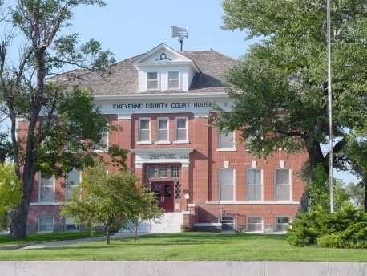


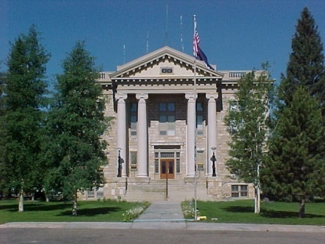

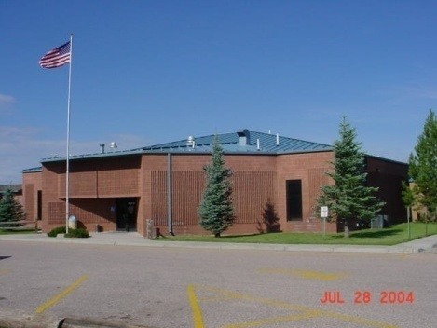
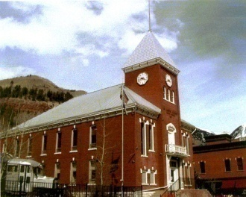
Our Courts
Serving Colorado
Serving Justice

