Slide 1

“Our State Courts”
Notes:
Introduce yourself and Our Courts.
Our Courts is a joint activity of citizens, lawyers, and judges to provide nonpartisan information to the public about our state and federal courts.
****Alert the audience to the materials on the tables.*** Please note that we’ve placed some materials on your tables. There are three different brochures.
The brochure called “Our Courts Serving Colorado” tells you about Our Courts and how to get in touch with us to schedule a presentation.
During the presentation today, I’ll be telling you about various commissions whose work relates to the state court system. The brochure “More Information about Colorado State Courts” tells you where you can get more information about those commissions.
And the brochure called “More Information about United States Courts” tell you where you can get information about the United States Courts.
We value your comments, so we’ve provided evaluations of today’s presentation on the tables. We ask that at least one person at each table fill out the evaluation as the presentation progresses.
*****Talk with the Audience******
How many of you have been called for jury service?
How many have actually served on a jury?
What was your role?
What did you take into account in reaching your decision?
When you were questioned about your qualifications to serve as
a juror, do you remember the kinds of questions you were
asked? What was the purpose of those questions?
Was it to determine if you could be fair and impartial?

Slide 2
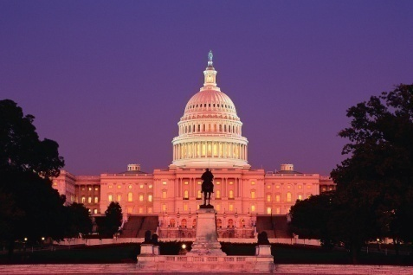
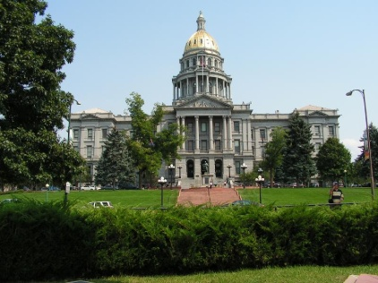

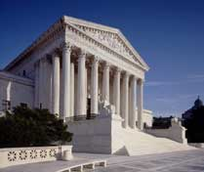
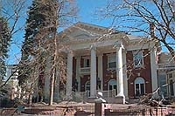

Legislative
Three Branches
Executive
Judicial
Notes:
Orient to 3 Branches
***Orient the audience to the three branches of government***
I’m sure you remember from civics classes that there are
three branches of government.
Legislative
Executive
Judicial

Slide 3
Court Systems
Municipal Courts
State Courts
Federal Courts
Notes:
Orient to 3 Courts
And there are three judicial systems in Colorado:
Municipal Courts
State Courts
Federal Courts

Slide 4
Our State Courts are Busy
Cases Filed—FY 2012
    484,371 -County Courts
    288,877 -District Courts
    1,076 -Water Courts
    2,711 -Court of Appeals
    1,494 -Supreme Court
778,529 Total State Cases
Notes:
Our Focus Today Our State Courts
The state courts are very busy.
In fact, not counting traffic cases, about 94% of all criminal and civil cases filed are filed in the state courts and only about 6% are filed in the federal courts.
Today we will be talking about our state courts.

Slide 5
An Unexpected Event
Walker slips on ice, falls, and breaks a hip.
Notes:
Talk with the Audience
***Establish the hypothetical***
It is three days after a major blizzard.
There is a city ordinance that requires residents to clear their sidewalks within 24 hours after it stops snowing.
Walker is going home after getting groceries.
Walker slips on a patch of ice in front of Castle’s home and breaks a hip.
Walker has surgery to repair the injury and is out of work for several weeks.
Walker knows about the city ordinance and believes that Castle’s failure to do so caused his injury.
About 8 months after the accident, Walker sues Castle alleging negligence.
Castle has difficulty remembering what exactly happened so long ago, but the sidewalks were always shoveled within 24 hours, and suspects that Walker slipped on ice that was created after piles of snow melted onto the sidewalk and then refroze.
Divide the audience into three groups.
Tell one group it is Walker,
the other Castle,
the third, the public.
They are in court,
They can imagine hearing the bailiff say “all rise,” and you (If you are not a judge, you may prefer to describe this as “the judge” ) walk in.
Ask questions to establish the concepts of:
Fairness & impartiality
Equal treatment
Free from improper influences
Some sample questions appear below.
The questions and discussion will set up the transition to the next slide.
Sample Comments & Questions:
The 7th Amendment to the U.S. Constitution guarantees Walker and Castle the right to a trial by jury, and, of course, there will be a judge presiding over the trial.
And, of course, each side wants to win in the end.
But apart from winning or losing, how do you want to be treated Walker? Castle?
Public, do you care how the judge and jury treat Walker & Castle?
Guide the discussion toward what each side expects:
A chance to speak, present evidence
The court to listen, be fair, not favor the other side
Apply the law
QUESTIONS ABOUT FAIRNESS & IMPARTIALITY:
Walker, would it matter if I was a friend of Castle’s?
Castle would it matter if Walker’s lawyer had let me use his condo at Vail?
Public, would it matter if Castle’s insurance company was one of my clients in private practice?
QUESTIONS ABOUT EQUAL TREATMENT
Would it be fair for the court to make a decision based on whether Walker was
a man or a woman?
rich or poor?
Castle came from another continent?
Walker doesn’t go to church?
QUESTIONS ABOUT THE RULE OF LAW
Would it be fair for the court to make its decision based on who the judge likes?
Or based on what the judge thinks what social policy should be?
Why do these things matter?

Slide 6
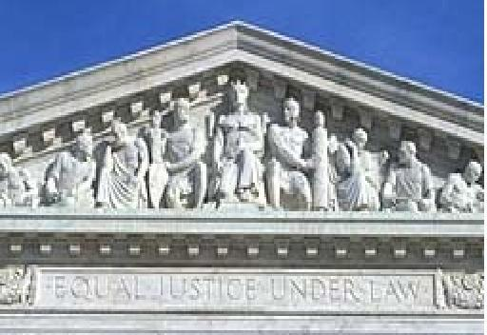
EQUAL JUSTICE UNDER LAW
Entrance to the U.S. Supreme Court
Notes:
A Fundamental American Value: Equal Justice Under Law
This is what it says at the entrance to the U.S. Supreme Court.
This is what our courts have done for more than 230 years, and what they must continue to do.

Slide 7
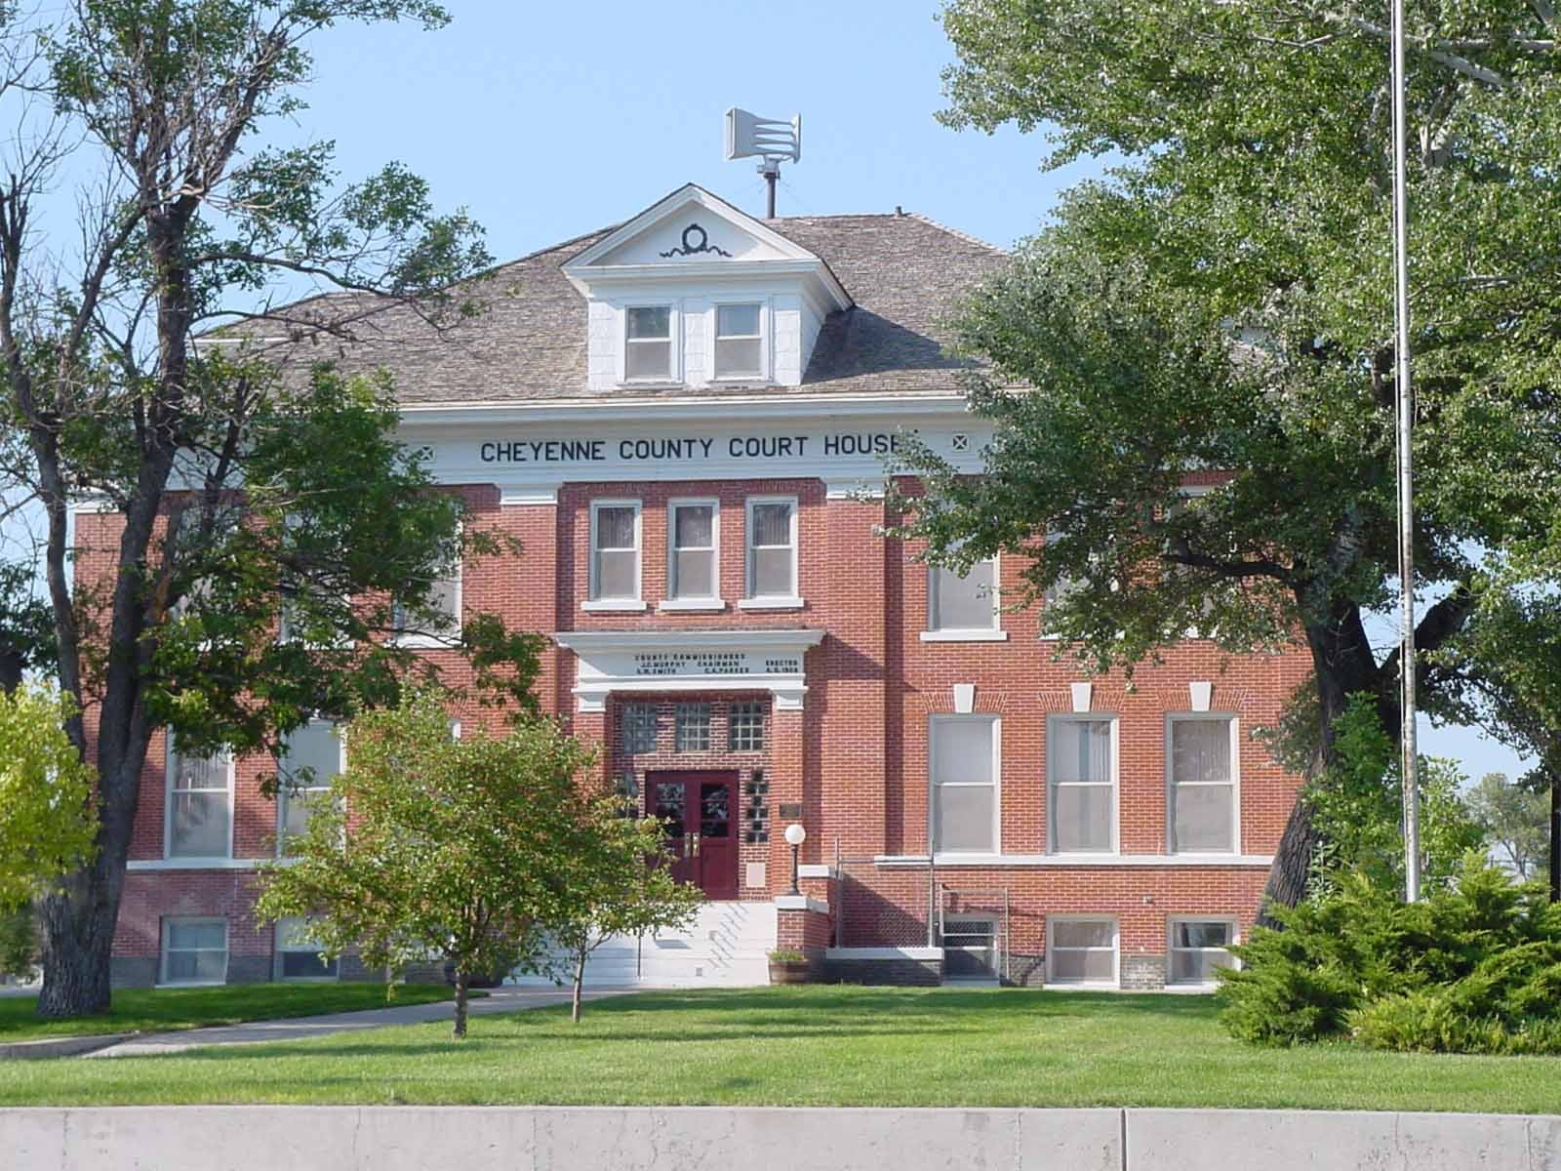
How we keep our courts
fair & impartial
Cheyenne County Courthouse
Cheyenne Wells - 1908
Notes:
Fairness & Impartiality
***The picture is of the Cheyenne County Courthouse in Cheyenne Wells, Colorado.
It was built in 1908****
To have freedom, we must have fair and impartial courts.
Let’s talk about how we ensure that.

Slide 8
Judges Must
Not participate when they have a personal relationship with either party
Not participate in any case in which they have a personal interest in the outcome of the case
Notes:
The Promise of Impartiality
Ask questions that provide examples of relationships that might make it difficult for a judge to be fair and impartial
Some sample questions appear below.
Recall that we talked about whether it would be fair if
I was a friend of Castle’s?
Walker’s lawyer had let me use his condo at Vail?
Castle’s insurance company was one of my clients in private practice?
These are the kind of things that a judge must consider when determining whether he or she can sit as a fair and impartial judge in each case.
Judges must not participate in cases
in which they have a personal interest in the outcome of the case
Not participate when they have personal relationships with the parties

Slide 9
Judges Must
Regularly disclose
their personal financial interests
Notes:
Impartiality
***Ask questions that provide examples of financial interests that might make it difficult for a judge to be fair and impartial***
Some sample questions appear below.
What if the judge held stock in Castle’s company?
To ensure that judges do not sit on cases in which the outcome could affect their financial interests, judges are required to disclose their family financial interests.
Annual disclosures. Family finances & income from performing weddings.
Quarterly disclosures. Honoraria and gifts.
You can find out what any judge’s financial interests are from public records maintained by the Secretary of State.
The brochure called “More Information About Colorado State Courts” tells you how to obtain this information.

Slide 10
“Recusal”
Notes:
Ensuring Impartiality
To remove any question about the fairness and impartiality of the trial, a judge may decide that he or she will not preside in a case. This is called recusal.
If you think the judge won’t be able to treat both sides fairly and impartially?
You can ask that the judge recuse.
***Give an example of an instance in which you, as a judge, or a judge on a case you tried
Disclosed information and asked whether either party thought the judge should recuse
Recused without being asked by a party to do so
Was asked by a party to recuse
***Transition to the judicial disciplinary process by asking questions regarding judicial in-court or out-of-court conduct?
Ask questions like the following:
What if the judge yelled at your lawyer, and, in open court said your lawyer was stupid or dishonest.
What if a judge commits a crime?
What if a judge has a romantic relationship with one of the lawyers appearing before him or her.
What if a judge heard the case and didn’t make a decision for years?

Slide 11
Anyone can
submit a complaint about a judge.
Notes:
Everyone can Help Ensure Impartiality
Anyone can submit a complaint about a judge.
The brochure called “More about State Courts” tells you how to make a complaint.

Slide 12

Enforcing Rules of Conduct
Judicial Disciplinary Commission
Governor
appoints
Chief Justice
appoints
4 Non Lawyers
2 District Court Judges
State Senate confirms
2 Lawyers
2 County Court Judges
Notes:
Enforcing Rules of Conduct
****Take time to explain this slide.***
Complaints about a judges in-court or out-of-court conduct are resolved by the Judicial Disciplinary Commission.
Six of the members are citizens
Appointed by the Governor
Confirmed by the Senate
Four of them are non-lawyers.
Non-lawyers – bring an understanding of how the judge’s conduct affects the community’s confidence in the judicial system
Lawyers - bring an understanding of the effect of the judge’s conduct on parties to lawsuits.
Four of the members are judges who are appointed by the Chief Justice of the Supreme Court.
Judges - bring an understanding of how the judge’s conduct
might affect the judge’s ability to decide cases
impartially affects the quality of the judiciary as a whole

Slide 13
Options
Counsel the judge
Reprimand the judge, privately or publicly
Place the judge on disability status
Recommend to the Supreme Court that the judge be removed from office
Notes:
Response Options
Counsel the judge
Reprimand the judge, privately or publicly
Place the judge on disability status
Recommend to the Supreme Court that the judge be removed from office
The Disciplinary Commission has been in existence for more than 40 yrs:
169 letters of reprimand
25 ordered retired for disability
49 judges resigned or retired during or after disciplinary investigation, perhaps because they knew what the outcome was going to be.
No judge has chosen to be removed from office rather than resign first.
In 2006, 2 judges resigned while they were being investigated.
Although investigations are not public,
Information about how to submit complaints in federal and state courts to be described here and included in the brochure titled “More Information about Colorado State Courts.”

Slide 14
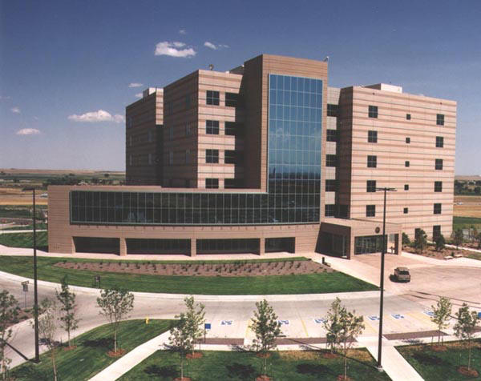
How we decide who
should serve as a judge
Adams County Courthouse
Brighton - 1998
Notes:
Deciding who should serve
***The picture is of the Adams County Courthouse in Brighton, Colorado. It was built in 1998.***
***Ask questions such as the following:
How do we decide who should continue to serve as a judge?
Does it matter to you, Walker & Castle, what qualifications the judge has?
Public, does it matter to you?
Does it matter to you if the judge has, himself or herself, been convicted of a crime?
Does it matter to you whether the judge has paid his or her taxes?
Does it matter whether the judge has a reputation for telling racist jokes?

Slide 15
Colorado is one of 25 states
that uses nominating commissions as part of the
judicial selection process.
Notes:
Merit Selection
For more than 40 years, Colorado has selected its judges based on merit and qualifications.
It is one of 25 states that does so with regard to at least some of its courts. Colorado does it for all county, district & appellate courts. Some states do so only for some courts, some only for trial courts, some for only appellate courts.
Unlike states that elect their judges, a person’s ability to raise money and conduct a campaign is not part of becoming a judge or remaining a judge.

Slide 16
These states
appoint judges based
on comprehensive reviews of applicants’ backgrounds & qualifications.
Notes:
In addition, unlike many states, Colorado judges do not take time away from their duties to raise money and make campaign speeches when the voters decide whether they should continue to serve.
***If you are a judge, tell the audience about your application and selection process using the following slides.
If you are not a judge, describe the process using the following slides and examples you know of. ***

Slide 17

Nominating Commissions
County and District Courts
1 commission in each of 22 judicial districts
Governor
Governor
Attorney General
4 Non Lawyers
3 Lawyers
Not more than 4 from same political party.
Chief Justice
Notes:
22 Trial Court Nominating Commissions
***Take time to explain this slide***
There are 22 judicial districts and each district has its own commission to nominate the judges in that district.
There are 7 citizens on each district commission.
If you do the math, that means that there are 154 citizens [including non-lawyers & lawyers] around the state reviewing applications for judgeships.
Most of the members of each commission are non-lawyers
Governor appoints 4 non-lawyers to each of the 22 commissions – so the Governor appoints a total 88 commissioners.
Governor, Attorney General, & Chief Justice, work together to appoint the lawyers.
Has anyone here ever served on a nominating commission? What was it like?
Anyone can apply to serve on these commissions.
Openings are announced.
The brochure called “More information about Colorado State Courts” contains information about how to contact the nominating commission to find out about and apply to fill openings.

Slide 18
Nominating Commission
Considers the Applications
Reviews the applications
Checks each applicant’s
references & reputation
Notes:
How the Commissions work
They review the written applications
Applicants must list
judges they appeared before and
lawyers they worked against.
The commissioners contact these judges and lawyers to check on each applicant’s legal ability, professional conduct, and reputation.
Applicants also list references, which the commissioners also check.
***If you are a judge, tell an anecdote about your decision to apply or learning about contacts with your former opponents or references.
If you are not a judge and were ever contacted about an applicant, tell about the questions you were asked***

Slide 19
Interviews the
Trial Court Applicants
County & District Courts
Non-voting chair, Assoc. Justice
Notes:
Trial Court Interviews
***If you are a county or district judge, tell the audience what it felt like to walk into the interview room and what the interview was like.
If you are not a judge, ask the audience to imagine walking into a job interview with this many people, but these people have thoroughly investigated your credentials, contacts, and reputation.

Slide 20
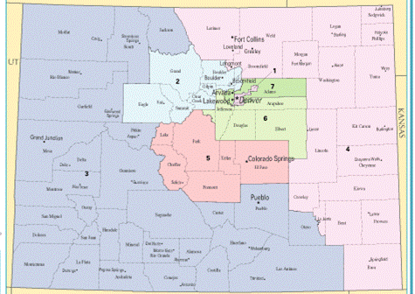

Nominating Commission
Supreme Court & Court of Appeals
Not more than 8 from same political party.
Governor
Governor
Attorney
General
+1 at-large
7 Lawyers
Chief Justice
8 Non Lawyers
Notes:
Appellate Court Nominating Commission
Our appellate courts have statewide jurisdiction. Therefore, the nominating commission for these courts has statewide representation.
15 citizens [non-lawyers & lawyers] on this commission. These are in addition to the 154 citizens already mentioned.
2 from each of the 7 U.S. congressional district
1 at-large
Governor picks 8 non-lawyers
1 from each district
1 at-large
Governor, Attorney General, & Chief Justice, together appoint
1 lawyers from each of the 7 districts
Anyone can apply to serve on this commission.
Openings are announced.
If interested in serving on a commission, there is contact information in the “ More Information about Colorado State Courts” brochure.

Slide 21
Interviews the
Appellate Court Applicants
Court of Appeals & Supreme Court
Non-voting chair,
Chief Justice
Notes:
Appellate Court Interviews
Court of Appeals & Supreme Court
If you are a Court of Appeals judge or a Supreme Court justice, tell them what it felt like to walk into the interview room and what the interview was like.
If you are not a judge or justice, ask them to imagine walking into a job interview with this many people, but these people have thoroughly investigated your credentials, contacts, and reputation.

Slide 22
The commission nominates
at least two, and
not more than three applicants,
whose names
are sent to the Governor
Notes:
Nominations
The commission nominates at least two and not more than three applicants, whose names are sent to the Governor
This pertains to trial and appellate judges.
***If you are a judge, tell an anecdote about how you were appointed.
If you are not a judge, tell about involvement you have had in the nomination process.
Otherwise, simply describe the Governor’s screening process as shown in the following slides.

Slide 23
Governor’s Office
Checks state and federal agency records to ensure no violations of law.
  Solicits and receives information
  about each applicant.
  Typically interviews each applicant.
  Appoints one.
Notes:
Governor Thoroughly Screens the Nominees
Governor’s office checks state and federal agency records to ensure no violations of law.
Solicits and receives information about each applicant.
Interviews each of applicant.
Appoints one.
***If you are a judge, tell the story of your appointment.
If you are not a judge, describe the process.
All speakers emphasize that this selection process ensures that those who are selected to serve as our judges have:
integrity
experience and knowledge of the law
are committed to
the rule of law
fair & impartial application of law
equal justice for all

Slide 24
The Oath
Each judge swears an oath
to support the Constitution of the United States and of the State of Colorado, and
faithfully perform the duties of Judge.
Notes:
A Solemn Oath
I swore an oath
to support the Constitution of the United States and of the State of Colorado, and
faithfully perform the duties of Judge.
***If you are a judge, tell:
How you felt when you took the oath,
What the oath means to you
How the oath affects the way you approach your work.
If you are not a judge, talk about the meaning of the oath.
***All speakers, emphasize that judges are public servants,
who serve the law and the community.

Slide 25
Initial Term of State Judges
All state court judges must serve a provisional term of two years.
The voters then decide whether the judge or justice continues to serve.
Notes:
First Term is Provisional
State court judges are not appointed for life.
The first term of all state court judges is provisional, which means that they serve for not less than two years and not more than four years before the voters decide whether the judge should continue to serve.
How we decide whether a judge should continue to serve.
The point here is that after the appointment process, there is a period of at least two years and not more than four years during which the judge can be evaluated.
Then the citizens can decide whether to allow the judge to continue to serve or to require the governor to appoint a someone else.

Slide 26
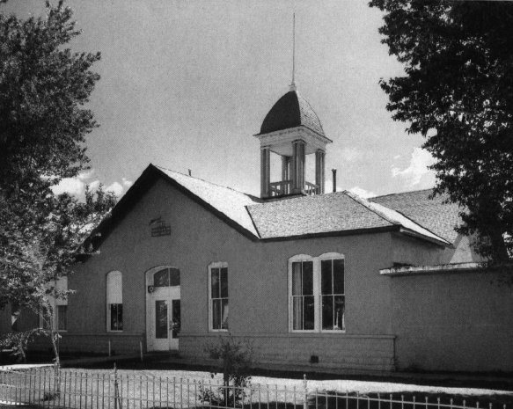
How we decide whether a judge should continue to serve
Costilla County Courthouse
San Luis – 1886
The oldest courthouse
still in use in Colorado
Notes:
Deciding who should continue to serve
***The picture is of the Costilla County Courthouse in San Luis, Colorado. It was built in 1886, and is the oldest Colorado courthouse still in use.***
Ask questions such as the following:
What if the judge is unable to keep up with the court’s work?
What if the judge demonstrates a terrible temper in the courtroom?
What if the judge routinely shows favoritism to one type of party, such as plaintiffs or corporate defendants?
(If these questions sound familiar, it’s because we have already discussed them in the context of the disciplinary process.)
On the other hand, what if a judge is fair & impartial, and makes decisions based on the law?
And it’s appropriate that citizens consider all these conduct & performance issues when we decide whether a judge should continue to serve.

Slide 27


Judicial Performance Commission
Reviews the Performance of Every Judge
2 Non Lawyers
2 Non Lawyers
1 Lawyer
1 Lawyer
Governor
appoints
Chief Justice
appoints
1 commission in each of 22 judicial districts
1 statewide commission
for court of appeals and supreme court
1 Non Lawyer
1 Non Lawyer
1 Lawyer
1 Lawyer
Senate
President
appoints
House Speaker
appoints
Notes:
Make-up of the Performance Commissions
Once again, there is a separate commission for each of the 22 judicial districts and one more for the two appellate courts.
Each commission has 10 citizens. So if you do the math here, there are an additional 230 citizens [non-lawyers & lawyers] around the state who review the performance of our judges.
Like the nominating commissions, the performance commissions are comprised primarily of non-lawyers.
The performance commissions are appointed by all three branches of the state government.
Anyone can apply. If you’re interested in serving on a commission, there is information in the handout about how to apply.
The commissions must evaluate each judge at least twice during the judge’s term of office. Once in the last year of the judge’s term, when voters will have the chance to vote whether the judge should continue to serve, and once in the interim between the start and the end of the judge’s term. The state created the requirement for an interim evaluation in 2008.

Slide 28
Performance Criteria
Integrity
Knowledge and understanding of the law
Judicial demeanor
Equal treatment of all parties
Notes:
Performance Criteria
Integrity
Knowledge and understanding of the law
Judicial demeanor
Equal treatment of all parties

Slide 29
Sources of Performance Information
Litigants & Lawyers
Other judges
The Public
Case Statistics
Unannounced Visits
Commission’s interview of the judge
Notes:
Where the commissions get their information
Sources of Performance Information
Litigants
Including interviews of agency officials
Lawyers
Including a presentation from the local District Attorney
Other judges
Including a presentation by the court’s Chief Judge
The Public
Case Statistics
Unannounced visits
Commission members are expected to observe the judges they evaluate while the judges perform their courtroom duties
Questionnaires
Each judge being evaluated is required to fill out a questionnaire and identify his or her judicial strengths & weaknesses
Interviews
Each judge being evaluated appears before the commission and is asked questions about his or her performance.

Slide 30
Public Information
About Judges’ Performance
Reports are available on the Internet:
www.coloradojudicialperformance.gov
Notes:
Where to find more information
The website is in the brochure labeled “More Information about Colorado State Courts”

Slide 31
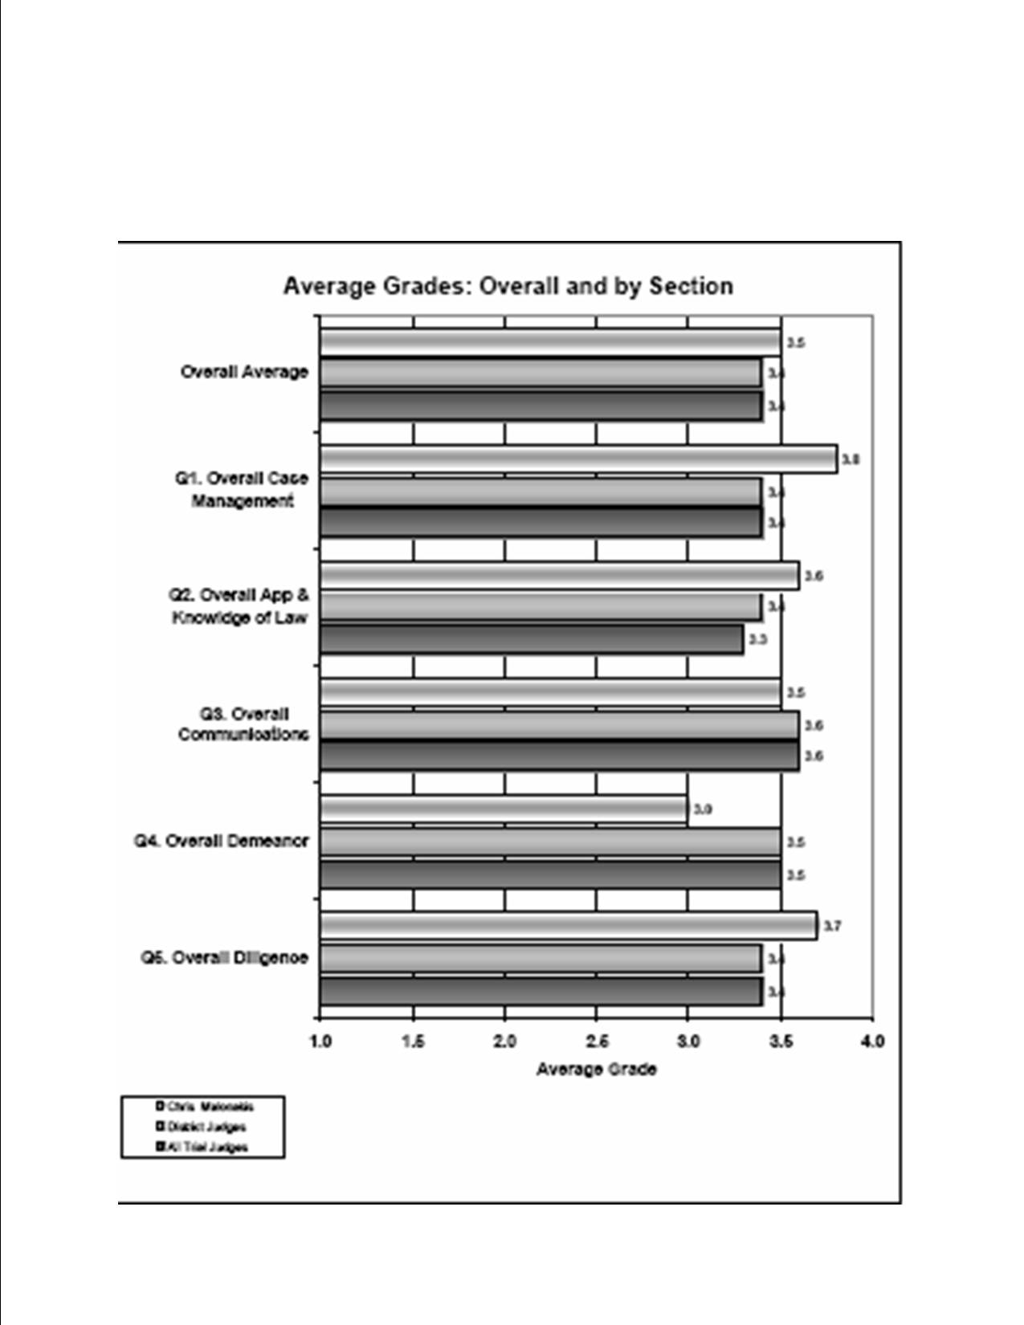
Public Information
Complete
Performance
Report
Often as many
as 90 pages long.
Notes:
You can get a lot of information about the judges
Questionnaires are sent to
litigants, lawyers, and jurors,
asking them to grade each judge as to performance criteria related to the judge’s
case management
knowledge of the law
communications
demeanor
diligence
bias
appropriateness of criminal sentences
Attorneys are asked to grade each trial judge regarding
41 performance criteria.
Litigants are asked to grade trial judges on
21 performance criteria.
The report provides the answers to these questions and graphs comparing the judge to other judges.

Slide 32

Public Information
One-page
summary of commission findings printed in
Blue Book
Including a
recommendation
to retain or
not to retain
the judge
Notes:
And a recommendation from a
bi-partisan commission
of fellow voters in your area

Slide 33
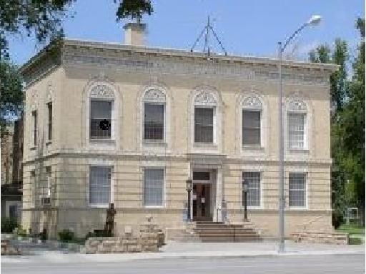
Our Courts Must Apply the Law
Baca County Courthouse
Springfield - 1930
Notes:
The Rule of Law
***The picture is of the Baca County Courthouse in Springfield, Colorado. It was built in 1930.***
Ask questions such as the following:
Walker & Castle, on what basis will your case be decided?
Should the judge decide the case based on his or her own beliefs as to what is fair?
For example, Castle, should the court be influenced by statements Walker’s lawyer makes to the press?
Public, should the court be influenced by the fact that Castle has a lot of power and influence in the community?
Walker, should the court be influenced by the fact that there is a lot of public interest in the case, indeed there is newspaper and TV coverage?
***The audience should conclude that the decision should be based on the law and the evidence.
The next question transitions to the next slide
Where does the law come from?

Slide 34
Our Courts Must Apply
U.S. & Colorado Constitutions
U.S. & Colorado Statutes
U.S. & Colorado Agency Regulations
Colorado Rules of Procedure
Colorado Rules of Evidence
Notes:
The Rule of Law
Trial courts must follow the
U.S. Constitution
Colorado Constitution
Applicable federal laws
State laws
State rules of procedure & evidence
AND

Slide 35
Decisions of Higher Courts
U.S. Supreme Court
Colorado Supreme Court
Colorado Court of Appeals
Notes:
Past Decisions of Higher Courts Control Many Court Decisions
Trial courts must apply these laws as they have been interpreted by the decisions of higher courts.
***Start with the court on which you sit or the court before which you usually appear and explain that the court at your level must apply the law as it has been interpreted by all higher courts, each of which is bound by the interpretations of the courts above it.***

Slide 36
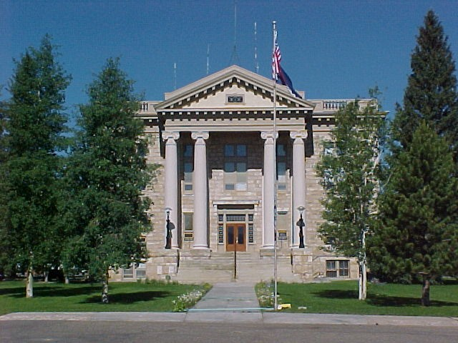
Our Trial Courts
Do Not Have the Last Word
Jackson County Courthouse
Walden - 1913
Notes:
Court decisions are subject to review and correction
***The picture is of the Jackson County Courthouse in Walden, Colorado. It was built in 1913.***
Ask questions such as:
Walker & Castle, what can you do if you lose the case and you think the court was wrong, either in the way it handled the case or in the decision?

Slide 37
Appeals
Notes:
The Appeal Process
The icon at the bottom represents the trial court.
The group of three represents the Colorado Court of Appeals.
The group of seven represents the Supreme Court of Colorado.
The group of nine represents the U.S. Supreme Court.
Describe the appellate process. Comment that the litigants have an appeal of right to the Colo. Ct. of Appeals,
but that the Supreme Ct. of Colo. and the U.S. Sup. Ct. choose the cases they will hear.
Acknowledge that most cases are resolved in the trial courts and court of appeals, and that few cases are decided by the Colorado Supreme Court.
And even fewer by the U.S. Supreme Court.
Since 1996, the U.S. Supreme Court has accepted and rendered opinions in only two appeals from cases decided in the Colorado Supreme Court.
(Romer v. Evans - Amendment 2; and
Colorado v. Hill – state statute on bubble zone around health clinics.)

Slide 38
Applying
the Rule of Law
Equally to All
Equal Justice
Fair & Impartial Courts
Notes:
The Theme: Equal Justice
To preserve the freedom of each and every individual, our courts must provide EQUAL JUSTICE.
We do this with
Fair & Impartial Courts
Applying the RULE OF LAW
EQUALLY TO ALL

Slide 39
Select the best
to serve as judges.
Nominating Commissions
select the best to serve.
Ensure Compliance
with
Judicial Code of Conduct
Disciplinary Commission
enforces conduct
& performance standards.
Our Courts
Ensure that Judges
are fair & impartial
Judges are required to
disclose their personal finances
and to recuse.
Ensure that judges
conduct proceedings fairly
& apply the Rule of Law
Appellate courts review
trial court decisions.
Notes:
How Colorado Ensures Equal Justice
To ensure equal justice here in Colorado, we strive to:
Select the most qualified individuals to serve as judges
And we do this through nominating commissions, each of which has a majority who are not lawyers.
Ensure that judges comply with a Judicial Code of Conduct and are diligent in the performance of their duties
We do this through a disciplinary commission
Ensure that judges are fair & impartial
One mechanism we have of identifying possible sources of partiality is to require judges to disclose their personal finances and make those disclosures available to the public.
Another is by allowing judges to remove themselves from cases in which their impartiality might be questioned.
Ensure that judges correctly apply the Rule of Law
To do this those who have cases are permitted to apply their cases and have them reviewed by a panel of three judges, and, in some cases, as many as ten judges.

Slide 40
Voters decide whether
each judge
should continue to serve.
Performance Commissions
review the performance
of all judges.
Notes:
Voters Decide Who Will Continue to Serve as a Judge
And within four years after the Governor appoints a judge,
a performance commission composed of voters from the community that the judge serves
conduct a thorough review of the judges performance
Issue a lengthy report addressing more than 30 performance criteria
Make a recommendation about whether that individual should continue to serve as a judge
And the voters then decide whether that individual should continue to serve or whether the Governor should be required to appoint someone else.
There are more than 400 citizens around the state who sit on the various disciplinary, nominating, and performance commissions that ensure the quality of our courts.
And, ultimately, many thousands of citizens like yourselves ensure that our courts are fair & impartial.

Slide 41
Our Voters Ensure
Our Courts
serve all of us . . .
fairly & equally.
Notes:
Voters Ensure Our Courts are Fair & Impartial
Thus, it is up to each and every one of us to ensure that we have courts that serve everyone fairly and impartially.

Slide 42
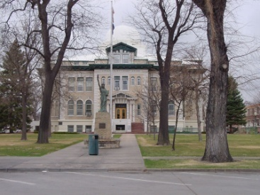
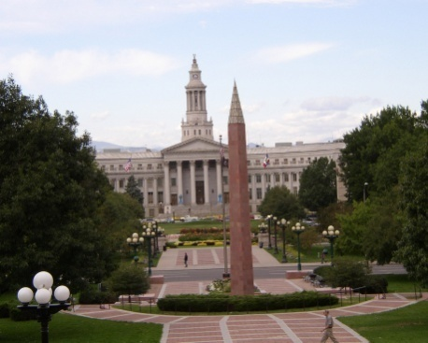
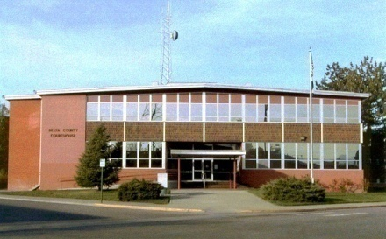

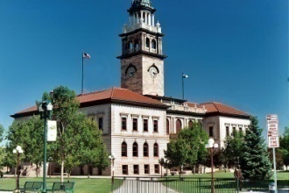
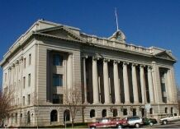

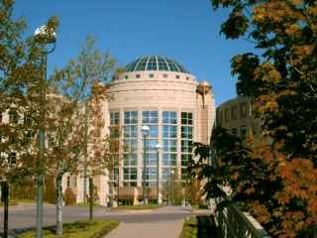
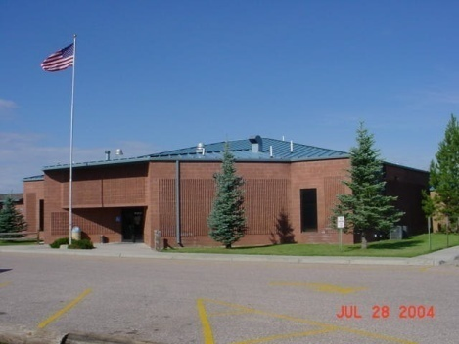
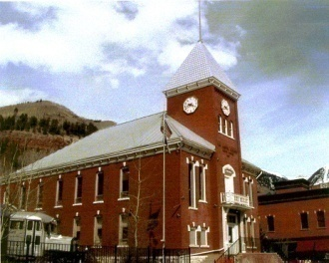
Our Courts
Serving Colorado
Serving Justice

