Slide 1

“Our United States Courts”
Notes:
Introduce yourself.
Introduce Our Courts: Our Courts is a joint activity of citizens, lawyers, and judges to provide information to the public about our state and federal courts.
Ask the Audience:
Have you heard the expression, “Don’t make a federal case out of it”? How about, “I’m going to take my case all the way to the Supreme Court”?
It may surprise some of you to hear that most cases are in the state court system and not in our federal court system. It isn’t easy to make a federal case out of something, and it is very rare to get a case to the Supreme Court.
Our goal today is to introduce you to our federal courts in Colorado
We’ll start by discussing our two parallel but separate government systems (federal and state), and we’ll explore how our federal courts fit in that structure.
Next, we’ll talk about how our federal courts themselves are structured and the types of cases they hear.
We’ll then talk about how U.S. Judges are selected and how long they serve.
And we’ll end by talking about the many ways that we keep our U.S. Courts fair and impartial.
When we are done today, I feel confident that you will all leave here with a better understanding of our U.S. Courts.

Slide 2
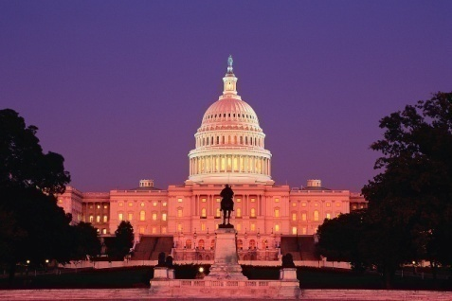
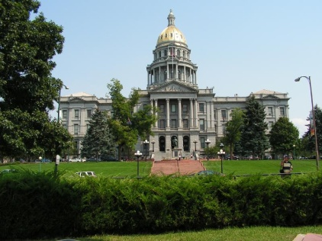

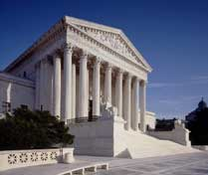
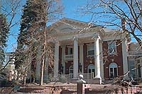
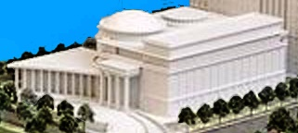
Legislative
Three Branches
Executive
Judicial
Notes:
I’m sure that you all remember that there are three branches of government
Legislative
Executive
Judicial
These are photos representing those branches in both the federal and the state systems.
This slide also makes an important point that underlies much of what we will be discussing today:
We are governed by two parallel but separate government systems.
The states have their own government system, represented by the photos of our Colorado capitol, governor’s mansion, and Supreme Court building.
And the federal government has a completely separate governmental system that governs us.
When people hear about courts, they may think of one system of courts. There are really two, the state court system and the federal or U.S. court system.
Today, I will be talking about our federal or U.S. courts, and, particularly, our Colorado federal courts.

Slide 3
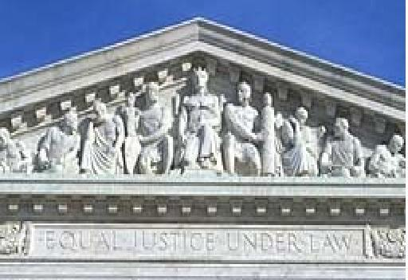
EQUAL JUSTICE UNDER LAW
Entrance to the U.S. Supreme Court
Notes:
Equal Justice Under Law: This is what it says at the entrance to the U.S. Supreme Court.
This is what our federal courts have been doing for more than 230 years and must continue to do.

Slide 4
Our Dual Court System
United States Supreme Court
Colorado Appellate Courts
U.S. Courts of Appeal
Colorado District (Trial) Courts
U.S. District (Trial) Courts
Notes:
I mentioned that there are two separate governmental systems, one state and one federal.
This dual government system applies to the courts, as well as the legislative and executive branches.
This is a simplified chart showing an overview of our dual court system.

Slide 5
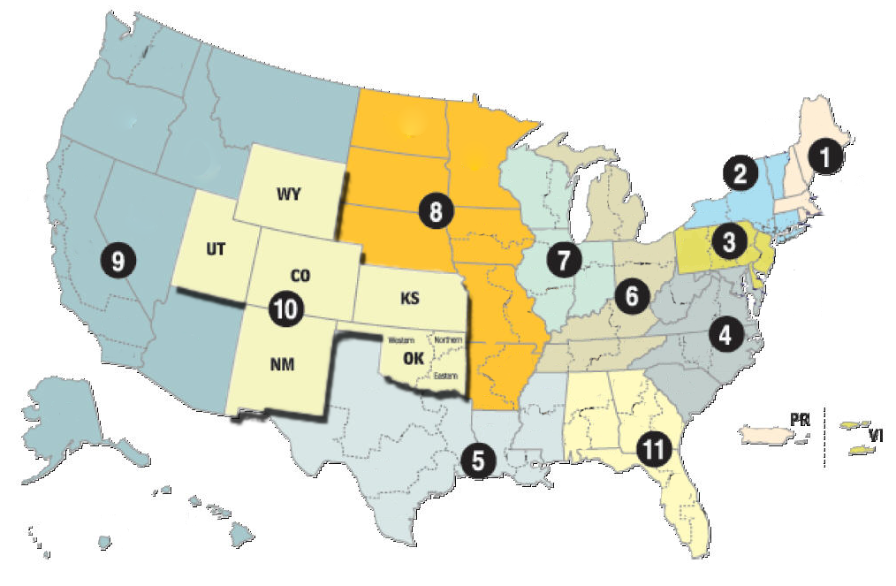
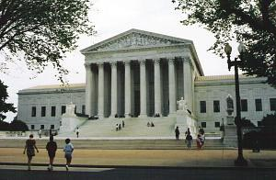
United States Supreme Court
13 United States Courts of Appeal
94 United States Districts
Notes:
This map shows how the 3 tiers of our federal courts fit together.
Has anyone sat on a jury in a state court case? What kind of case? [establish civil and criminal].
So, state court cases hear civil and criminal cases. State courts also review decisions by state administrative agencies (motor vehicle, worker’s compensation).
So what is the difference between the U.S. Courts and the state courts, in this dual government structure that we have?

Slide 6
Colorado State Courts
can hear a wide variety of cases.
Federal Courts
can hear only certain types of cases:
Federal Law
Disputes Between States
Between People from Different States
Notes:
Colorado state courts have general jurisdiction. they can decide almost any kind of case: negligence, contract disputes, DUI, etc.
U.S. courts are limited in the cases that they can decide.
Cases involving federal law. Can anyone think of some examples? (U.S. constitution, copyright law, etc.)
Cases between states or people from different states. Can anyone think of why this might be important? (Avoid hometown bias).
So, would our Colorado federal court be likely to deal with a traffic ticket? A car accident between two Coloradans?
So, what kinds of cases do federal courts hear?

Slide 7
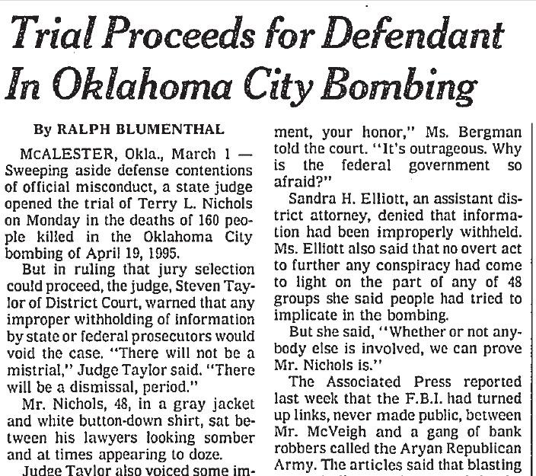
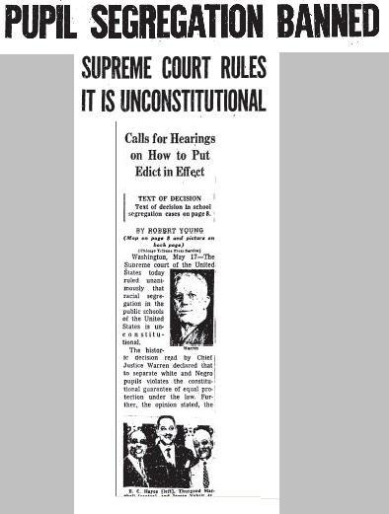
Cases in U.S. Courts
Criminal Cases
Civil Cases
Notes:
Here are examples of two famous cases in federal court.
In criminal cases, like the Oklahoma City bombing case, which was tried right here in Colorado before Senior Judge Richard Matsch, the United States brings charges against a defendant for violations of a United States statute (as opposed to a Colorado statute).
In a typical civil case in Colorado, like our sample employment dispute, a private party brings a dispute to the Colorado federal district court to try to resolve that dispute. Sometimes, a party is seeking money damages from the other. Other times, one party is asking the Court to force the other side to do something or do stop doing it (like the famous Brown v. Board of Education case, which said that you can’t have racial segregation in schools).

Slide 8
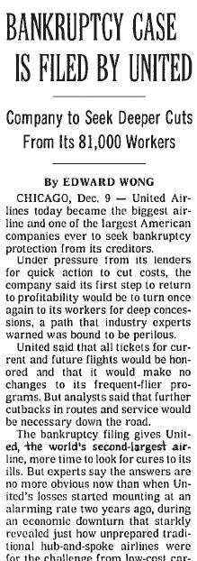
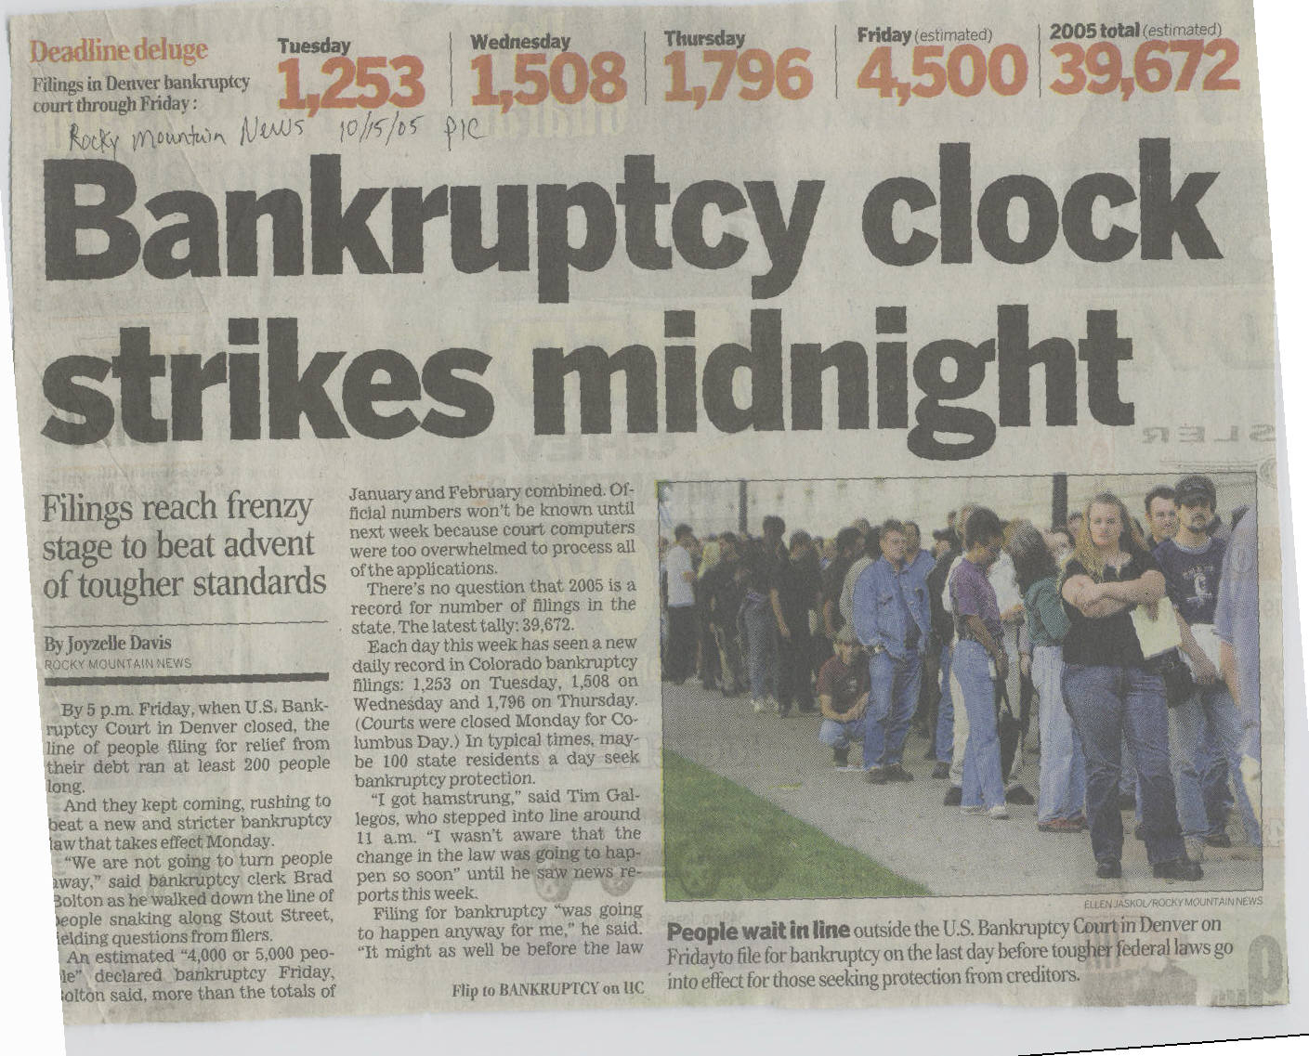
Bankruptcy Cases
Notes:
As I mentioned, U.S. Courts also hear bankruptcy cases filed by individuals or companies. Bankruptcy laws are U.S. laws, and our Bankruptcy Courts are part of our U.S. District Courts.
Can anyone think of other types of cases that U.S. Courts might decide? [set up review of state Supreme Court actions, administrative agencies, and other branches]

Slide 9
U.S. Courts Also Review:
Decisions of
State Supreme Courts
Decisions of Administrative Agencies
Miranda v. Arizona
Social Security Appeals
Disputes Between Other
Branches of Government
Nixon Tapes
Notes:
Here are some examples of other kinds of cases that U.S. Courts decide.
In Miranda v. Arizona, the Arizona courts considered what police officers had to do or say before questioning someone in custody. The U.S. Supreme Court ultimately reviewed this Arizona case and adopted the now-famous Miranda warnings.
In the Nixon Tapes case, the U.S. Courts were asked to review a dispute between the Legislative and the Executive Branches. The issue was whether President Nixon had to produce certain tapes of recorded conversations to Congress during Congress’s investigation of Watergate, or whether President Nixon could avoid having to provide those tapes based on executive privilege.
And U.S. Courts review the actions of many, many administrative agencies, like the Social Security Administration.

Slide 10
State vs. Federal
Number of Cases (2012)
Colorado State Courts | District of Colorado
484,371 in County Courts 288,877 in District Courts 1076 in Court of Appeals 2,711 in Supreme Court 1,494 in Water Court 778,529 TOTAL CASES | 4,282 in District Court (non-Bankruptcy) 26,099 in Bankruptcy Court 466 in 10th Circuit 30,847 TOTAL CASES
Notes:
Because our U.S. Courts have limited jurisdiction, they see fewer cases than state courts and have fewer judges.
Not counting traffic cases, in FY 2012 about 95% of all criminal and civil cases in Colorado were filed in our Colorado state courts, and only about 5% were filed in our Colorado federal courts. Again, it isn’t so easy to make a federal case out of an issue.
This chart compares the number of cases in the state courts of Colorado and our own U.S. District Court for Colorado and the 10th Circuit Court of Appeals, which is based right here in Denver, in 2012.

Slide 11
State vs. Federal
Number of Judges (2012)
Colorado State Courts | District of Colorado
176 District Court Judges 114 County Court Judges 59 Magistrates 22 Court of Appeals Judges 7 Colo. Supreme Court Justices | 7* District Judges 8 Magistrate Judges 5 Bankruptcy Judges 10 10th Circuit Judges (3 from Colorado) 9 U.S. Supreme Court Justices
Notes:
This slide compares the number of judges in our Colorado state courts and those in our Colorado federal trial courts, in the 10th Circuit, and in the U.S. Supreme Court.
Remember that the judges on the 10th Circuit Court of Appeals decide cases from 8 U.S. District Courts in 6 states, including Colorado.

Slide 12
How U.S. Judges Are
Selected and How
Long They Serve
Notes:
The process for selecting our U.S. Judges involves a number of steps.
This process ensures that our U.S. Judges are qualified to serve and meet extremely high ethical standards.

Slide 13

Judges of the Supreme Court, Courts of Appeal & District Courts
Senators
recommend
U.S. Senate
confirms
President
investigates
President Appoints
U.S. Judge
Senate Judiciary
Committee
investigates
ABA
FBI
Term: Good Behavior
President
nominates
Notes:
This slide shows how judges of the U.S. Supreme Court, the U.S. Circuit Courts, and the U.S. District Courts (other than Bankruptcy and Magistrate Judges) are selected.
Go through process.
If you are a judge, relate your personal experience with this process.
The U.S. Constitution says that these judges serve for “good behavior.” That means for life, unless there is a basis to remove them from office. This is different from our state court judges, who are appointed for a term of years.
Can anyone think of why terms for good behavior would be a good thing?
Discuss freedom from political trends and pressures.

Slide 14
Magistrate & Bankruptcy Judges
Application
Merit Selection Panel
Recommend
to District
or Circuit Court
Investigation
Appointment by
District or Circuit Court
8 year terms for Magistrate Judges
14 year terms for Bankruptcy Judges
Nomination
Interviews
Notes:
U.S. Magistrate Judges and U.S. Bankruptcy Judges are chosen in a different way than other U.S. judges. U.S. statutes spell out this process.
Go through process.
If you are a Magistrate or Bankruptcy Judge, relate your personal experience.
U.S. Magistrate Judges serve for renewable terms of 8 years.
U.S. Bankruptcy Judges serve for renewable terms of 14 years.

Slide 15
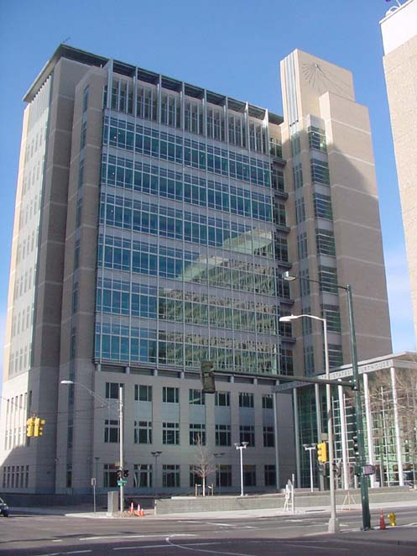
How we keep our U.S. Courts fair & impartial
Alfred A. Arraj
United States Courthouse
Denver, Colorado
Notes:
This slide shows the Alfred A. Arraj U.S. Courthouse in Denver. This courthouse was built in 2002 and honors Alfred A. Arraj, the longest serving federal trial court judge in Colorado history.
Ask questions to establish the concepts of fairness and impartiality, equal treatment, and freedom from improper influence. For example, you might ask the following:
Apart from winning or losing, if you were a party in a lawsuit in a U.S. Court like Emily Employee, how would you want to be treated? Why?
What would you expect from the judge and/or the jury in your case? Why?

Slide 16
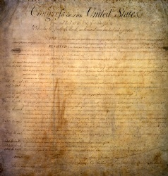
Fair & Impartial Juries
Sixth Amendment:
Criminal Prosecutions
Seventh Amendment:
Civil Suits
Notes:
Our U.S. Courts are kept fair and impartial in a number of ways.
First, the U.S. Constitution talks about the right to jury trials in civil and criminal cases.
Note the 6th and 7th Amendments.
Some of you mentioned that you have served as jurors. How did the court try to ensure that you could be fair and impartial?
What about the judge? What kinds of things would affect whether the judge can be fair and impartial, say in Emily Employee’s case? Does it matter if the judge knows the parties? The lawyers? What other factors? [this sets up next slide].

Slide 17
Fair & Impartial Judges
Judges must:
Comply with Rules of Judicial Conduct
Make public disclosures of finances & attendance at private seminars
Not preside when they have a
  personal interest in the outcome of the case
  personal relationship with either party
Notes:
Code of Judicial Conduct & statutes provide
No nepotism
No political activity
No receipt of gifts
Limits on outside income
Must act impartially and diligently
Must avoid impropriety and the appearance of impropriety
More information on the statutes and the Code is in the brochure that we have distributed.
Set up next slide: So, what if a U.S. Judge violates these rules? If the judge in Emily Employee’s federal case violated these rules, can Emily do something? Yes
There are ways that citizens like Emily and the Legislature hold judges accountable.
If Emily feels that the Court has done something wrong, she not only has the right to appeal, but also she could file a complaint against the judge.
Any person can file such a complaint, but there have to be rules to protect both the person filing the complaint and the judge.

Slide 18
Discipline of U.S. Judges
Judicial Conduct and Disability Act of 1980
Nationwide procedural rules
Censure, Removal
(Bankruptcy and Magistrate Judges)
Impeachment
(District, Circuit, and Supreme Court Judges/Justices)
Notes:
When someone like Emily files a complaint against a judge, it starts as a private matter, to protect her privacy and the judge’s privacy. The disciplinary process then runs its course, with disciplinary power largely exercised by the legislative branch. Various statutes and rules govern what happen:
Judicial Conduct and Disability Act of 1980 permits any person to file a complaint where the person believes that the U.S. judge has engaged in conduct “prejudicial to the effective and expeditious administration of the business of the courts” or that the U.S. judge is unable to perform his or her duties due to a mental or physical disability. [If asked: complaint goes first to Chief Judge of Circuit and, possibly, through higher levels of the judiciary and on to the House of Representatives for the commencement of impeachment proceedings, with an impeachment trial to be heard in the U.S. Senate.]
Judicial Conference Rules for Judicial Conduct and Judicial Disability Proceedings create uniform procedural rules for handling misconduct and disability complaints against U.S. judges.
[If asked: Rules re disclosure of proceedings: (1) consideration of complaint by Chief Judge, Special Committee, Judicial Conference, or Judicial Conference Committee is confidential. To maintain public confidence, however, a chief judge may disclose the existence of a proceeding; (2) when final action is taken and the process is complete, all orders are made public except where the matter was dismissed, resolved by voluntary action, or resolved by private censure or reprimand, in which case the judge’s name and/or the text of the private reprimand are not disclosed.]
There is also the remedy of censure, removal, or impeachment, as applicable. [If asked: In our history, 13 federal judges have been impeached, and 7 have been convicted.]
The handout explains how to get more information and how to file a complaint against a U.S. Court judge

Slide 19
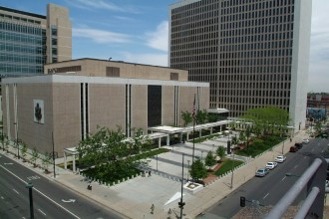
U.S. Courts Must
Apply the Law
Byron G. Rogers
U.S. Courthouse
Notes:
This slide shows the Byron G. Rogers U.S. Courthouse in Denver. Byron Rogers was a lawyer who served in the Colorado legislature, as an assistant U.S. Attorney, as Colorado’s attorney general, and as a U.S. Representative for Colorado from 1951-1971.
Ask the audience questions, such as the following, using our employment case as an example:
Should the judge decide the case based on his or her own beliefs as to what is fair?
Should the court be influenced by statements a lawyer makes to the press?
Should the court be influenced by the fact one party has a lot of power and influence in the community?
Should the court be influenced by the fact that there is a lot of public interest in the case, indeed there is newspaper and TV coverage?
(The audience should conclude that the decision should be based on the law and the evidence.)

Slide 20
U.S. Courts Apply
U.S. Constitution
U.S. Statutes
U.S. Agency Regulations
Federal Rules of Procedure
Federal Rules of Evidence
Applicable State Law
Notes:
20
The Courts must apply the law.
The law has many sources, including the United States Constitution, U.S. statutes, regulations that come from U.S. agencies, the Federal Rules of Procedure and Evidence, and state laws that might apply.
If you are a judge, explain how you are bound by precedents of higher courts.
AND:

Slide 21
Binding Decisions of
Other Courts
U.S. Supreme Court
U.S. Circuit Court of Appeals
Colorado Supreme Court
As to Requirements of
Colorado Constitution & Statutes
Notes:
21
Past decisions of higher courts control many court decisions. Trial courts must apply laws as they have been interpreted by the decisions of higher courts.

Slide 22
Trial Courts
Do Not Have the Last Word
Byron R. White U.S. Courthouse
10th Circuit
Notes:
This photo shows the Byron R. White U.S. Courthouse in Denver. This is where the 10th Circuit Court of appeals principally hears cases. Byron White was a star running back at the University of Colorado, practiced law in Colorado for many years, and, in 1962, became the first and, to date, the only Coloradan to serve on the U.S. Supreme Court. He served on the Supreme Court from 1962 until his retirement in 1993.
Ask the Audience:
What can Emily Employee do if she loses the case and thinks the trial court was wrong, either in the way it handled the case or in the decision?

Slide 23
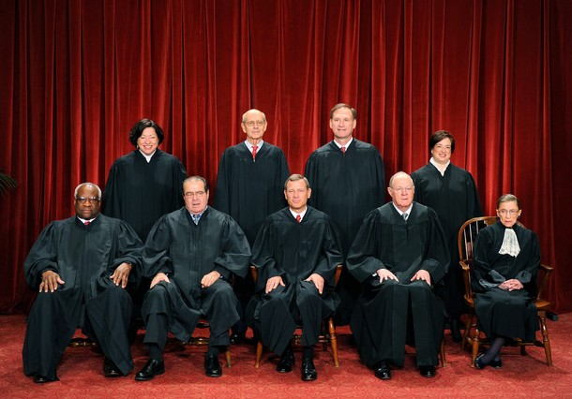
Appeals
10th Circuit Court
of Appeals
U.S. Supreme Court
Sotomayor, Breyer, Alito, Kagan
Thomas, Scalia, Roberts, Kennedy, Ginsburg
Colorado Federal
Trial Court
Notes:
This slide shows the appeals process from a case that starts in federal court in Colorado.
Describe the appellate process.
Comment, that the litigants have an appeal of right to the Court of Appeals.
BUT, the U.S. Supreme Court chooses the cases that it will hear.
Acknowledge that most cases are resolved in the trial courts and court of appeals, and that few cases are decided by the U.S. Supreme Court.
We talked about that oft-heard threat that someone is going to take a case all the way to the Supreme Court. The reality is that it is not likely to happen. In the Supreme Court’s last completed 9-month term, there were over 10,000 cases filed in the Supreme Court (i.e., including cases where a party was asking the Supreme Court to hear his or her case). Of those, only 78 cases were argued and 74 were disposed of in 67 signed opinions. So, it is obvious that most cases that get appealed end at the Court of Appeals.

Slide 24
Applying
the Rule of Law
Equally to All
Equal Justice
Fair & Impartial Courts
Notes:
The Theme: Equal Justice
To preserve the freedom of each and every individual, our courts must provide EQUAL JUSTICE.
We do this with
Fair & Impartial Courts
Applying the RULE OF LAW
EQUALLY TO ALL

Slide 25
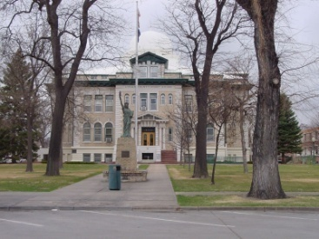
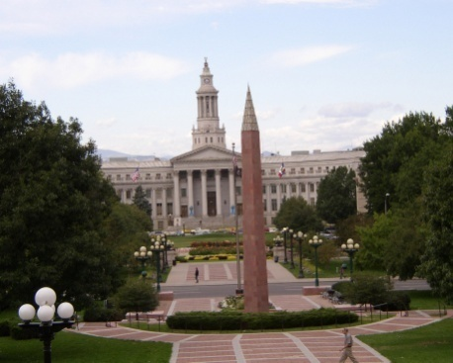
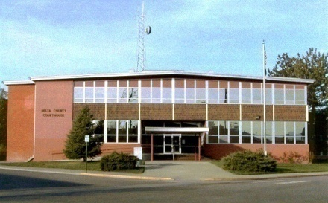
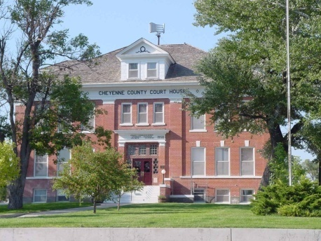

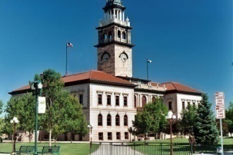
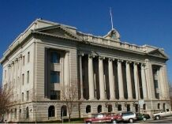
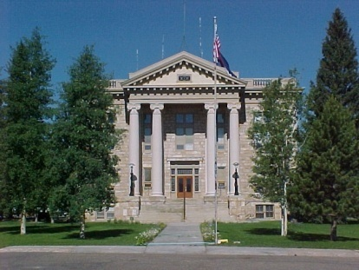
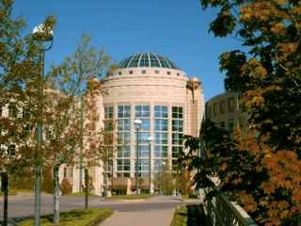
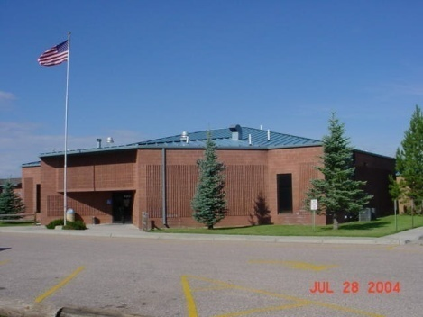
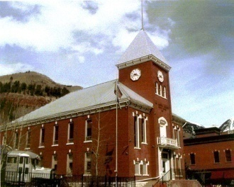
Our Courts
Serving Colorado
Serving Justice

