Slide 1

Court Fundamentals
-Third Branch
-Independent
-Structure
Notes:
Introduce yourself.
Introduce Our Courts: Our Courts is a joint activity of citizens, lawyers, and judges to provide information to the public about our state and federal courts.
Ask the Audience:
Have you heard the expression, “Don’t make a federal case out of it”? How about, “I’m going to take my case all the way to the Supreme Court”?
It may surprise some of you to hear that most cases are in the state court system and not in our federal court system. It isn’t easy to make a federal case out of something, and it is very rare to get a case to the Supreme Court.
Our goal today is to introduce you to our fundamental judicial concepts
We’ll start by discussing our two parallel but separate government systems (federal and state).
When we are done today, I feel confident that you will all leave here with a better understanding of our the fundamental principles behind our courts.

Slide 2
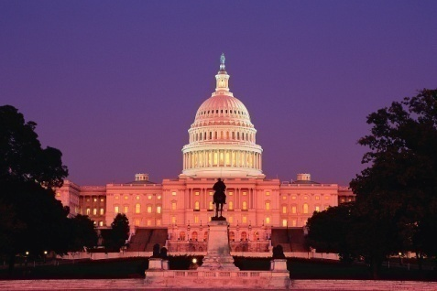
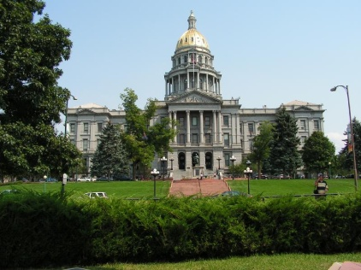

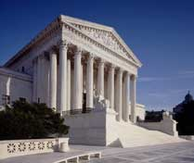
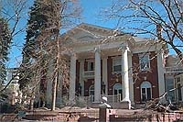
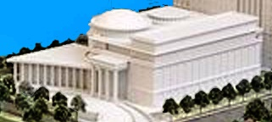
Legislative
Three Branches
Executive
Judicial
Notes:
I’m sure that you all remember that there are three branches of government
Legislative
Executive
Judicial
These are photos representing those branches in both the federal and the state systems.
This slide also makes an important point that underlies much of what we will be discussing today:
We are governed by two parallel but separate government systems.
The states have their own government system, represented by the photos of our Arizona capitol, governor’s mansion, and Supreme Court building.
And the federal government has a completely separate governmental system that governs us.
When people hear about courts, they may think of one system of courts. There are really two, the state court system and the federal or U.S. court system.
Today, I will be talking about our federal or U.S. courts, and, particularly, our Arizona federal courts.

Slide 3
Separation of Powers
Legislative
Three Branches of Government
Executive
Courts/Judiciary

Slide 4
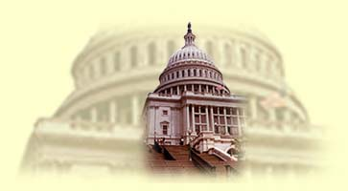

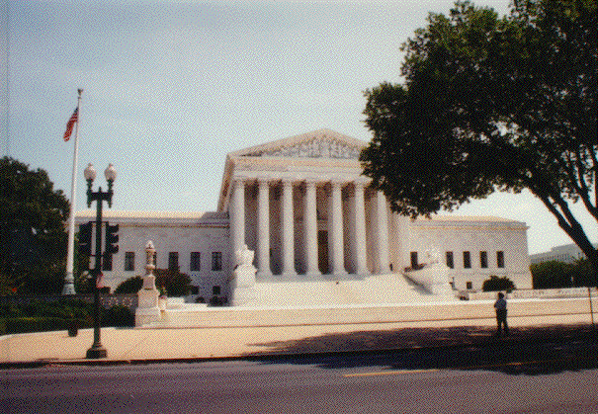
Separation of Powers
Governments are divided into three branches, each with different powers. Each branch is given some powers which enables it to “check” or limit the power of the other two branches.
  Legislative Branch
    Makes our laws
  Executive Branch
    President/Governor enforces our laws
  Judicial Branch
    The supreme and appellate courts interpret our laws; the trial courts apply the laws.

Slide 5
Our Dual Court System
United States Supreme Court
Arizona Appellate Courts
U.S. Courts of Appeal
Arizona Superior (Trial) Courts
U.S. District (Trial) Courts
Notes:
I mentioned that there are two separate governmental systems, one state and one federal.
This dual government system applies to the courts, as well as the legislative and executive branches.
This is a simplified chart showing an overview of our dual court system.

Slide 6
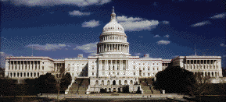
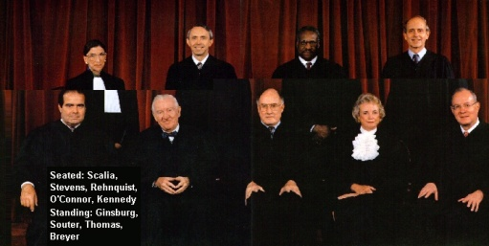
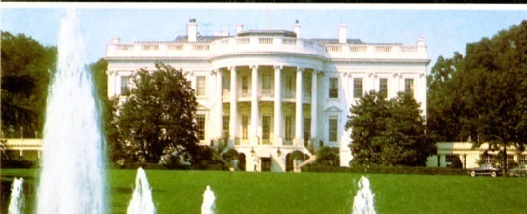
Checks and Balances
Legislative Branch
makes laws
The President/Governor can veto bills passed by Legislative Branch
Laws passed by Legislative Branch can be declared unconstitutional by the courts
Executive Branch actions can be
declared unconstitutional
Judicial Branch
interprets and applies laws
Executive Branch
approves and enforces
laws

Slide 7
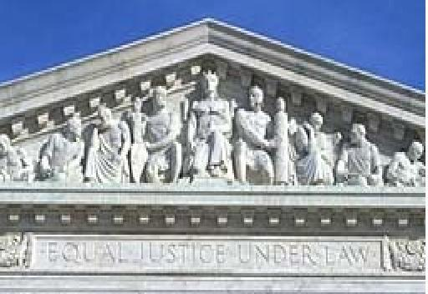
EQUAL JUSTICE UNDER LAW
Entrance to the U.S. Supreme Court
Notes:
Equal Justice Under Law: This is what it says at the entrance to the U.S. Supreme Court.
This is what our state and federal courts have been doing for more than 230 years and must continue to do.

Slide 8
Applying
the Rule of Law
Equally to All
Equal Justice
Fair & Impartial Courts
Notes:
The Theme: Equal Justice
To preserve the freedom of each and every individual, our courts must provide EQUAL JUSTICE.
We do this with
Fair & Impartial Courts
Applying the RULE OF LAW
EQUALLY TO ALL

Slide 9
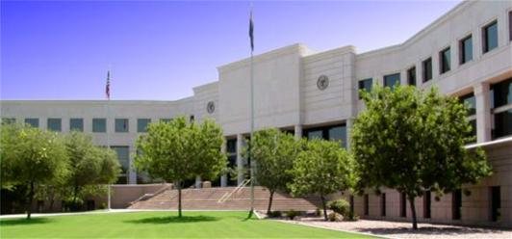
How we keep our courts fair, impartial, and an independent branch
Arizona Courts Building
Notes:
This slide shows the north side of the Arizona Courts Building.
Ask questions to establish the concepts of fairness and impartiality, equal treatment, and freedom from improper influence. For example, you might ask the following:
Apart from winning or losing, if you were a party in a lawsuit like Emily Employee, how would you want to be treated? Why?
What would you expect from the judge and/or the jury in your case? Why?

Slide 10
What is
a “fair and impartial judiciary”?

Slide 11
A Judge is bound to decide each case fairly, in accord with the relevant facts and applicable law, even when the decision is not the one the home crowd wants.
-- William H. Rehnquist, Chief Justice-1986-2005

Slide 12
“The law makes a promise – neutrality. If the promise gets broken, the law as we know it ceases to exist. All that’s left is the dictate of a tyrant, or perhaps a mob.”
--Justice Anthony M. Kennedy

Slide 13
Fair and Impartial Judiciary
…..is the freedom we give judges to act as principled decision-makers. [This] independence is intended to allow judges to consider the facts and the law of each case with an open mind and unbiased judgment. When truly independent, judges are not influenced by personal interests or relationships, the identity or status of the parties to a case, or external economic or political pressures.
Notes:
SOURCE: “Questions and Answers About Judicial Independence,” Brennan Center for Justice at NYU School of Law.

Slide 14
ATTACKS on Judicial Independece
“One more example of judicial activism out of control…These judges are supposed to interpret the law, not rewrite it.”
“An abomination of justice…shows the need to appoint the right judges. There are some judges who want to weaken our criminal justice system and some who do not.”

Slide 15
Threats to a Fair and Impartial Judiciary
Election of judges and justices
Formation of Groups to Target Judges-e.g. Jail for Judges
Labeling of Judges
Lack of Education about the Role of the Judiciary

Slide 16
Why is a fair and impartial judiciary critical to our democracy?

Slide 17
The Concern
MADISON MADE IT CLEAR
One of the greatest dangers to liberty in a free society would come not from government’s acting contrary to the wishes of the majority, but from government’s acting as a mere instrument of the majority and contrary to the individual rights of the minority.

Slide 18
The Solution
As Stated by HAMILTON
The courts were designed to be an intermediate body between the people and the legislature... The courts of justice are to be considered as the bulwarks of a limited Constitution against legislative encroachments.....
This independence of the judges is equally requisite to guard the Constitution and the rights of individuals.

Slide 19
Fair and impartial courts protect:
(1) the Rule of Law – by ensuring that every person enjoys the same protections and restrictions under the law;
(2) Constitutional Integrity – by ensuring that one societal institution has the power to overturn laws that violate the Constitution;
(3) Application of the Law – by guaranteeing that legitimate laws can be enforced in daily life, not simply stated in theory.

Slide 20
Checks on Judicial Power
How State Court Judges are Held Accountable:
The Appellate Process (Appellate review)
The Disciplinary Process
The Election and Retention Processes
Notes:
These are legitimate checks on judicial power, but are subject to potential abuse if one seeks to remove a judge with whom one disagrees.

Slide 21
OATH OF OFFICE
I do solemnly swear (or affirm) that I will support, protect, and defend the Constitution and Government of the United States and the State of Florida; that I am duly qualified to hold office under the Constitution of the state; and that I will well and faithfully perform the duties of Circuit Court Judge on which I am now about to enter. So help me God.

Slide 22
CANONS
CANON 1– A Judge Shall Uphold the Integrity and Independence of the Judiciary.
CANON 2 – A Judge Shall Avoid Impropriety and the Appearance of Impropriety in all of the Judge’s Activities.
CANON 3 – A Judge Shall Perform the Duties of Judicial Office Impartially and Diligently.

Slide 23
Commentary to Canon 1
Deference to the judgments and rulings of courts depends upon public confidence in the integrity and independence of judges. The integrity and independence of judges depend in turn upon their acting without fear or favor…Public confidence in the impartiality of the judiciary is maintained by the adherence of each judge to this responsibility.

Slide 24
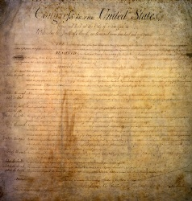
Fair & Impartial Juries
Sixth Amendment:
Criminal Prosecutions
Seventh Amendment:
Civil Suits
Notes:
Our U.S. Courts are kept fair and impartial in a number of ways.
First, the U.S. Constitution talks about the right to jury trials in civil and criminal cases.
Note the 6th and 7th Amendments.
Some of you mentioned that you have served as jurors. How did the court try to ensure that you could be fair and impartial?
What about the judge? What kinds of things would affect whether the judge can be fair and impartial, say in Emily Employee’s case? Does it matter if the judge knows the parties? The lawyers? What other factors? [this sets up next slide].

Slide 25
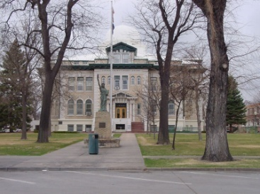
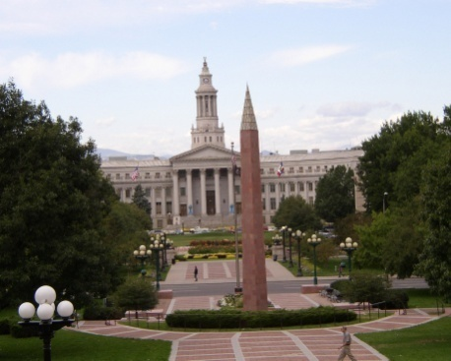
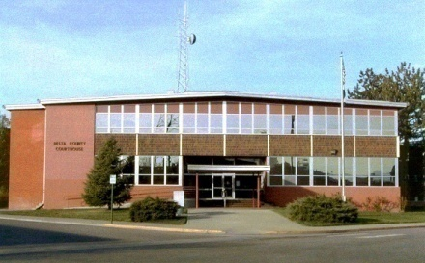
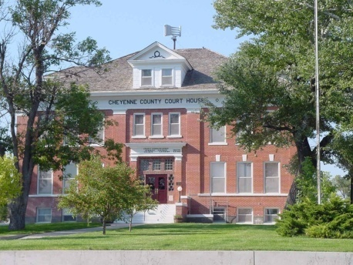

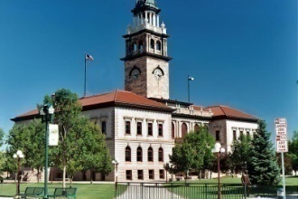
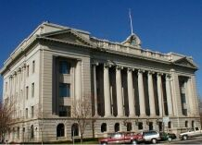
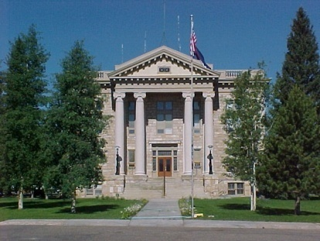
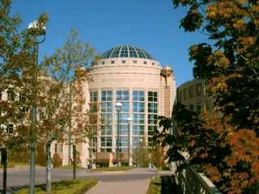
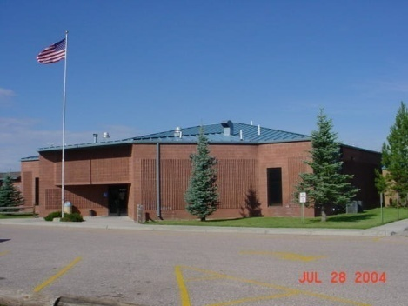
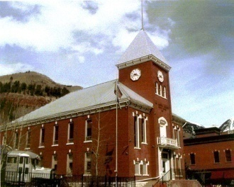
Our Courts
Serving Arizona
Serving Justice

