Slide 1

Serving Arizona
Notes:
Introduce yourself.
Introduce OC, as a joint activity of citizens, lawyers, and judges to provide information to the public about our state and federal courts.
Today’s presentation is about the state courts in Colorado.
How many of you have been called for jury service? Use the words “serve” and “service” frequently.
How many have actually served on a jury?
What was your role?
What did you take into account in reaching your decision?
When you were questioned about your qualifications to serve as a juror, do you remember the kinds of questions you were asked? What was the purpose of those questions?
Was it to determine if you could be fair and impartial?

Slide 2
CONSTITUTION

Slide 3
CONSTITUTION

Slide 4
RULE OF LAW
CONSTITUTION

Slide 5


Slide 6
RULE OF LAW
DUE PROCESS
CONSTITUTION

Slide 7
RULE OF LAW
DUE PROCESS
EQUAL PROTECTION
CONSTITUTION

Slide 8
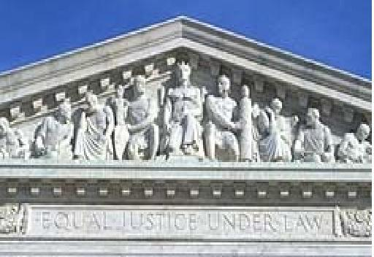
EQUAL JUSTICE UNDER LAW
Entrance to the U.S. Supreme Court

Slide 9
RULE OF LAW
DUE PROCESS
EQUAL PROTECTION
GUARANTEED RIGHTS
CONSTITUTION

Slide 10
RULE OF LAW
DUE PROCESS
EQUAL PROTECTION
GUARANTEED RIGHTS
SEPARATION OF POWERS
CONSTITUTION

Slide 11
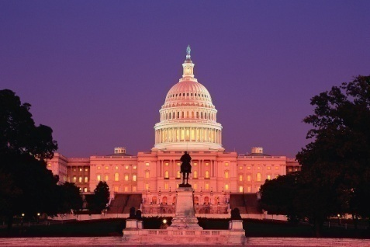


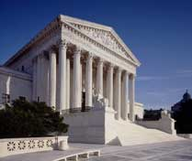
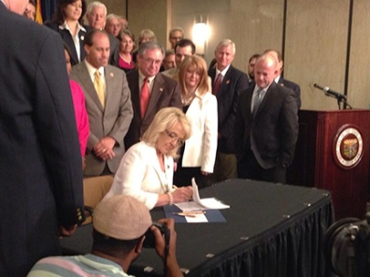

Legislative
Three Branches
Executive
Judicial

Slide 12
RULE OF LAW
DUE PROCESS
EQUAL PROTECTION
GUARANTEED RIGHTS
SEPARATION OF POWERS
CONSTITUTION

Slide 13
GOVERNMENT
OF LAWS, NOT MEN
DUE PROCESS
EQUAL PROTECTION
GUARANTEED RIGHTS
CONSTITUTION

Slide 14
Serving Arizona
Notes:
Introduce yourself.
Introduce OC, as a joint activity of citizens, lawyers, and judges to provide information to the public about our state and federal courts.
Today’s presentation is about the state courts in Colorado.
How many of you have been called for jury service? Use the words “serve” and “service” frequently.
How many have actually served on a jury?
What was your role?
What did you take into account in reaching your decision?
When you were questioned about your qualifications to serve as a juror, do you remember the kinds of questions you were asked? What was the purpose of those questions?
Was it to determine if you could be fair and impartial?

