Slide 1

Court Fundamentals
-Third Branch
-Equal Justice
-Fair & Impartial
Notes:
Introduce yourself.
Introduce Our Courts: Our Courts is a joint activity of citizens, lawyers, and judges to provide information to the public about our state and federal courts.
Ask the Audience:
Have you heard the expression, “Don’t make a federal case out of it”? How about, “I’m going to take my case all the way to the Supreme Court”?
It may surprise some of you to hear that most cases are in the state court system and not in our federal court system. It isn’t easy to make a federal case out of something, and it is very rare to get a case to the Supreme Court.
Our goal today is to introduce you to our fundamental judicial concepts
We’ll start by discussing our two parallel but separate government systems (federal and state).
When we are done today, I feel confident that you will all leave here with a better understanding of our the fundamental principles behind our courts.

Slide 2
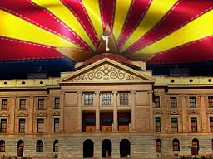
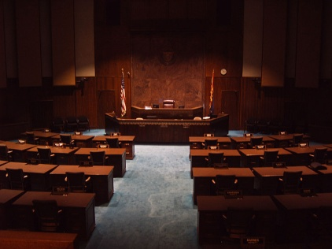
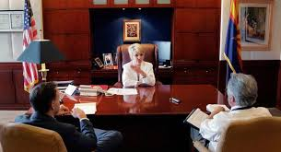
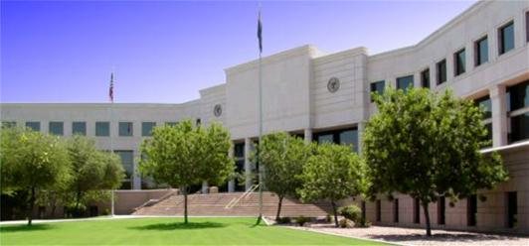
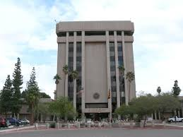
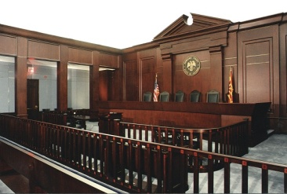
Legislative
Three Branches
Executive
Judicial
Notes:
I’m sure that you all remember that there are three branches of government
Legislative
Executive
Judicial
These are photos representing those branches in both the federal and the state systems.
This slide also makes an important point that underlies much of what we will be discussing today:
We are governed by two parallel but separate government systems.
The states have their own government system, represented by the photos of our Arizona capitol, governor’s mansion, and Supreme Court building.
And the federal government has a completely separate governmental system that governs us.
When people hear about courts, they may think of one system of courts. There are really two, the state court system and the federal or U.S. court system.
Today, I will be talking about our federal or U.S. courts, and, particularly, our Arizona federal courts.

Slide 3
Separation of Powers
Legislative
Three Branches of Government
Executive
Courts/Judiciary

Slide 4

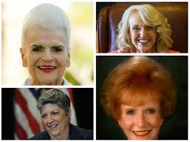

Separation of Powers
Governments are divided into three branches, each with different powers. Each branch is given some powers which enables it to “check” or limit the power of the other two branches.
  Legislative Branch
    Makes our laws
  Executive Branch
    Governor enforces our laws
  Judicial Branch
    The appellate courts interpret our laws; the trial courts apply the laws.

Slide 5
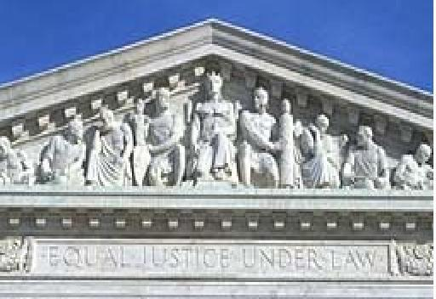
EQUAL JUSTICE UNDER LAW
Entrance to the U.S. Supreme Court
Notes:
Equal Justice Under Law: This is what it says at the entrance to the U.S. Supreme Court.
This is what our state and federal courts have been doing for more than 230 years and must continue to do.

Slide 6
Applying
the Rule of Law
Equally to All
Equal Justice
Fair & Impartial Courts
Notes:
The Theme: Equal Justice
To preserve the freedom of each and every individual, our courts must provide EQUAL JUSTICE.
We do this with
Fair & Impartial Courts
Applying the RULE OF LAW
EQUALLY TO ALL

Slide 7
What is
a “fair and impartial judiciary”?

Slide 8
A Judge is bound to decide each case fairly, in accord with the relevant facts and applicable law, even when the decision is not the one the home crowd wants.
-- William H. Rehnquist, Chief Justice-1986-2005

Slide 9
Fair and impartial courts protect:
(1) the Rule of Law – by ensuring that every person enjoys the same protections and restrictions under the law;
(2) Constitutional Integrity – by ensuring that one societal institution has the power to overturn laws that violate the Constitution;
(3) Application of the Law – by guaranteeing that legitimate laws can be enforced in daily life, not simply stated in theory.

Slide 10
The Accident Case

Slide 11

Notes:
Discuss Two Scenarios
Injured student sues: 1) Bus Driver; 2) Trucking Company; 3) State Highway Department
Student’s Damages are $100,000.
Create Two Scenarios to Illustrate Separation of Powers and Fair & Impartial Judiciary
Examples:
After judgment is entered against State Highway Department for 30% of the student’s damages, legislature passes law that throws out verdicts against the state unless the state was more than 50% at fault --- And applies it to all cases starting in 2012.
Bus driver is the friend of a potential juror and/or attends the same church as the judge.

Slide 12
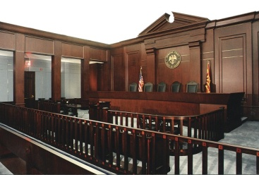
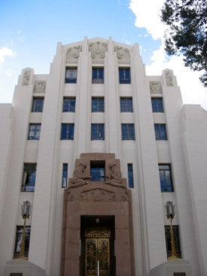
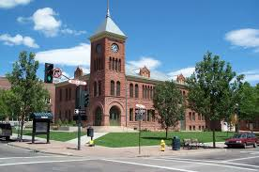
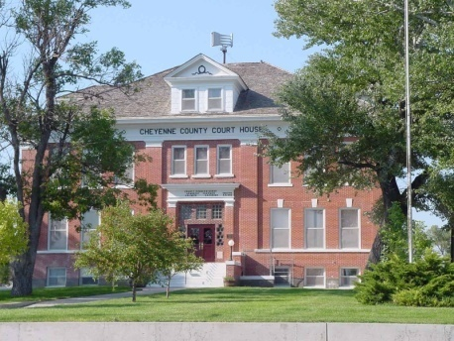
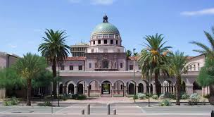
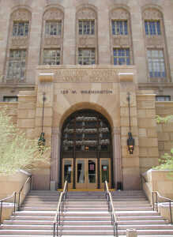

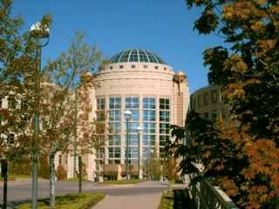
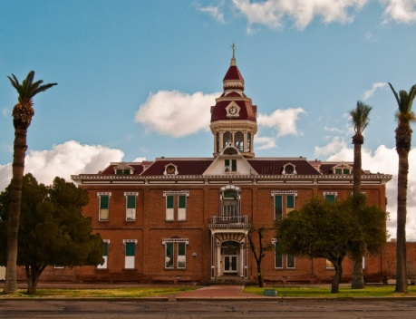
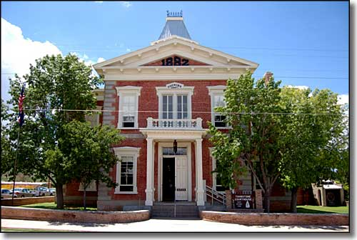
Our Courts
Serving Arizona
Serving Justice

