Slide 1

Counting Continuances -
Request and
Courts’ Responses

Slide 2
Counting Continuances
When courts have issue with meeting time standards, questions regarding continuances arise.
National research has consistently shown that limiting continuances and the time between proceedings leads to courts getting closer to meeting standards
Courts knowing their continuance data can help them make decisions regarding processes and caseflow management
No statewide standardization regarding continuance data and reports exists
We would like to learn more from courts about how they currently count continuances to begin constructing a possible solution to this data gap

Slide 3
Requested Information from each CMS
Imagine your court is considering adopting a continuance policy and the presiding judge wants data. How would staff go about obtaining that data?
  Does your CMS have hearing results, like held, continued, vacated?
  Does your CMS list Orders to Continue? Minute entries with Continued or Reset in the title?
  Something else? How would you obtain this information?
For the June 2024 meeting, one member (from each CMS) please put together a short summary to present. Please include in there how you would obtain the data and any challenges you would encounter. “Short” = 3-7 bullet points

Slide 4
Counting Continuances
“Continuance” – When a proceeding/hearing type is repeated on the court calendar. In some states this is called a “postponement”
Examples of a Continuance:
  Arraignment is continued/reset because an in-custody defendant is not transported
  Case is at Case Management Conference and prosecutor asks for another CMC to wait for discovery like BAC results
  Trial being reset because the judge isn’t available
Not a Continuance:
  Defendant and attorney file motion to continue from PTC to CMC

Slide 5
Tempe Municipal Court: Collecting Continuance Data
Recording: Tempe’s CMS logs continuances using hearing result codes.
Reporting: Monthly workload indicator reports are generated, detailing hearing result codes and other data for each case type. Separate reports exist for Civil and Criminal cases.
Accessibility: These reports are available on demand by month and year.
Compilation: Tempe can gather continuance data manually via the workload indicator report or through a targeted query for the required date range.
Challenges: Accurate data collection is hindered if the correct procedure for hearing continuance not followed by staff.
  Example: The Judge grants a motion to continue; a staff member vacates the current hearing and schedules a new hearing. This will be counted by CMS as a “new” hearing instead of a “continued” hearing.

Slide 6
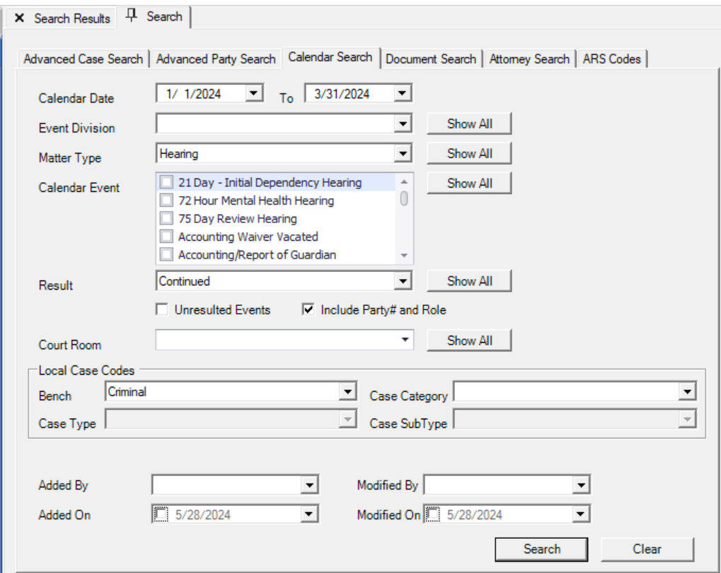
Pima County
AGAVE allows for an event result code of “Continued”. So, continuances are determined by 1) matter type, 2) case-defendant, and/or 3) bench. The screenshot below depicts a query for all CY24-Q1 criminal bench continuances on a hearing matter type. Note: the “Party Number” and the “Party Role” only refers to the defendant associated to the event. The party initiating or requesting a continuance is not captured as a distinct element.

Slide 7
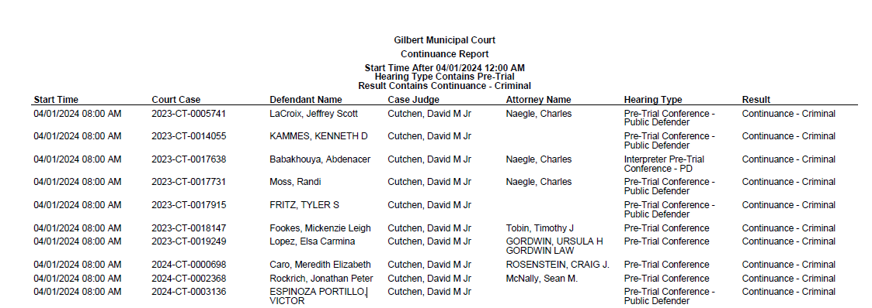
Gilbert's CMS has an existing report for continuances.

Slide 8
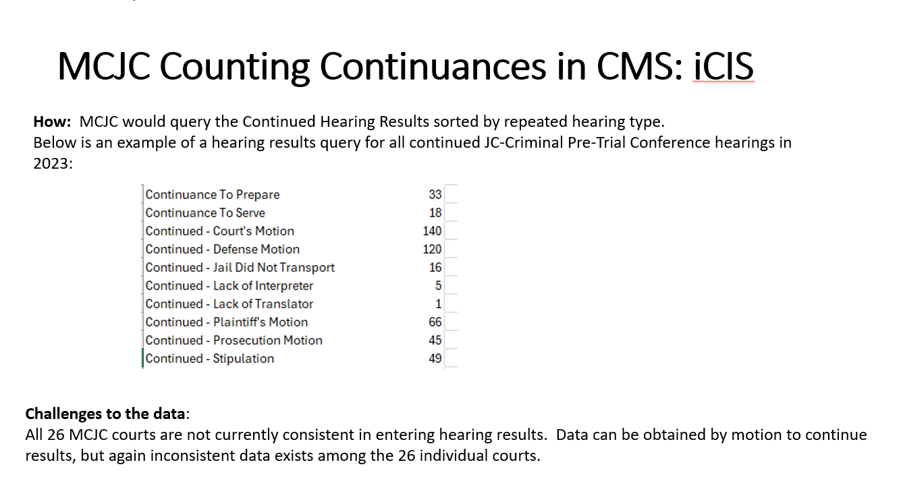

Slide 9
Mesa Municipal Court
There are 6 codes used to update a hearing status (Appeared-Continued, Appeared-COP, Appeared-Held, Failed to Appear, No Defendant from County-Continued, and Vacated).
We would need to write requirements, script, and test the report.
Greatest challenge would be IT resources.
Certain settings are used for specialty courts with ongoing hearing types we would not want to include in the count.

Slide 10
The events in AJACS are not specific enough to track MTC. Here are some issues:
The event types are too vague, stating “Order”- “Motion Granted”. Currently captures all Motions. Not specific to MTC granted.
Need to add specific event type under “Order”” – “Motion to Continue Granted”.
Need the ability to choose a specific case type.
Need the ability to select a date range.
The ability to count each MTC event category and each MTC granted event type in each case.

Slide 11
PCCJC:
Our case management system has a result code for each scheduled event. We could track continues by running a query for events with the result of “Continued.”
The concern with the result codes would be the reliability and consistency of how the codes are used. Example: Some clerks may be using a result code of “Completed” instead of “Continued.”
A more reliable search would be to query all the events and count the duplicate hearings.

Slide 12
Phoenix
Does not natively track continuances in current CMS.
Does have a weekly report (MRPT0003) that shows continuances for only PDCs using a query that counts subsequent PDCs set by case.
If asked to provide these numbers for other settings, staff would have to write a custom query to count duplicate hearing types by case number.
Staff could also look to create a new report that leverages the logic of MRPT0003 and extend it to include other hearing types.

